Slide 1
JUBCOR
2024
CONFERENCE & EXHIBITION
INNOVATIVE SOLUTIONS FOR CORROSION CHALLENGES
Presented By: Anas S. Al Ghamdi
ADVANCED NDT to Improve The Integrity of FRP Line (UT-COMP)

Slide 2
ADVANCED NDT to Improve The Integrity of FRP Line (UT-COMP)
Contents:
Introduction and problem statement
Driver and intervention
Advanced NDT and result analysis
Conclusion and benefit realization

Slide 3
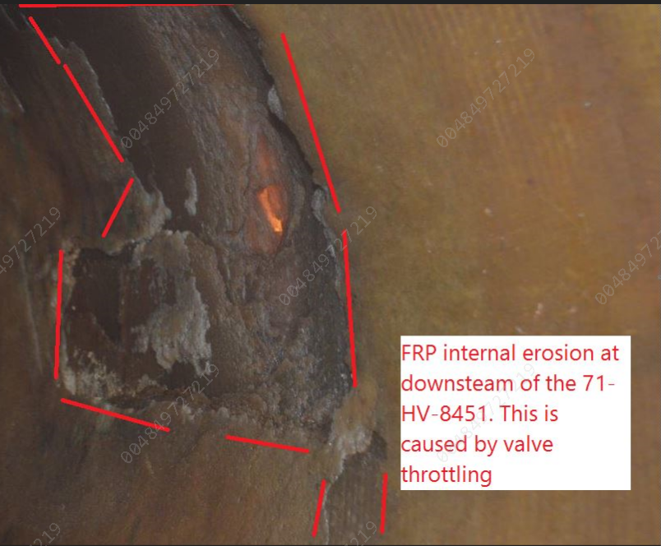
ADVANCED NDT to Improve The Integrity of FRP Line (UT-COMP)
Introduction and problem statement
In GAS PH-7 FRP reducer; downstream of 71-HV-8451 having severe thinning concern due the butterfly valve is operated in throttling mode. This concern could affect the plant operation and lead to unplanned outage due to severe SW leak from FRP pipe. We need to decide whether it is safe to operate and for how long until this affected pipe is replaced.
In 2018, inspection team found FRP eccentric reducer downstream the valve 71-HV-8451 (1000 x 800 mm EEC reducer FRP line# 1000-SW8422-AV1W02-N-N) with major erosion and thinning due to the operational mode of the throttling butterfly valve 71-HV-8451. Moreover, after the repair it became an area of concern where inspection team need to observe this reducer carefully on nearest opportunity.

Slide 4
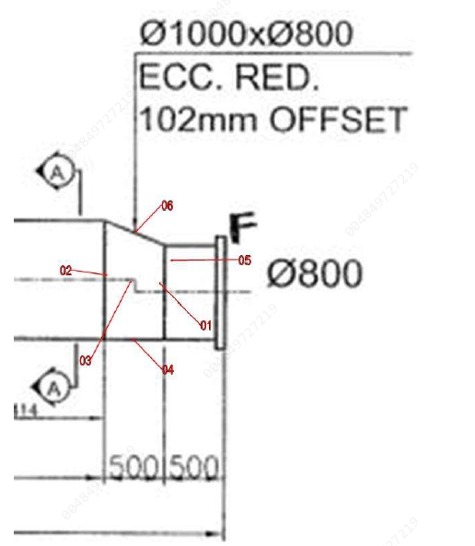
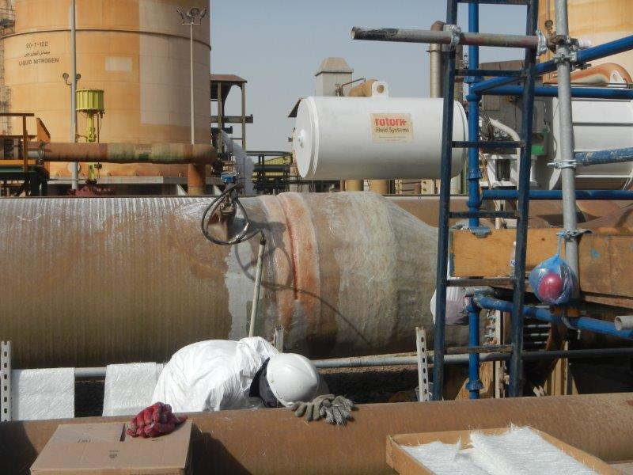
ADVANCED NDT to Improve The Integrity of FRP Line (UT-COMP)
Introduction and problem statement
On 07 November 2022, due to access limitation, the integrity of the pipe internally was not confirm and couldn’t verify to check the development of any erosion signs on the reducer.
Instead, we decided to utilize new NDT technique called “UTCOMP“ (recently approved advanced NDT by SABIC). This technique help us to evaluate the existing integrity & the service life of the FRP condition without disturbing the plant.

Slide 5
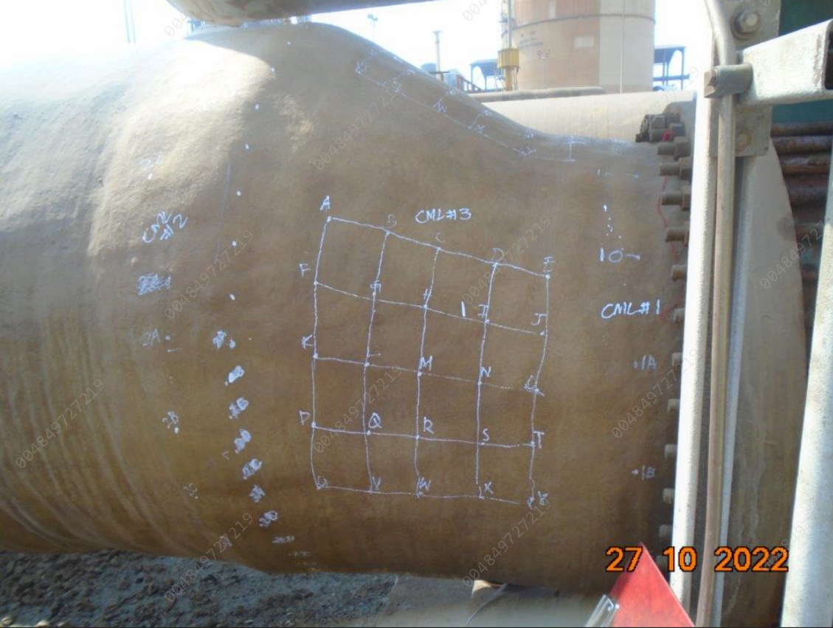
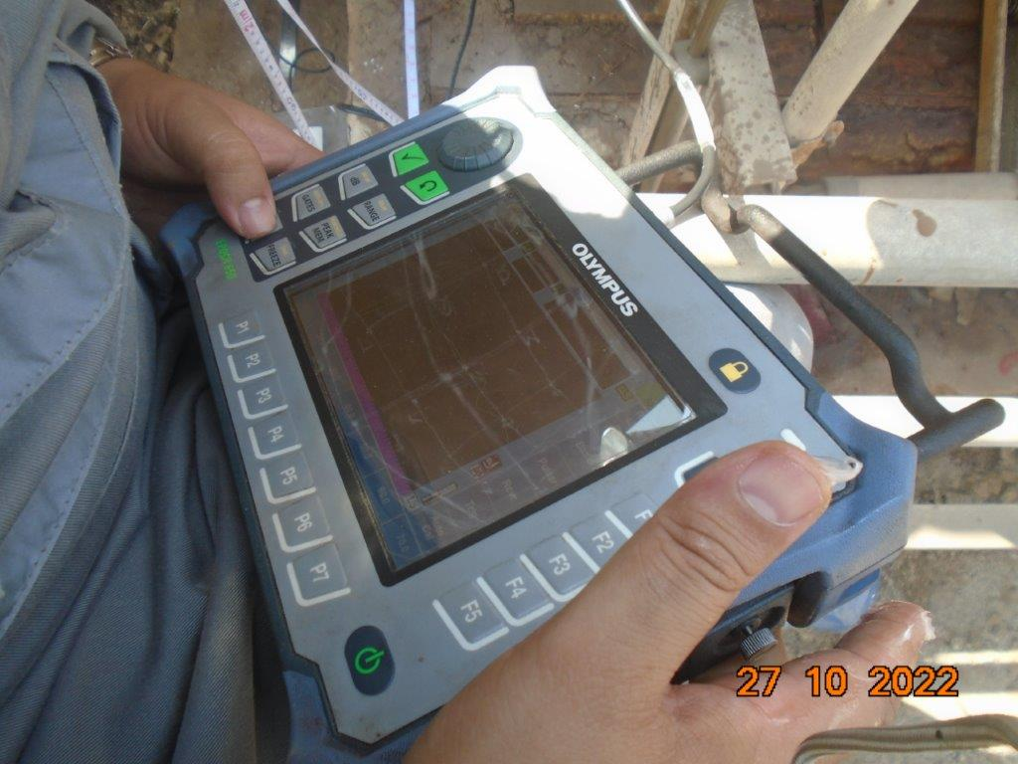
ADVANCED NDT to Improve The Integrity of FRP Line (UT-COMP)
Driver
Intervention
Unknown condition of the FRP line with a history of failure with major erosion and thinning due to the operational mode of the throttling butterfly valve 71-HV-8451 and it could lead to unplanned shut down of the plant.
Due to access limitation , the integrity of the pipe internally was not confirm and couldn’t verify to check the development of any erosion signs on the reducer. Instead, we decided to utilize new NDT technique called “ UTCOMP “.This technique help us to evaluate the existing integrity & the service life of the FRP condition without disturbing the plant.

Slide 6
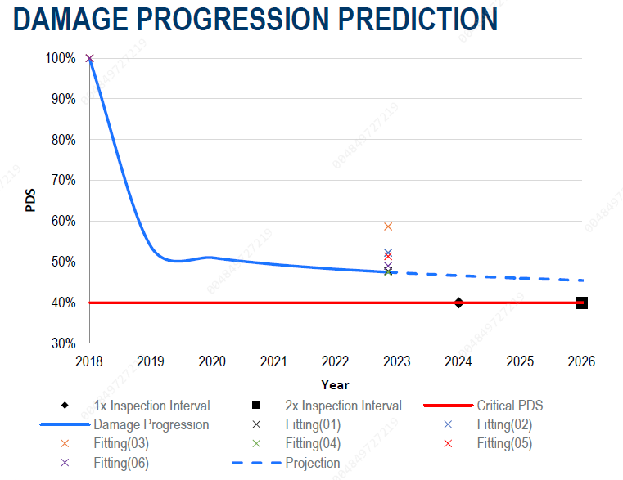
ADVANCED NDT to Improve The Integrity of FRP Line (UT-COMP)
Advanced NDT and result analysis
Assessment was conducted to evaluate the line integrity, indicated several area of concern were identified based on previous damage observed to a similar reducer under the same service conditions. Particular emphasis was put on the analysis for the 3-o clock and 9-o clock positions as viewed from the larger diameter end of the reducer. Data collected for this inspection determined that damage progression at these areas is not of concern at this time and the equipment is suitable for continued service until the next recommended inspection date.
PDS: Percentage of Design Stiffness

Slide 7
ADVANCED NDT to Improve The Integrity of FRP Line (UT-COMP)
Advanced NDT and result analysis
Thickness measurement: For homogeneous materials such as metals, ultrasound is used to provide fairly accurate thickness measurement because the sonic velocity of the material is somewhat constant. For FRP, sonic velocity is not usually constant at all locations in the same structure. Sonic velocities have been determined for a statistically significant number of FRP specimens that have been in service for a wide range of times from 0 to 30 years. The distribution of sonic velocities matches a normal distribution. From this normal distribution, thickness calculations from UltraAnalytix data will use the sonic velocity whereby there is a 90% probability that the actual FRP will be thicker than the reported value. This approach is used to provide owners with confidence that the results reported are conservative.
PDS: Percentage of Design Stiffness

Slide 8
ADVANCED NDT to Improve The Integrity of FRP Line (UT-COMP)
Conclusion and benefit realization
Improved critical FRP lines reliability.
Clear action plan within suitable time frame to prepare for repair and resources.
Saved SAR 1.5M by avoiding to SD the unit and utilized advanced NDT instead.
This technique can be used while the system on service.
Safe from any radiation sources in the surroundings to ovoid impacting the people and operations in the area.
The test set up is portable, simple and less time consuming for data collection.

Slide 9
JUBCOR
2024
CONFERENCE & EXHIBITION
INNOVATIVE SOLUTIONS FOR CORROSION CHALLENGES
THANK YOU
Calle Cualquiera 123, Cualquier Lugar

