Slide 1
JUBCOR
2024
CONFERENCE & EXHIBITION
INNOVATIVE SOLUTIONS FOR CORROSION CHALLENGES
CORROSION BEHAVIOR OF 3D PRINTED
316 L STAINLESS STEEL IN CHLORIDE
AND HYDROCARBON ENVIRONMENTS
Presented By: Ibrahim Albalawi

Slide 2
Agenda
Introduction
What is additive manufacturing
Additive VS Convectional Manufacturing
SLMed 316L Stainless Steels Fabrication
Experimental Procedure and methodology
Results and discussion
Conclusions and recommendations
References

Slide 3
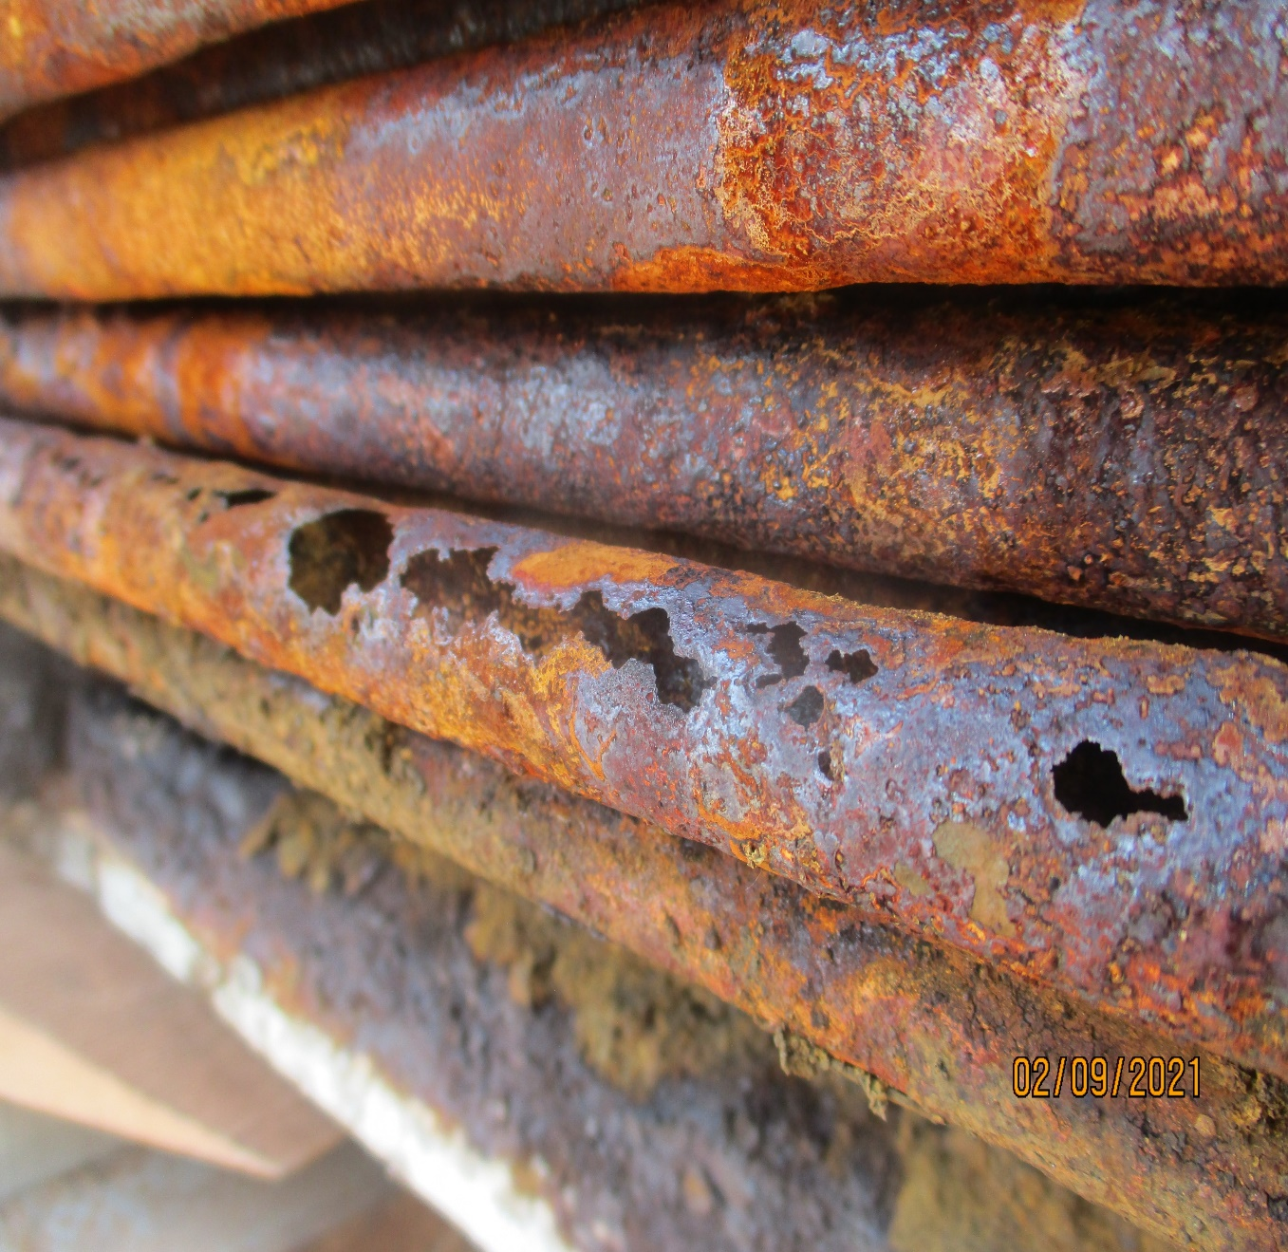
Introduction
Corrosion is a major issue in the oil and gas industry. It results from the interaction of metal with the corrosive environment, which can lead to leaks, explosions, and other safety risks.
To overcome this challenge, oil and gas industries use high corrosion resistance material.
One of most common materials that are used is 316L Stainless steel.
This type of stainless steel can be fabricated by convectional manufacturing and additive manufacturing

Slide 4
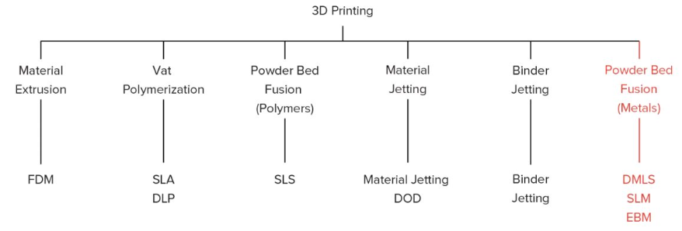
What is additive manufacturing
Additive manufacturing (AM) is a process by which computer-controlled machines build up objects from layers of material. This can be anything from toothpaste to airplane wings, and even prosthetic limbs for amputees.
FIGURE 2: 3D printing types [2].

Slide 5
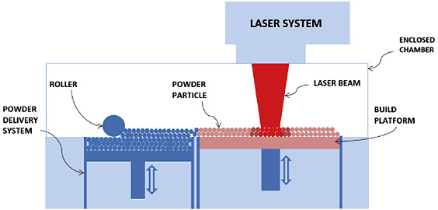
What is additive manufacturing
The selective laser melting technique (SLM), also known as direct metal laser melting (DMLM), is an advanced AM technique that uses a high-power laser to melt and fuse powdered metals.
FIGURE 3: The schematic of an SLM process [2].

Slide 6
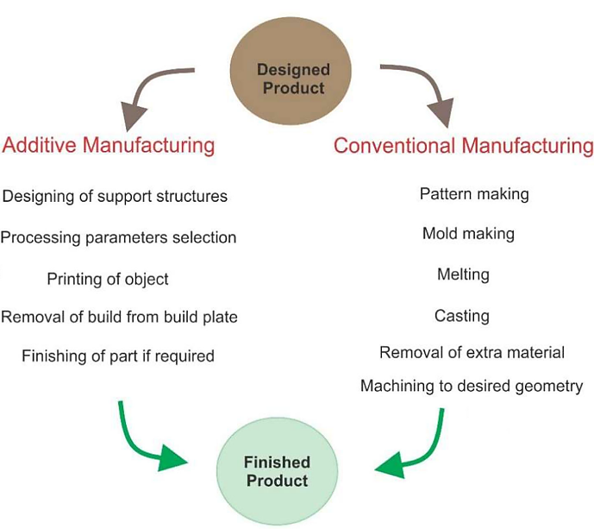
Additive VS Convectional Manufacturing
Advantages of Additive Manufacturing:
Short fabrication time.
AM enables manufacturers and industries to create complex structures.
Reduce material waste.
Eliminate indirect cost.
faster prototyping and product development cycles.
reduce the environmental impact of traditional manufacturing processes.
FIGURE 1 A comparison of traditional and additive manufacturing [1]
Notes:
Short fabrication time.
AM enables manufacturers and industries to create complex structures.
Reduce material waste.
Eliminate indirect cost. such as transportation, storage cost, and reducing the need for large inventories.
faster prototyping and product development cycles.
reduce the environmental impact of traditional manufacturing processes.

Slide 7
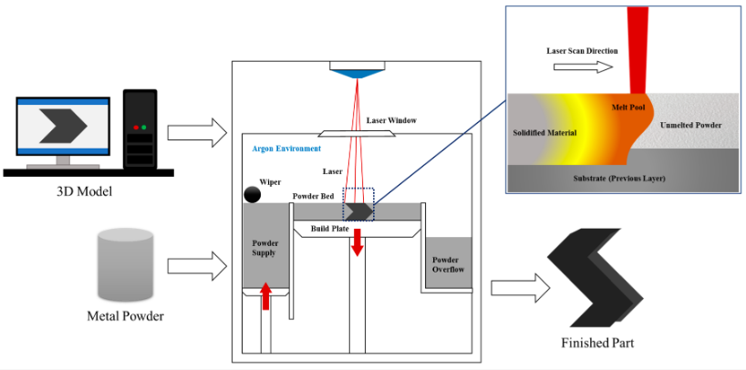
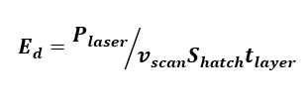
SLMed 316L Stainless Steels Fabrication
In SLM-based manufacturing, a high energy density may be employed to create materials with a density greater than 99.8%.
Each SLM process parameter can affect the material’s density.
Energy Density (Ed) Equation:
Where:
$P_{laser}$ is the Laser power in W,
$v_{scan}$ is the scanning speed in mm/s,
$S_{hatch}$ is the hatch spacing in mm,
$t_{layer}$ is the Layer thickness in mm.
FIGURE 4 SLM 3D printing Process parameters [3]

Slide 8
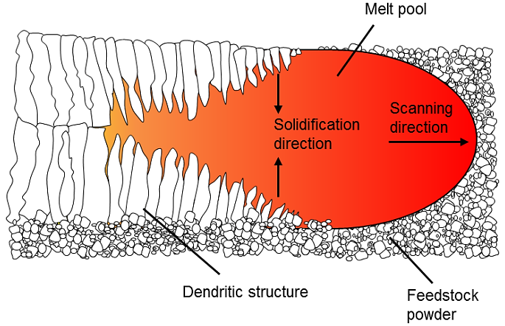
SLMed 316L Stainless Steels Fabrication
The rate of cooling and geometry of the melt container directly influences the microstructure and grain growth in the produced part.
Laser scan direction and energy density affect the microstructure and the relative density.
Impact the corrosion resistance of the SLM 3D printed material.
FIGURE 5 An illustration of melting and solidification of stainless steel in SLM [4]

Slide 9
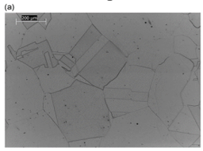
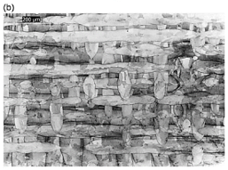
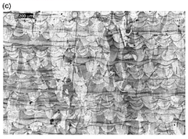
Effect the process parameters on the Microstructure
FIGURE 6 The microstructures of different samples, (a)-wrought, (b)-SLM XY 316 L stainless steel, and (c)- SLM XZ 316 L stainless steel[5]
The physical and mechanical characteristics of SLM materials can be impacted by the SLM process parameters.
At the macroscale, the SLM process causes the creation of overlapping melt pools with a semicircular shape in the plane perpendicular to the direction of construction
Pores were can be caused by 3D printed materials in low energy density.

Slide 10
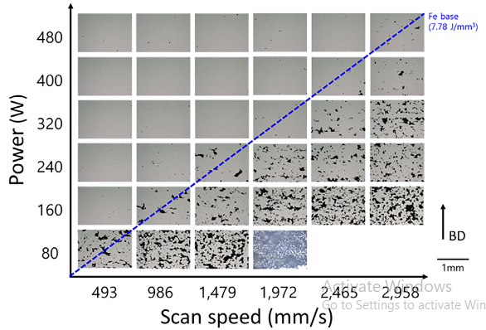
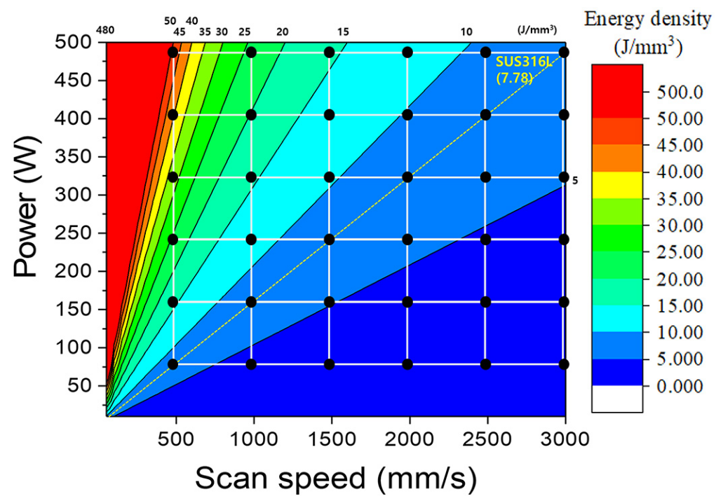
Effect the process parameters on the Microstructure
FIGURE 7 Microstructure image of 36 SLMed 316L specimens with blue line dot for almost compete melting energy density [6]
FIGURE 8 SLM process conditions Map with the theoretically calculated melting energy density [6]

Slide 11
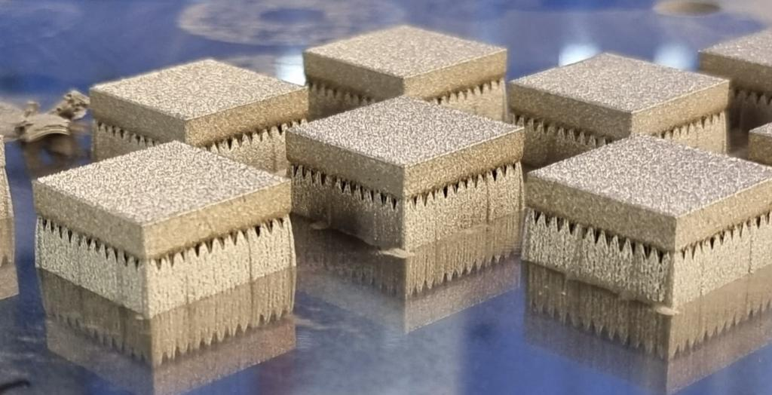
Experimental Procedure and Methodology
Materials
The 316L stainless steel has been selected for this work due to its important in oil and gas industry and less available research in industry environment.
Elements | C | Mn | Mo | S | P | O | Ni | Cr | Fe
SLMed | 0.03 | 2 | 2.25 | 0.01 | 0.025 | 0.05 | 13 | 17.1 | Bal.
Wrought | 0.03 | 2.2 | 2.3 | 0.03 | 0.05 | 0.05 | 11.2 | 17.5 | Bal.
Fabrication
The wrought samples was fabricated by using conventional casting methos and were bought from the local market. The SLMed 316L stainless steel samples were fabricated by using Selective Laser Melting (SLM).
FIGURE 9 Fabricated samples by SLM technique 20 x 20 x 4 mm.

Slide 12
Experimental Procedure and Methodology
Fabrication
Sample Name | Laser power (W) | Scan speed (mm/s) | Layer thickness (mm) | Trace width (mm) | Energy density (J/mm³)
ED20 | 180 | 1270 | 0.045 | 0.15 | 21.0
ED30 | 180 | 800 | 0.045 | 0.15 | 33.3
ED30T | 180 | 800 | 0.045 | 0.15 | 33.3
ED40 | 180 | 650 | 0.045 | 0.15 | 41.0
W-316L | conventional manufacturing for 316L stainless steel - Wrought Sample of 316L
The samples were printed with different energy densities, as calculated by the formula below:
Where:
$P_{laser}$ is the Laser power in W,
$v_{scan}$ is the scanning speed in mm/s,
$S_{hatch}$ is the hatch spacing in mm,
$t_{layer}$ is the Layer thickness in mm.

Slide 13
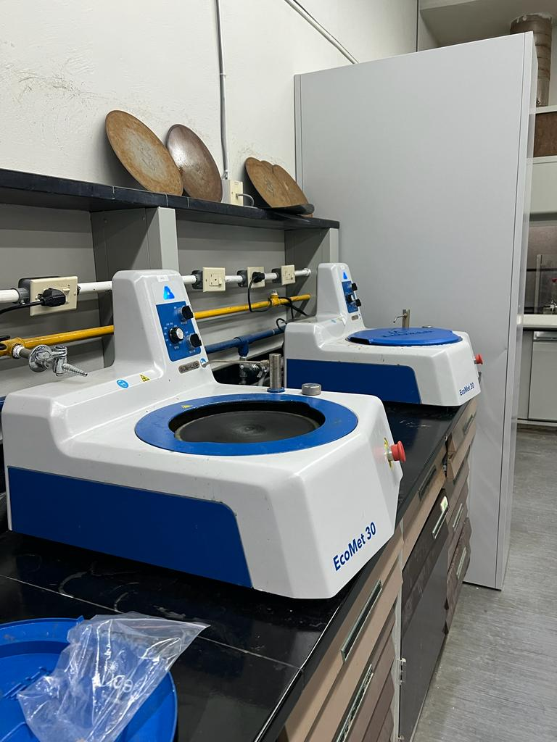
Experimental Procedure and Methodology
Microstructure Characterizations
All samples were Grinded and polished and prepared as per ASTM G1.
To reveal the microstructure of samples, a solution having 3 parts nitric; 1-part HCL; 5 parts deionized water was used as an etchant.
The samples of wrought 316L stainless steel and SLMed 316L stainless steel were characterized using Optical Microscope (GX53 olympus) to obtain and evaluate the microstructure of all samples before corrosion test.
XRD was performed to analyze the characterizing crystalline materials and obtain more information about the structure, phases and crystallinity.

Slide 14
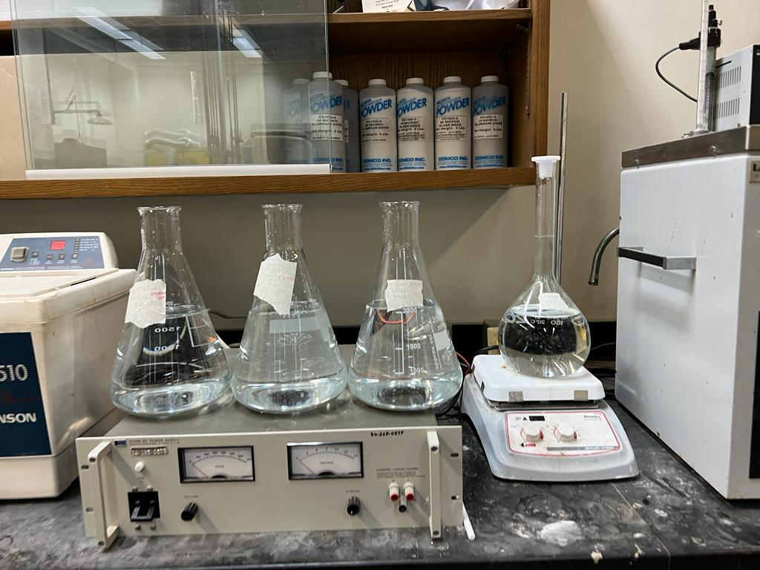
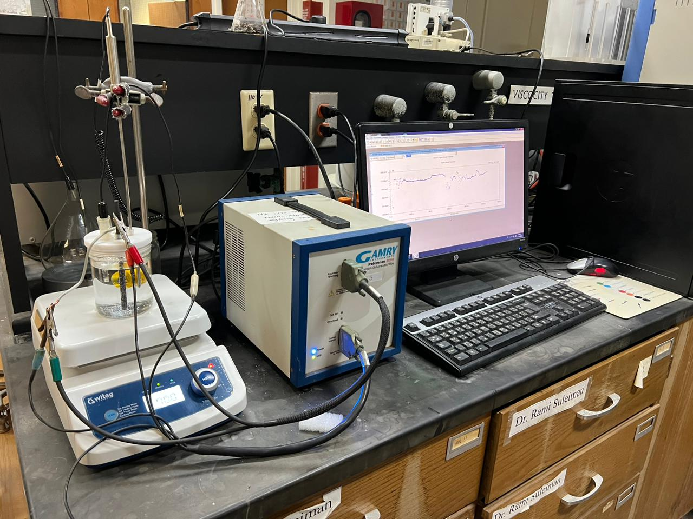
Experimental Procedure and Methodology
Electrochemical Corrosion Test
All electrochemical experiments were conducted in 3.5% NaCl at room temperature with four pH values; pH-1, pH-3, pH5, and pH 7.5.
The pH values were controlled by adding HCl to the solution.
The corrosion analysis was carried out using:
Linear Polarization Resistance (LPR),
Potentiodynamic Polarization (PDP),
open circuit potential (OCP),
Electrochemical impedance spectroscopy (EIS)

Slide 15
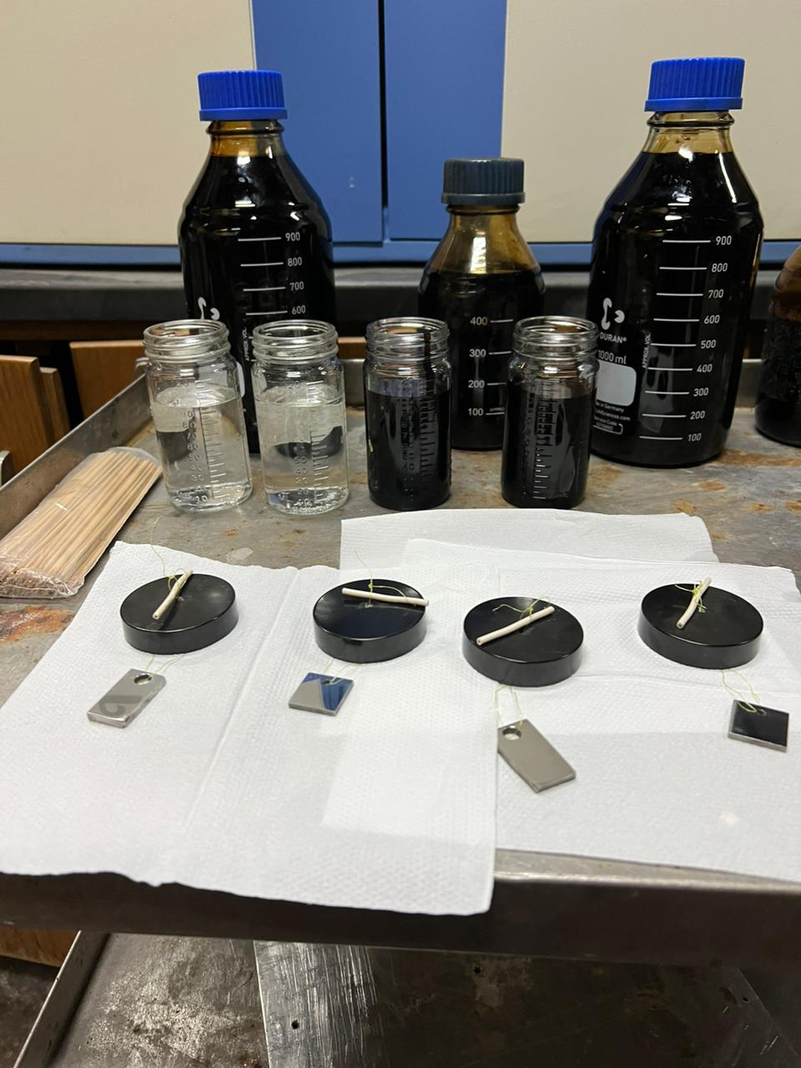
Experimental Procedure and Methodology
Immersion Corrosion Test
316L SLMed (ED30T) stainless steel and the 316L wrought samples were immersion in:
3.5% NaCl
crude oil (hydrocarbon)
Immersion duration: 14 days (336 h )
Test temperature: room temperature.
pH level : pH 1

Slide 16
Results and discussion
ED:20
ED:30
ED:40
Microstructure Analysis
Lowest energy density, highest porosity
Umelted powder
Grain size
Grain shape
Relative Density and Porosity
ED: 30T
Wrought 316L
Sample Name | Energy density (J/mm3) | Post treatment | relative density | porosity
ED20 | 21.0 | No | 93.96 % | 6.04%
ED30 | 33.3 | No | 99.48 % | 0.52%
ED40 | 41.0 | No | 98.89 % | 1.11%
ED30T | 33.3 | Yes | 99.81 % | 0.19%
W-316L | Conventional manufacturing for 316L SS - Wrought Sample | Yes | 99.68 % | 0.32%
Figure 10 Optical micrographs of as-received samples

Slide 17
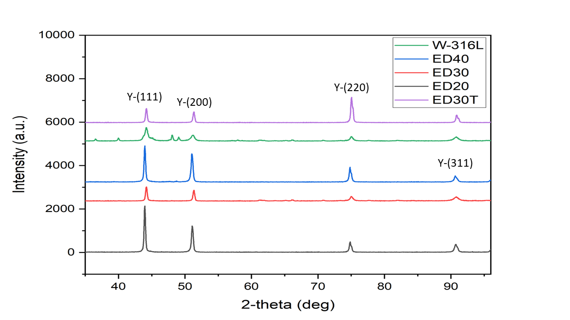
Results and discussion
X-Ray Diffraction

Slide 18
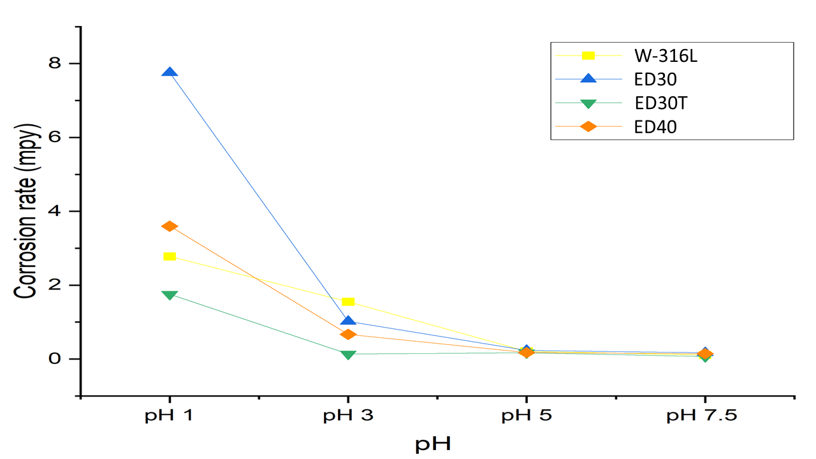
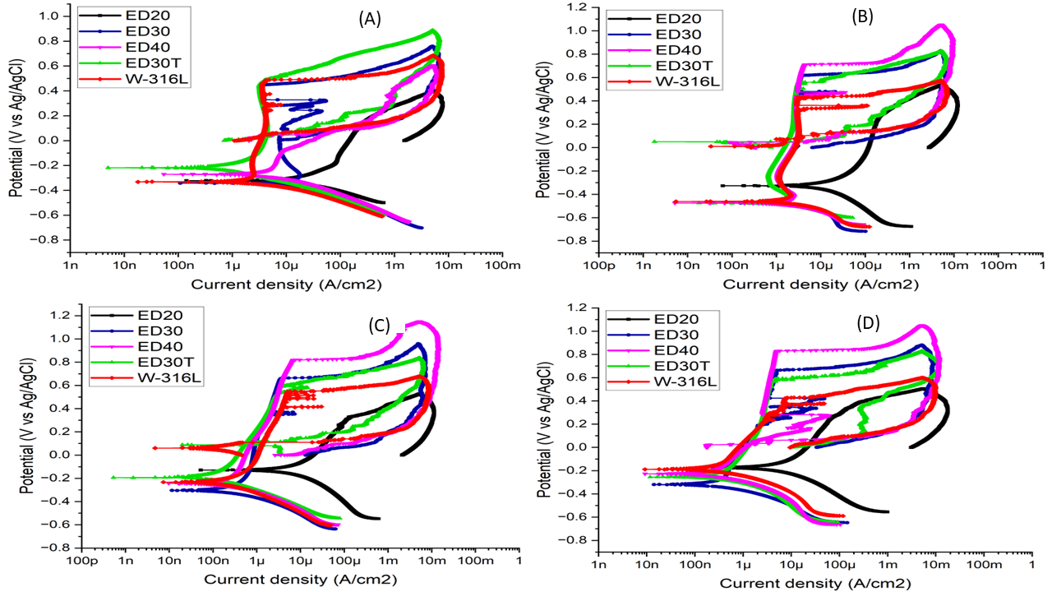
Results and discussion
Corrosion Behavior in room temperature NaCl
Figure 11 Corrosion rate of studied samples at different pH values based on CPDP Curves
Figure 12 Cyclic potentiodynamic polarization curves at 3.5 % NaCl solution at four different pH values. A) at pH 1 B) at pH 3 C) at pH 5 and D) at pH 7.5

Slide 19
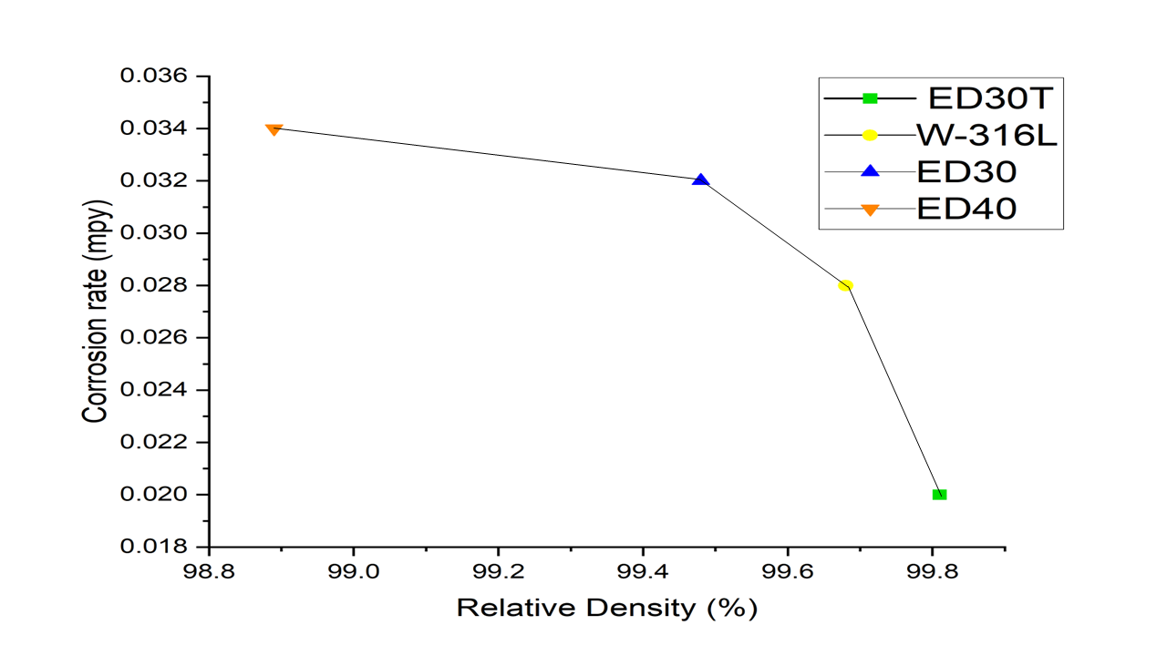
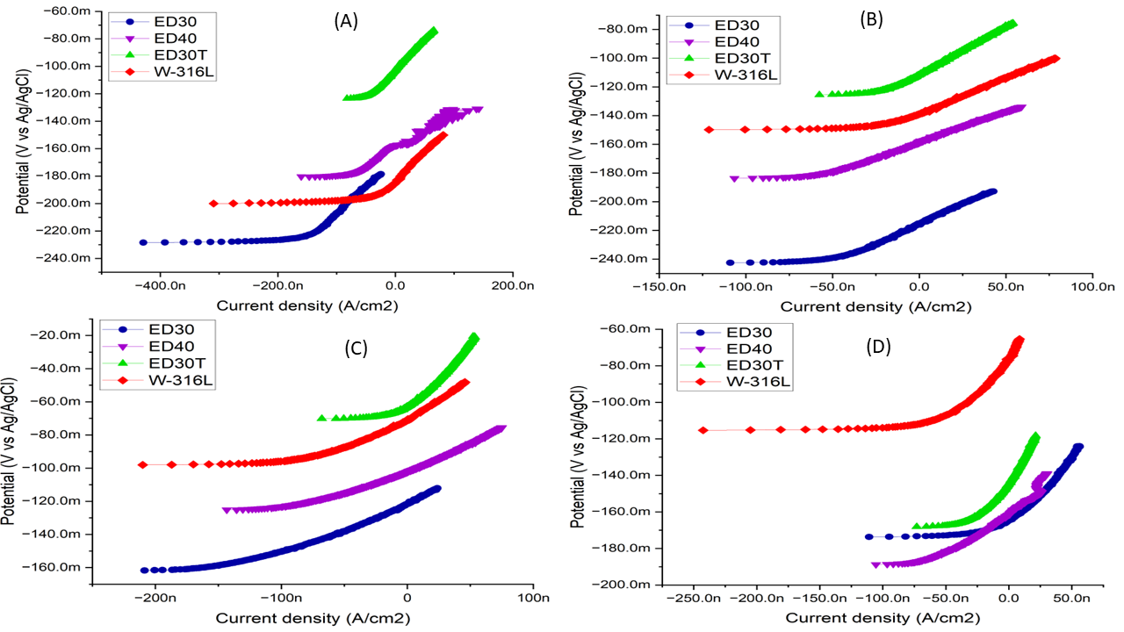
Results and discussion
Corrosion Behavior in room temperature NaCl
Figure 13 Linear Polarization Resistance (LPR) of all specimens in 3.5 % NaCl solution A) at pH 1 B) at pH 3 C) at pH 5 and D) at pH 7.5. without ED-20.
Figure 14 Corrosion rate versus Relative density extracted from Linear Polarization Resistance (LPR) results in 3.5% NaCl solution at pH 1

Slide 20
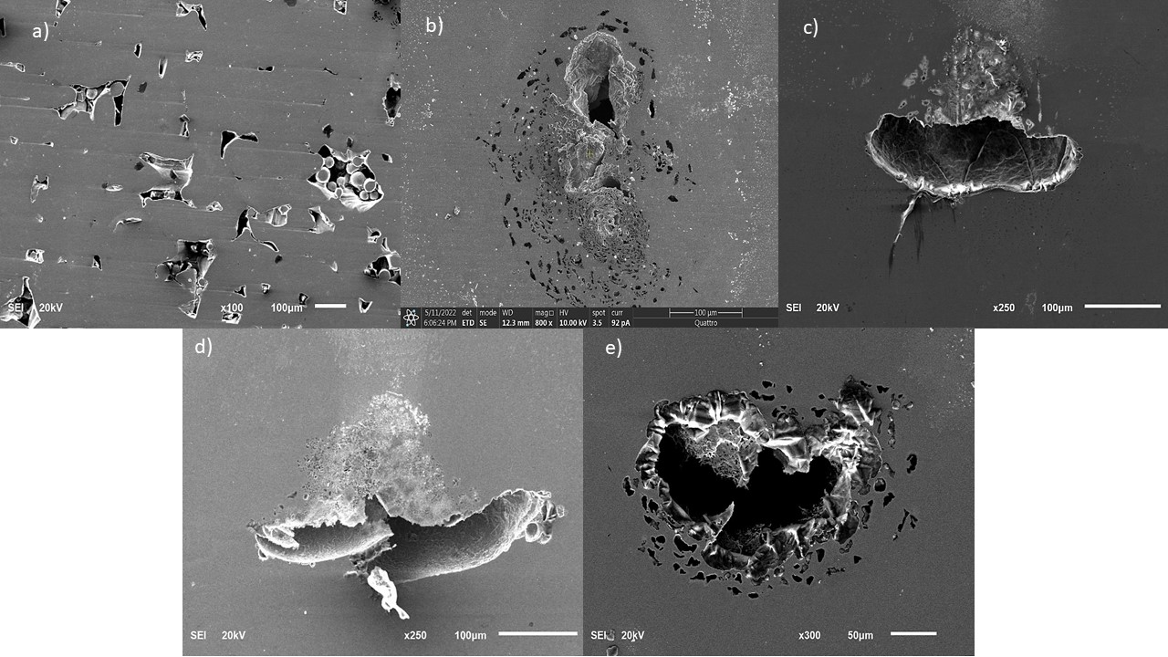
Results and discussion
Corrosion Behavior in room temperature NaCl
Figure 15 SEM image for pits on a) ED20 b)ED30 c) ED40 d) ED30T e) W-316L immersed in 3.5% NaCl solution at pH 1

Slide 21
Results and discussion
long-duration immersed sample in Hydrocarbon and NaCl
Corrosion rate after 14 days immersion
Corrosion rate after 14 days immersion
Immersion solution: 3.5 NaCl and crude oil
pH : 1
Temerature: room T
solution | Sample IDs | Calculated Corrosion rate
 |  | mpy *10^-2 (Effic.%)
3.5 NaCl, pH1 | W-316L | 7.97
 | ED30T | 4.84
Crude oil, pH 1 | W-316L | 2.66 (66.6 %)
 | ED30T | 1.56 ( 67.7 % )
Optical Profilometer
Figure 16 Typical 3D profilometer images, 2D optical images, and line profiles showing the pit density and depth for A) W316L at 3.5% NaCl, B) ED30 at 3.5% NaCl, C) W316L at crude oil, D) ED30 at crude oil.

Slide 22
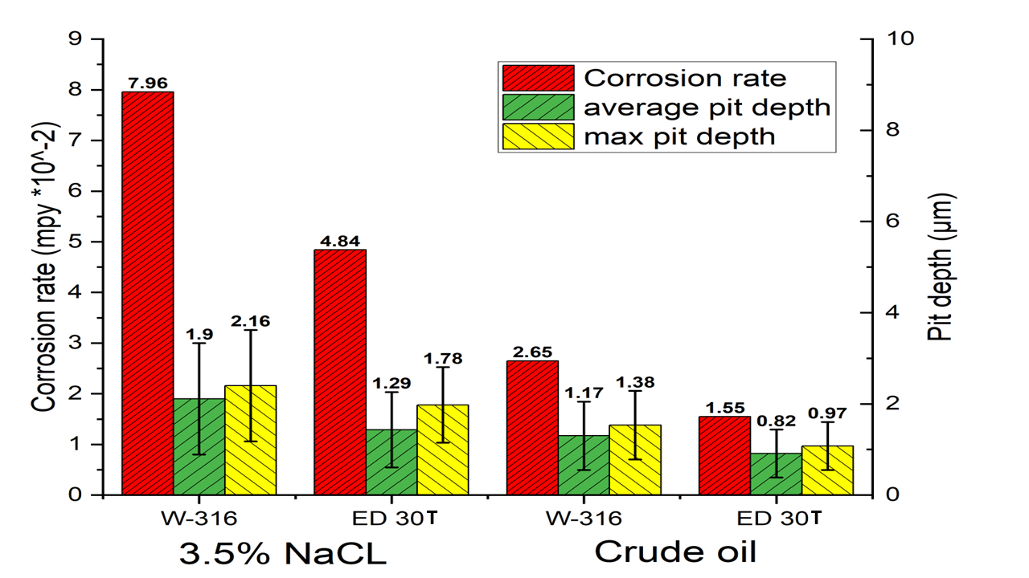
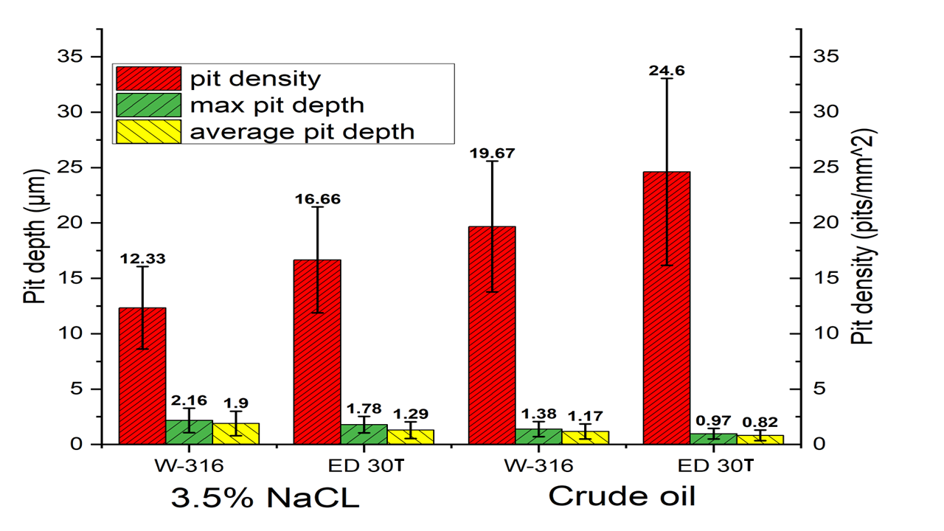
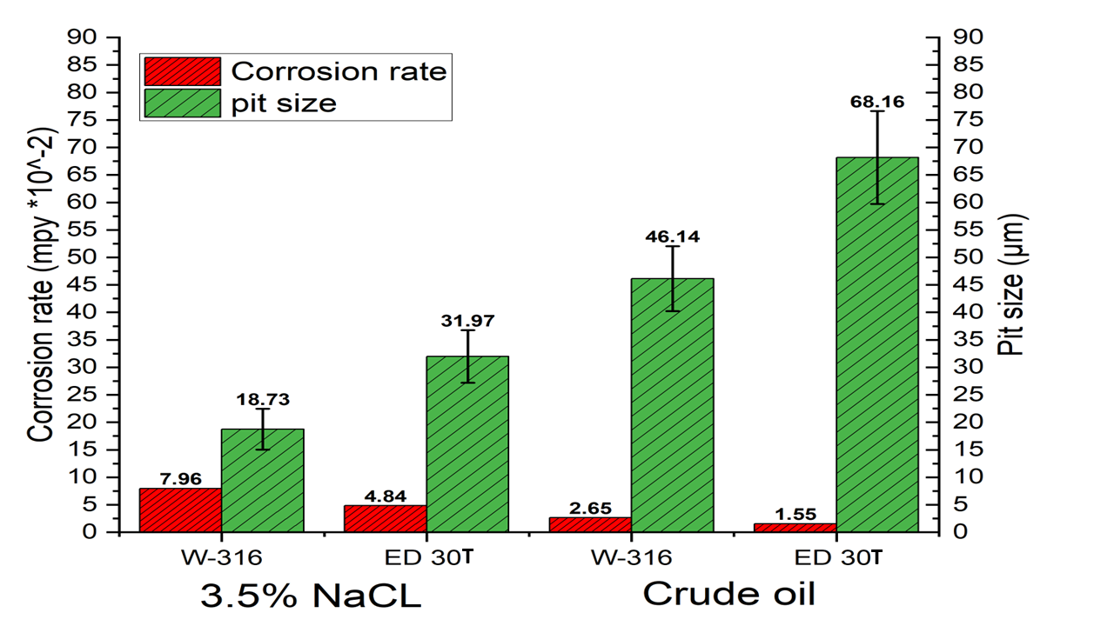
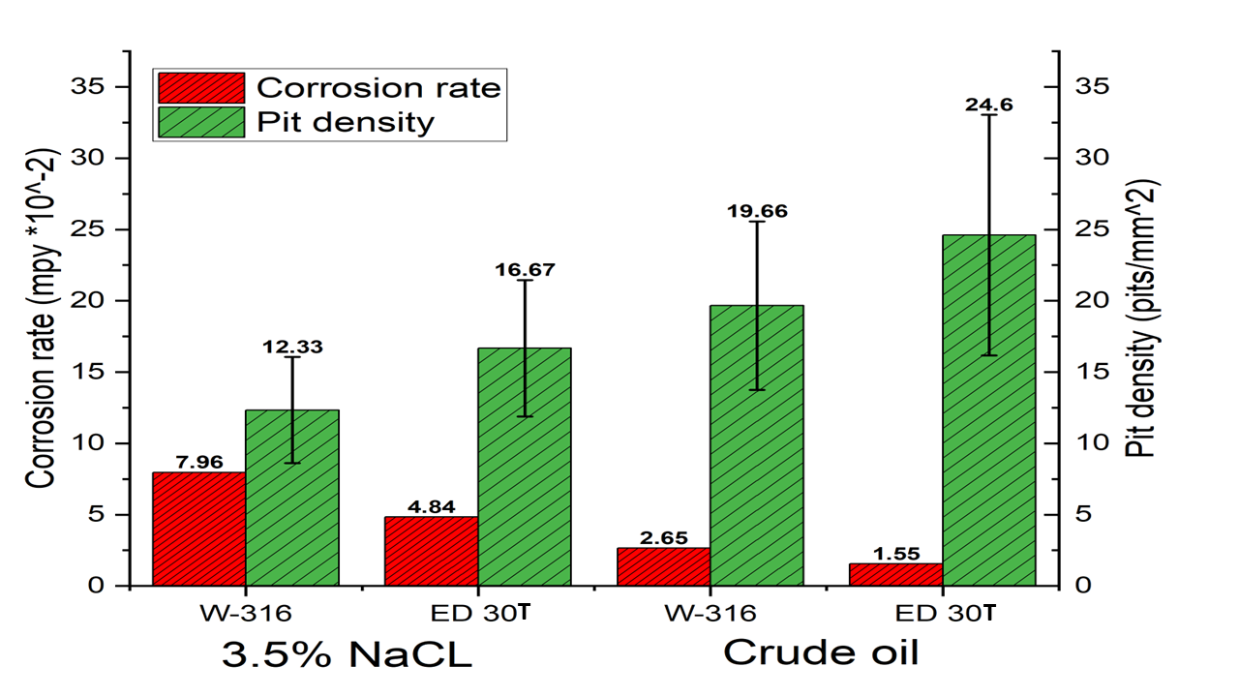
Results and discussion
Pit Evaluation (pit density, pit depth and pit size)
Figure 18 Corrosion rate versus temperature extracted from LPR results.

Slide 23
Conclusion and recommendations
Conclusion:
The pitting resistance of the SLM-316L stainless steel was found to be higher than that of the wrought alloy.
In crude oil, the corrosion resistance of SLMed 316L was greater than in the 3.5% NaCl solution.
The SLMed 316L sample has better corrosion resistance at high temperatures than wrought sample.
Recommendation:
Study the SLMed metal samples in an alkaline environment ( pH range: 7 to 14).
More attention needs to be put on the weldability of the SLMed material and its effect on the microstructure and corrosion behavior.
Notes:
Conclusion:
The pitting resistance of the SLM-316L stainless steel was found to be higher than that of the wrought alloy, especially at pH 1, where the Epit values of the samples show a clear difference.
In crude oil, the corrosion resistance of SLMed 316L was greater than in the 3.5% NaCl solution. This suggests that SLMed 316L could be a promising material for oil and gas pipelines and other oil ang gas industry environments.
Recommendation:
Study the SLMed metal samples in an alkaline environment ( pH range: 7 to 14). Is it more corrosion resistant, such as in an acidic environment, or will the trend change?
More attention needs to be put on the weldability of the SLMed material and its effect on the microstructure and corrosion behavior.
Study 3 D printed materials in high temperature hydrocarbon environment.

Slide 24
References
H. M. Hamza, K. M. Deen, A. Khaliq, E. Asselin, and W. Haider, “Microstructural, corrosion and mechanical properties of additively manufactured alloys: a review,” Critical Reviews in Solid State and Materials Sciences, vol. 47, no. 1. Taylor and Francis Ltd., pp. 46–98, 2022. doi: 10.1080/10408436.2021.1886044.
A. Concilio and L. Lecce, Shape Memory Alloy Engineering: For Aerospace, Structural and Biomedical Applications. 2014. doi: 10.1016/C2012-0-07151-7.
by Albert E. Patterson,Sherri L. Messimer and Phillip A. Farrington “Overhanging Features and the SLM/DMLS Residual Stresses Problem: Review and Future Research Need”. https://www.mdpi.com/2227-7080/5/2/15.
B. A. AlMangour, “Additive manufacturing of high-performance 316L stainless steel nanocomposites via selective laser melting,” University of California, Los Angeles, no. 2017.
Q. Chao et al., “On the enhanced corrosion resistance of a selective laser melted austenitic stainless steel,” Scr Mater, vol. 141, 2017, doi: 10.1016/j.scriptamat.2017.07.037.
G. B. Bang et al., “Effect of process parameters for selective laser melting with SUS316L on mechanical and microstructural properties with variation in chemical composition,” Mater Des, vol. 197, Jan. 2021, doi: 10.1016/j.matdes.2020.109221.
H. Maicas-Esteve, I. Taji, M. Wilms, Y. Gonzalez-Garcia, and R. Johnsen, “Corrosion and Microstructural Investigation on Additively Manufactured 316L Stainless Steel: Experimental and Statistical Approach,” Materials, vol. 15, no. 4, Feb. 2022, doi: 10.3390/ma15041605.

Slide 25
JUBCOR
2024
CONFERENCE & EXHIBITION
YOUR LOGO
INNOVATIVE SOLUTIONS FOR CORROSION CHALLENGES
THANK YOU
Q&A
Calle Cualquiera 123, Cualquier Lugar
Reach out.
phone
email
0553786980
Ibrahim.a.albalawi@gmail.com

Slide 26
JUBCOR
2024
CONFERENCE & EXHIBITION
YOUR LOGO
INNOVATIVE SOLUTIONS FOR CORROSION CHALLENGES
Appendix
Calle Cualquiera 123, Cualquier Lugar

Slide 27
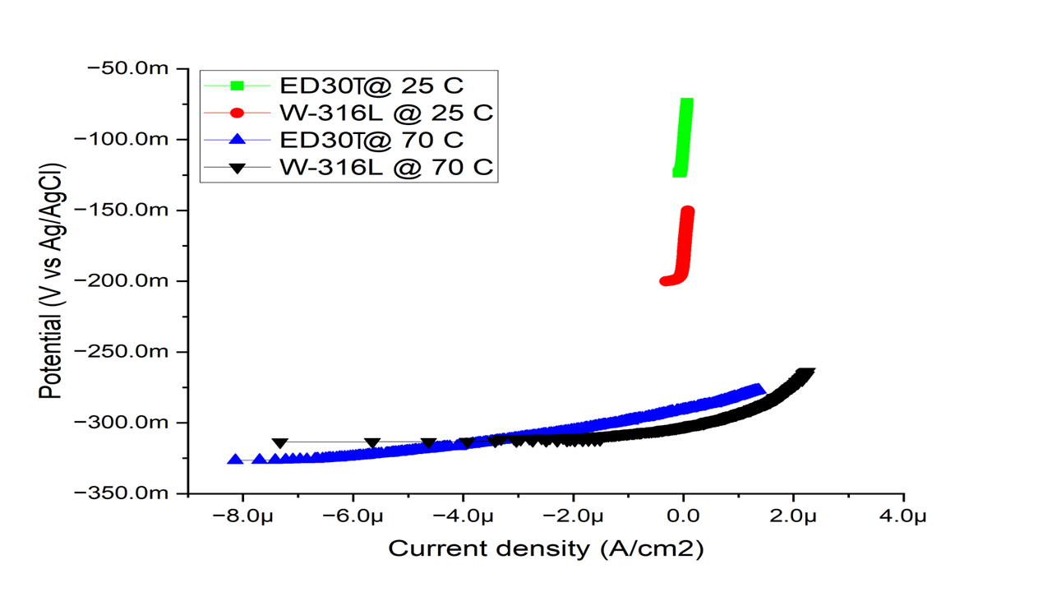
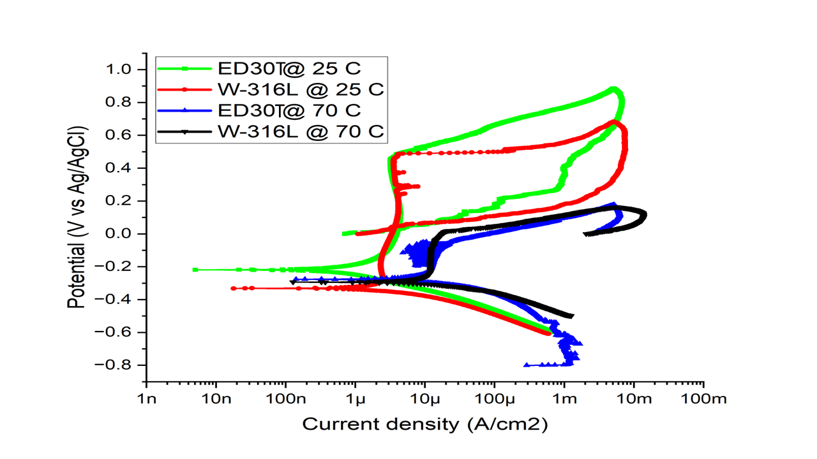
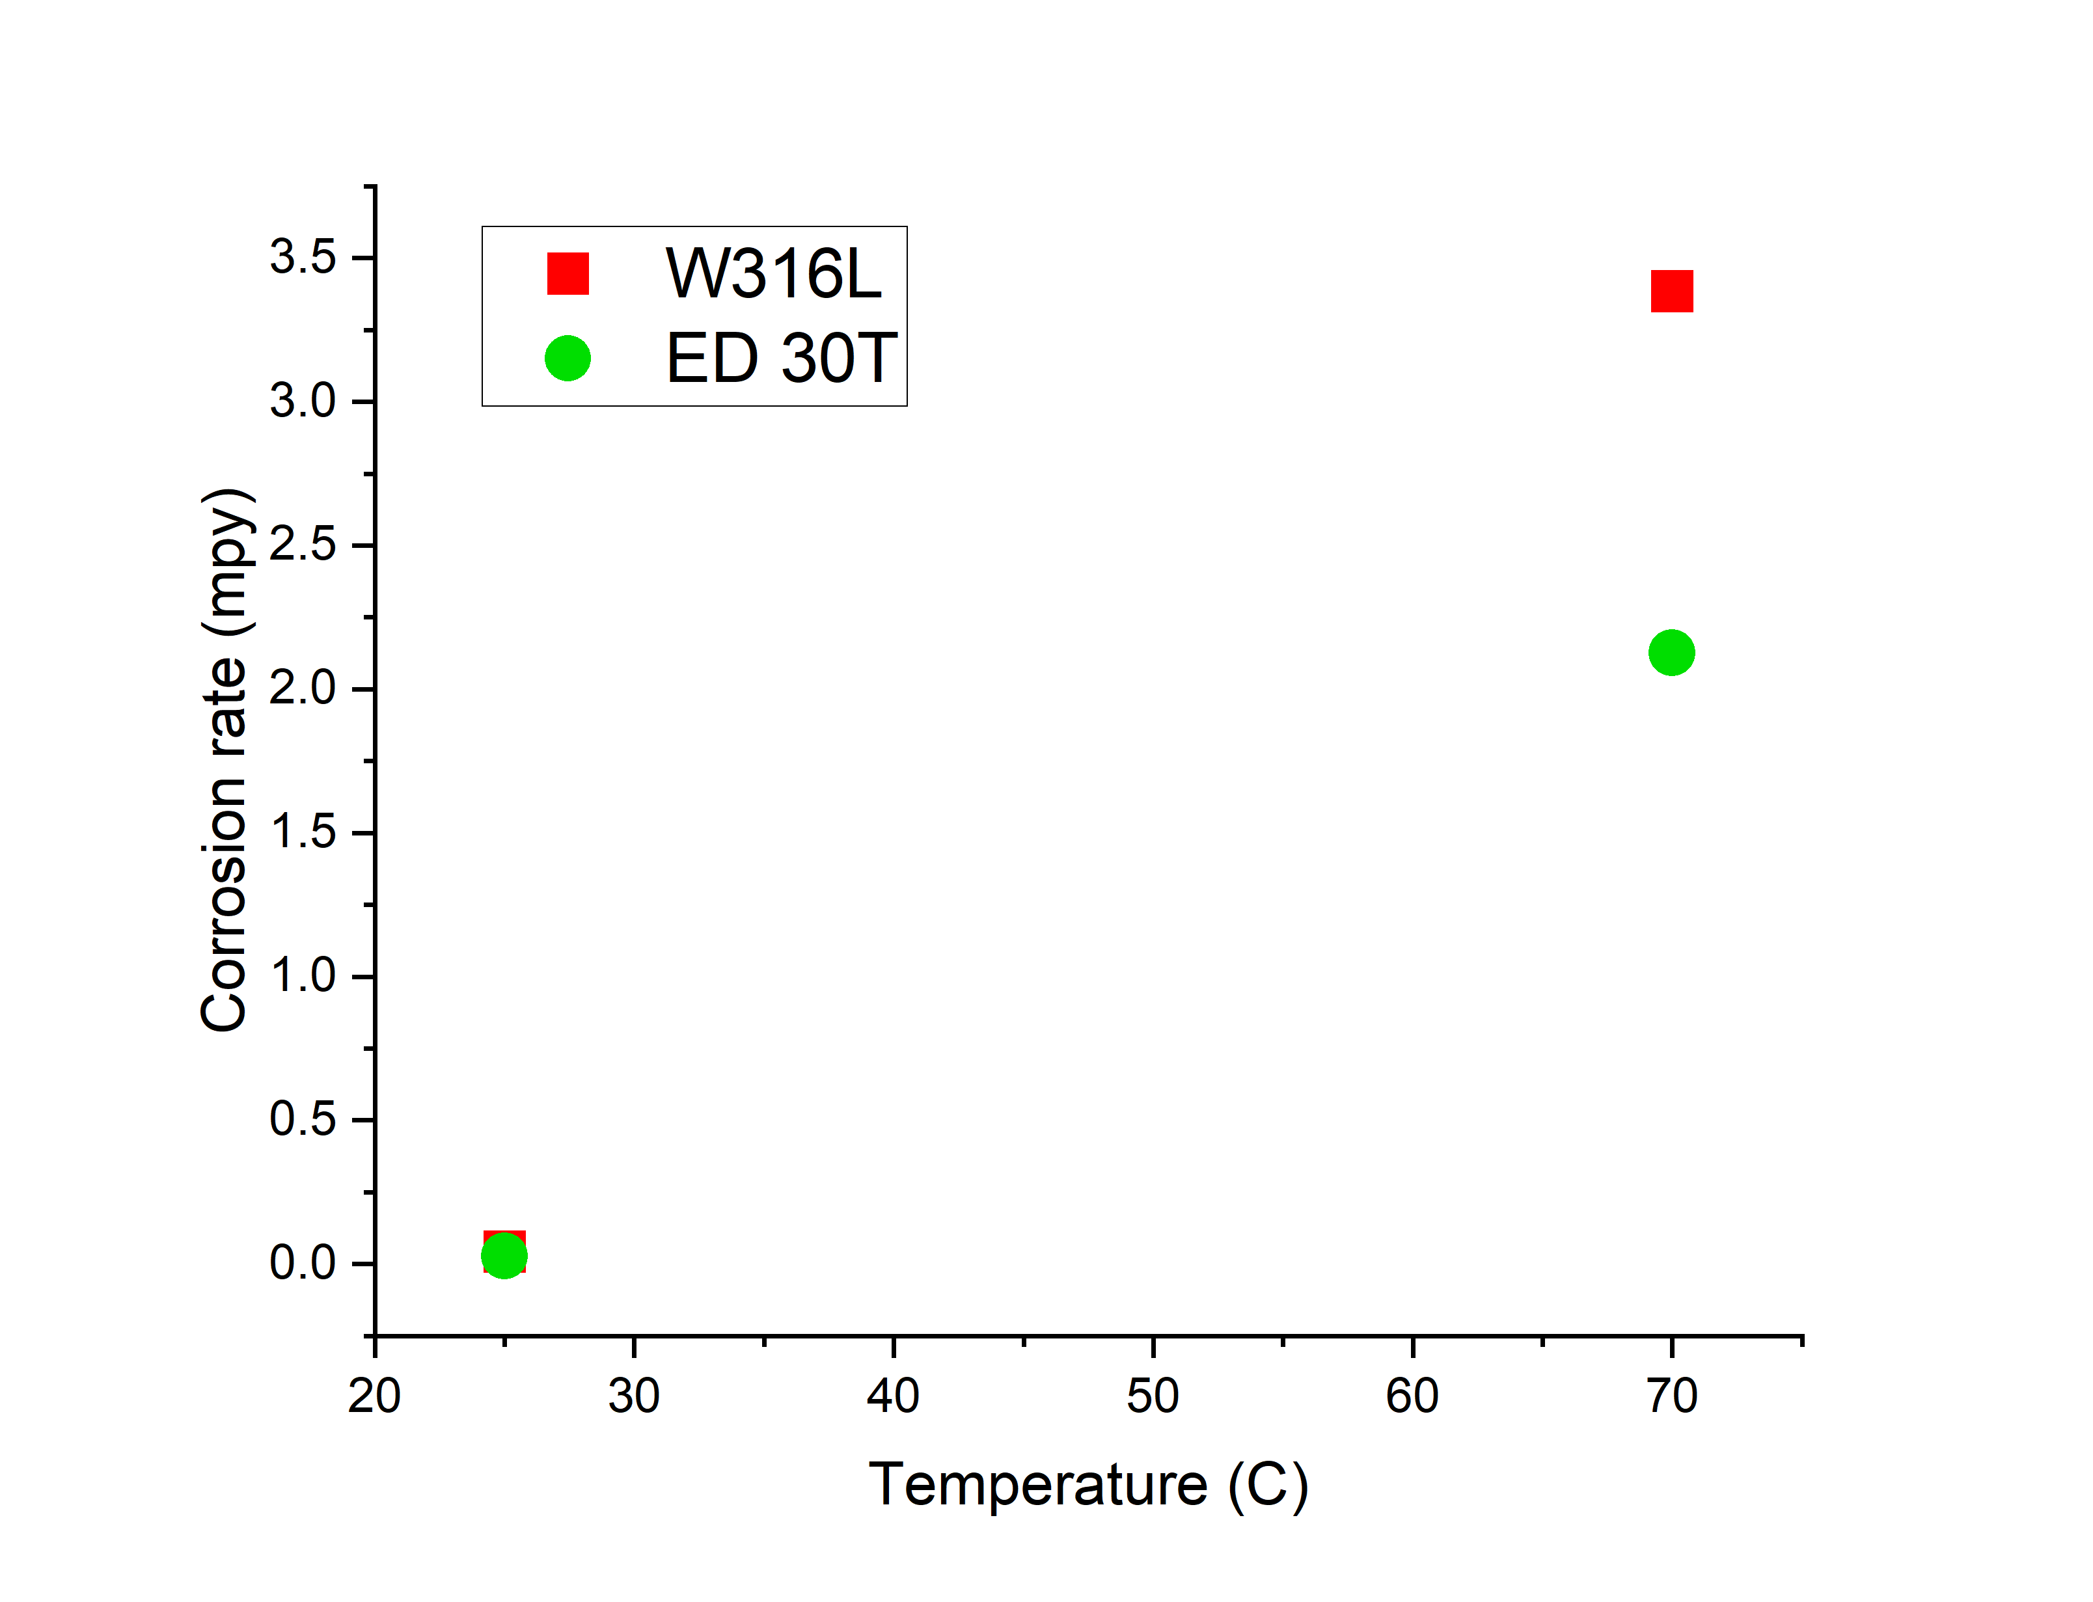
Corrosion Behavior at High Temperature NaCl
T | Sample IDs | Icorr µA | Ecorr mV | CR mpy | Rp kΩ.cm2 | Eff %
25 C | W-316L | 0.10 | -158.17 | 0.044 | 308.625
 | ED30T | 0.06 | -102.85 | 0.028 | 420.65 | 35%
70 C | W-316L | 7.407 | -304.05 | 3.3845 | 3.5665
 | ED30T | 0.005 | -290.05 | 2.127 | 5.6015 | 99.9%
Polarization resistance (Rp), corrosion current density (Icorr), and corrosion rate obtained from Linear Polarization Resistance (LPR) plots in 3.5 % NaCl solution at pH 1 room and 70 C temperature
Figure 18 Linear Polarization Resistance (LPR) plots of SLMed 316L and wrought 316L samples in 3.5 % NaCl at room temperature and 70 C
Figure 19 Cyclic potentiodynamic polarization curves at 3.5 % NaCl solution
Figure 18 Corrosion rate versus temperature extracted from LPR results.

Slide 28
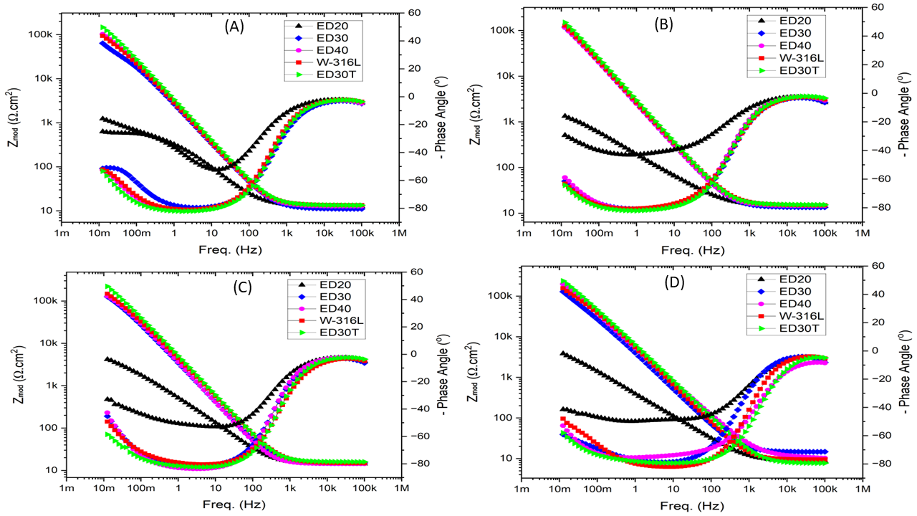
Corrosion Behavior in room temperature NaCl
The steady-state film thickness (Lss)
Thickness of passive layer
pH | Sample IDs
 |  | e | e0 | A | Cf | Lss | Deta
1 | W-316L | 15.6 | 8.85E-14 | 0.7854 | 6.51E-05 | 1.67E-08
 | ED20 | 15.6 | 8.85E-14 | 0.7854 | 4.34E-04 | 2.50E-09 | -1.42E-08
 | ED30 | 15.6 | 8.85E-14 | 0.7854 | 7.02E-05 | 1.55E-08 | -1.21E-09
 | ED30T | 15.6 | 8.85E-14 | 0.7854 | 5.57E-05 | 1.95E-08 | 2.81E-09
 | ED40 | 15.6 | 8.85E-14 | 0.7854 | 6.45E-05 | 1.68E-08 | 1.55E-10
3 | W-316L | 15.6 | 8.85E-14 | 0.7854 | 7.02E-05 | 1.55E-08
 | ED20 | 15.6 | 8.85E-14 | 0.7854 | 7.55E-04 | 1.44E-09 | -1.40E-08
 | ED30 | 15.6 | 8.85E-14 | 0.7854 | 7.32E-05 | 1.48E-08 | -6.33E-10
 | ED30T | 15.6 | 8.85E-14 | 0.7854 | 5.30E-05 | 2.05E-08 | 5.02E-09
 | ED40 | 15.6 | 8.85E-14 | 0.7854 | 7.55E-05 | 1.44E-08 | -1.08E-09
5 | W-316L | 15.6 | 8.85E-14 | 0.7854 | 5.38E-05 | 2.02E-08
 | ED20 | 15.6 | 8.85E-14 | 0.7854 | 2.09E-04 | 5.19E-09 | -1.50E-08
 | ED30 | 15.6 | 8.85E-14 | 0.7854 | 5.33E-05 | 2.04E-08 | 1.89E-10
 | ED30T | 15.6 | 8.85E-14 | 0.7854 | 3.57E-05 | 3.04E-08 | 1.02E-08
 | ED40 | 15.6 | 8.85E-14 | 0.7854 | 5.12E-05 | 2.12E-08 | 1.02E-09
7.5 | W-316L | 15.6 | 8.85E-14 | 0.7854 | 3.28E-05 | 3.31E-08
 | ED20 | 15.6 | 8.85E-14 | 0.7854 | 8.81E-04 | 1.23E-09 | -3.18E-08
 | ED30 | 15.6 | 8.85E-14 | 0.7854 | 4.79E-05 | 2.26E-08 | -1.04E-08
 | ED30T | 15.6 | 8.85E-14 | 0.7854 | 3.22E-05 | 3.37E-08 | 6.16E-10
 | ED40 | 15.6 | 8.85E-14 | 0.7854 | 3.90E-05 | 2.78E-08 | -5.26E-09
Electrochemical impedance spectroscopy (EIS) , Bode plots of all specimens in 3.5 % NaCl solution A) at pH 1 B) at pH 3 C) at pH 5 and D) at pH 7.5.

Slide 29
Corrosion Behavior in room temperature NaCl
Figure 14 Cyclic potentiodynamic polarization curves at 3.5 % NaCl solution at four different pH values. A) at pH 1 B) at pH 3 C) at pH 5 and D) at pH 7.5
pH | Sample IDs | W-316L | ED20 | ED30 | ED30T | ED40
1 | CR (mpy) | 2.78 | 17.58 | 7.75 | 1.75 | 3.60
 | Eff % |  | -533.98% | -179.63% | 36.78% | -29.82%
3 | CR (mpy) | 1.55 | 11.08 | 1.02 | 0.14 | 0.67
 | Eff % |  | -617.24% | -2.32% | 93.63% | -57.47%
5 | CR (mpy) | 0.21 | 6.08 | 0.23 | 0.17 | 0.18
 | Eff % |  | -188.05% | -11.39% | 20.26% | 17.05%
7.5 | CR (mpy) | 0.11 | 5.63 | 0.17 | 0.07 | 0.14
 | Eff % |  | -248.99% | -57.19% | 38.08% | -32.14%
Figure 13 Corrosion rate of studied samples at different pH values based on CPDP Curves

Slide 30
The results of Tafel fitting extract from CPDP curve at pH1, pH3, pH5, and pH7.5 solution
pH | Sample IDs | Beta A mV/dec | Beta C mV/dec | Icorr µA/cm2 | Ecorr mV | CR mpy | Eff % | Ipit µA | Epit mV | Erep mV | Epit-Erep
1 | W-316L | 7.5E+14 | 0.08 | 2.13 | -307.0 | 2.78 | - | 3.35 | 423.10 | 71.43 | 351.6
 | ED20 | 5.3E-01 | 0.17 | 13.5 | -322.0 | 17.5 | -533% | 236.5 | 115.4 | -208.8 | 324.2
1 | ED30 | 1.0E+15 | 0.11 | 5.95 | -343.0 | 7.75 | -179% | 3.57 | 439.60 | 5.49 | 434.11
 | ED30T | 4.0E+14 | 0.22 | 1.35 | -248.6 | 1.75 | 36% | 3.93 | 494.50 | 60.95 | 433.55
 | ED40 | 3.3E+14 | 0.10 | 2.76 | -271.0 | 3.60 | -29% | 746.40 | 285.70 | 93.40 | 192.30
3 | W-316L | 4.0E+14 | 0.11 | 1.19 | -461.00 | 1.55 |  | 2.70 | 340.7 | 170.3 | 170.40
 | ED20 | 5.85E-01 | 0.50 | 8.53 | -326.00 | 11.08 | -617% | 198.5 | 263.7 | -186.8 | 450.50
 | ED30 | 1.0E+15 | 0.09 | 1.22 | -474.00 | 1.02 | -2.3% | 3.74 | 615.40 | -5.35 | 620.75
 | ED30T | 8.15E-01 | 2.E+14 | 0.08 | -457.53 | 0.14 | 93% | 3.74 | 653.20 | 10.99 | 642.21
 | ED40 | 5.0E+14 | 0.05 | 1.87 | -238.12 | 0.67 | -57% | 4.60 | 696.40 | 43.96 | 652.44

Slide 31
The results of Tafel fitting extract from CPDP curve at pH1, pH3, pH5, and pH7.5 solution
pH | Sample IDs | Beta A mV/dec | Beta C mV/dec | Icorr µA/cm2 | Ecorr mV | CR mpy | Eff % | Ipit µA | Epit mV | Erep mV | Epit-Erep
5 | W-316L | 3.67E-01 | 0.16 | 0.16 | -174.60 | 0.21 |  | 4.97 | 554.90 | 104.40 | 450.50
 | ED20 | 5.12E-01 | 0.27 | 0.47 | -129.00 | 6.08 | -188% | 128.80 | 329.70 | 126.20 | 203.50
 | ED30 | 1.35E+00 | 0.14 | 0.18 | -304.00 | 0.23 | -11% | 3.46 | 653.80 | -104.0 | 758.20
 | ED30T | 2.00E+14 | 0.22 | 0.13 | -210.00 | 0.17 | 20% | 4.04 | 604.00 | 120.90 | 483.10
 | ED40 | 1.96E+00 | 0.14 | 0.13 | -244.00 | 0.18 | 17% | 6.69 | 806.30 | -10.99 | 817.29
7.5 | W-316L | 5.94E-01 | 0.09 | 0.08 | -187.60 | 0.11 |  | 3.10 | 489.00 | -10.49 | 499.49
 | ED20 | 6.29E-01 | 0.26 | 0.29 | -174.00 | 5.63 | -248% | 71.50 | 258.20 | -169.30 | 427.50
 | ED30 | 7.57E-01 | 0.10 | 0.13 | -319.00 | 0.17 | -57% | 5.02 | 659.30 | -142.90 | 802.20
 | ED30T | 4.49E-01 | 0.09 | 0.05 | -191.40 | 0.07 | 38.% | 5.40 | 604.40 | 6.42 | 597.98
 | ED40 | 3.76E-01 | 0.11 | 0.11 | -228.00 | 0.14 | -32% | 5.20 | 833.40 | -4.60 | 838.00

Slide 32
Corrosion Behavior in room temperature NaCl
EDS results for W-316L pit
EDS results for ED 30T pit

Slide 33
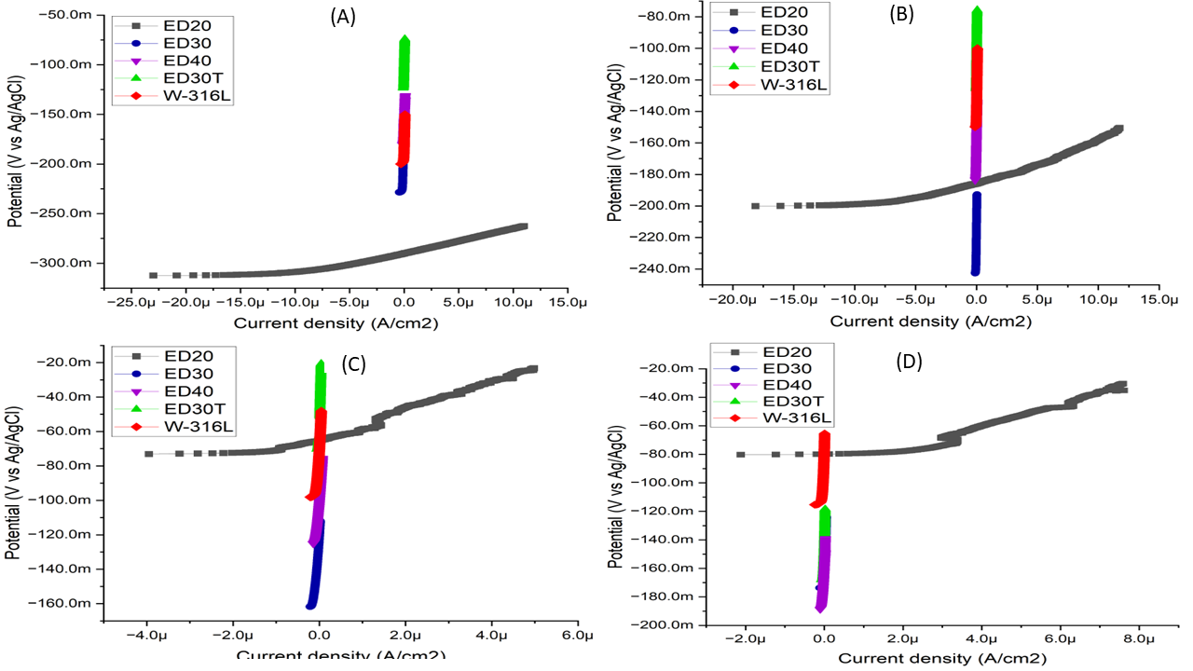
Linear Polarization Resistance (LPR) of all specimens in 3.5 % NaCl solution A) at pH 1 B) at pH 3 C) at pH 5 and D) at pH 7.5.

Slide 34
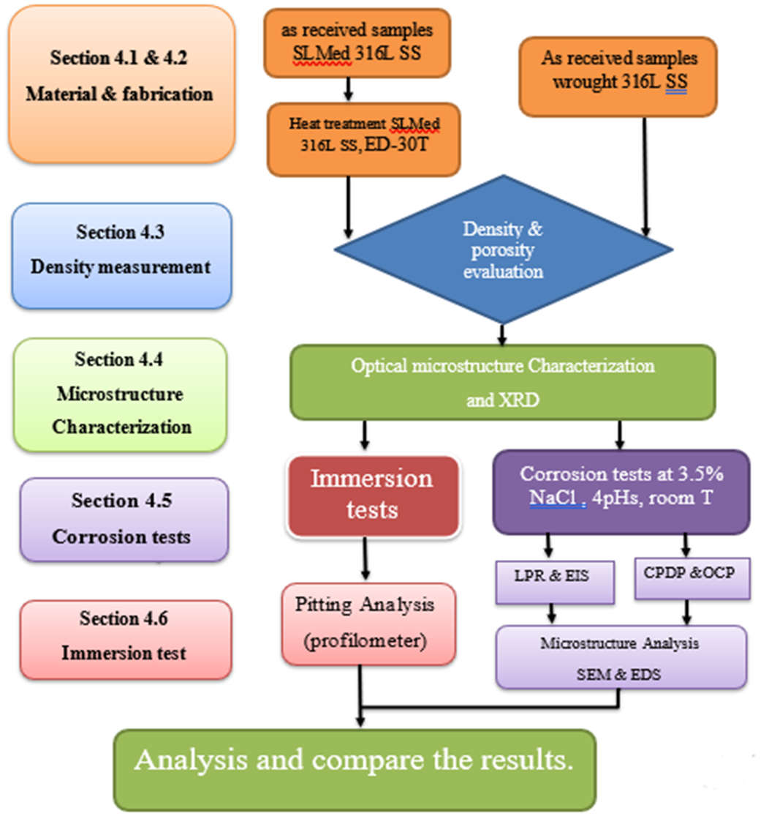
Section 4.1 and 4.2
Material and fabrication
Section 4.3
Density measurement
Section 4.4
Microstructure characterization
Section 4.5
Corrosion test
Section 4.6
Immersion test

Slide 35
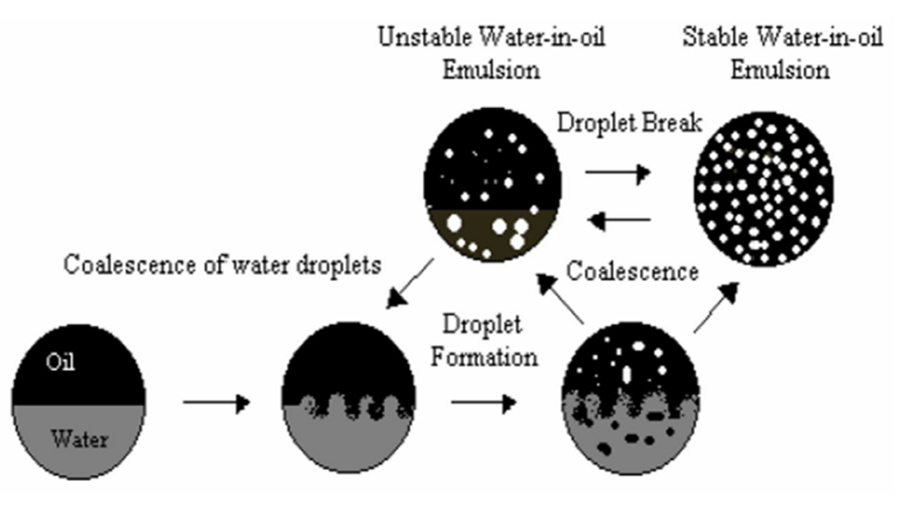
The process for the formation of water-in-oil emulsions

