Slide 1
JUBCOR
2024
CONFERENCE & EXHIBITION
INNOVATIVE SOLUTIONS FOR CORROSION CHALLENGES
Analytical Techniques Essential for corrosion studies
Presented By: Arun Kumar. S
Arun Kumar.S, Mohammad T. Akhtar, Ahmad Khudir Al-Raddadi,Nasheri-Al, Mansour Mohammad,
Ahmad Al-Musharaf

Slide 2
Outline

Slide 3
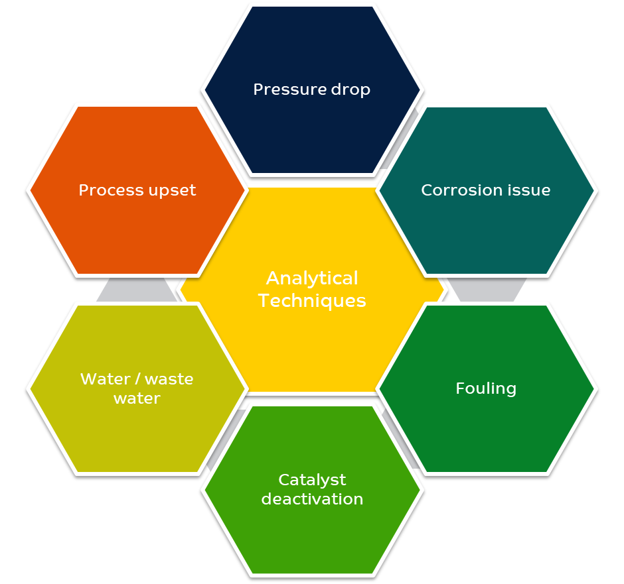
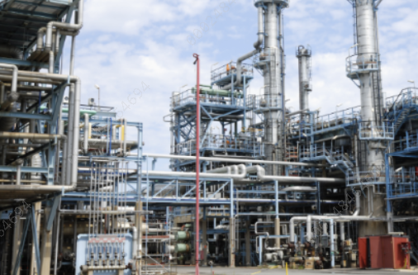
Industrial process are controlled – Analytical results are the indicator of controllability

Slide 4
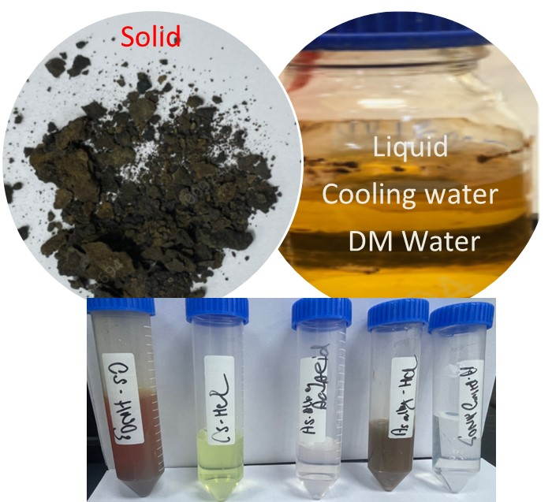
Background
Most of the Refinery and petroleum process corrosion sample are contaminated and at
Correlation
Resolve
Plan
Sampling
Representative samples
Relation to DP
Turnaround
Fouling
Deposits – different section
Limited samples ( low volume/weight)
Figure 1: Different type of sample collection for corrosion studies
Corrosion initiation
Fouling, acidic, basic, halides
Pitting, Erosion
Leaks and failure.
Analytical Challenges.
Undesired condition
Testing protocol

Slide 5
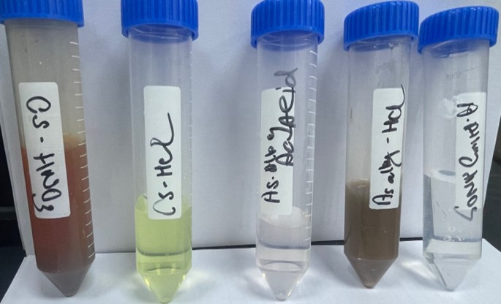
Problem description & objectives
Quick screening :XRF, XRD, SEM EDX
% level
Challenges – Nature of sample
Aqueous / organic.
Low volume & low concentration
Organic components
Figure 2: Solution obtained by treating CS and Austenitic steel samples
KSA is also hub
PVC and chlorine related products
Correlate -industry and corrosion studies using certified standard
Surface effect and corrosion residue using different analytical technique.
Exploring other Analytical for limited or corrosive samples

Slide 6
Methodology
Methodology
Experimental setup
Optical Microscopy
Energy dispersive spectroscopy (EDS)
ICP-MS, IC, Gas Chromatography
Scanning Electron Microscope (SEM)

Slide 7
Results & Discussion

Slide 8
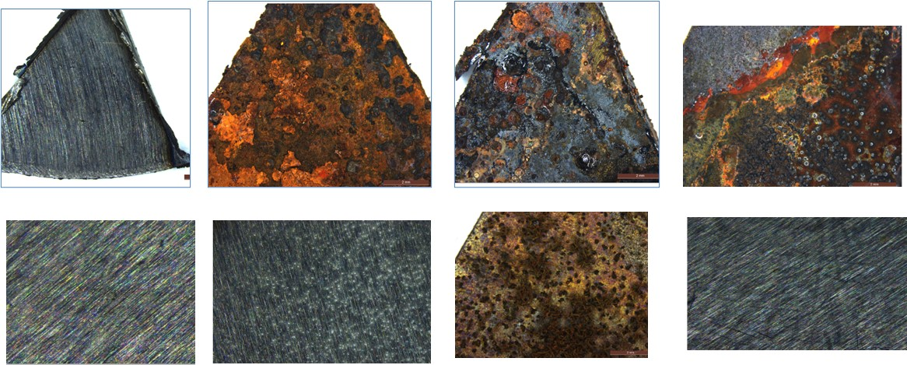
Results & Discussion
Experimental setup
Two Alloys were chosen for experiments with three chemicals : HCL , HNO3 & Acetic Acid
Carbon Steel
Austenitic Steel
Conditions
Room Temperature
HCl (35%), HNO3 (65%) & Acetic Acid (10%)
Time 2 Days
C Steel
C Steel- HNO3
C Steel- HCl
C Steel- AA
A.Alloy Steel
A. Alloy Steel- HNO3
A.Alloy Steel- HCl
A. Alloy Steel- AA
Figure 3: Images of CS and Austenic steel after chemical treatment
Elemental composition of Carbon Steel -3952
C | Si | S | P | Mn | Ni
0.114 | 0.34 | 0.002 | 0.001 | 0.5 | 0.112
Cr | Mo | Cu | Co | Al | Nb
0.105 | 0.519 | 0.202 | 0 | 0.048 | 0.76
The higher scaling is observed for the Carbon steel in all three acidic solution.
The color ranges between dark brown and reddish orange
Majority of the residue is Hematite in Carbon Steel sample
Pronounced attack of A.Alloy is observed in Hydrochloric acid.
A mild attack of Acetic acid in A.Alloy compared to Carbon steel
Elemental composition of Austenitic steel-13x 17001
C | Si | S | P | Mn | Ni
0.114 | 0.34 | 0.016 | 0.08 | 1.73 | 6.05
Cr | Mo | Cu | Co | Al | Nb
14.89 | 0.12 | 0.037 | 0.15 | 0.01 | 0.76
Table 1: Elemental composition of the carbon & Austenic steel

Slide 9
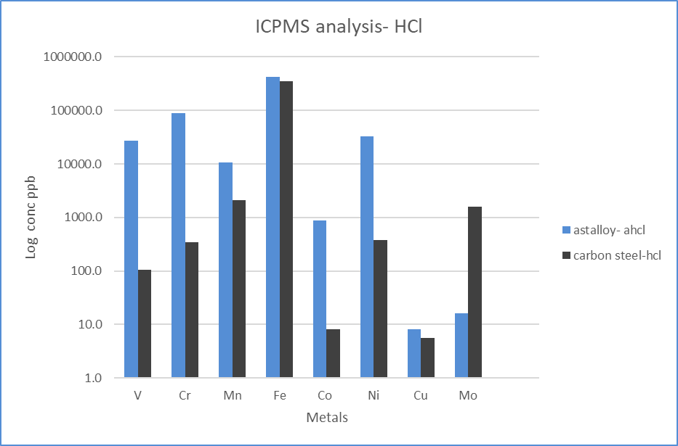
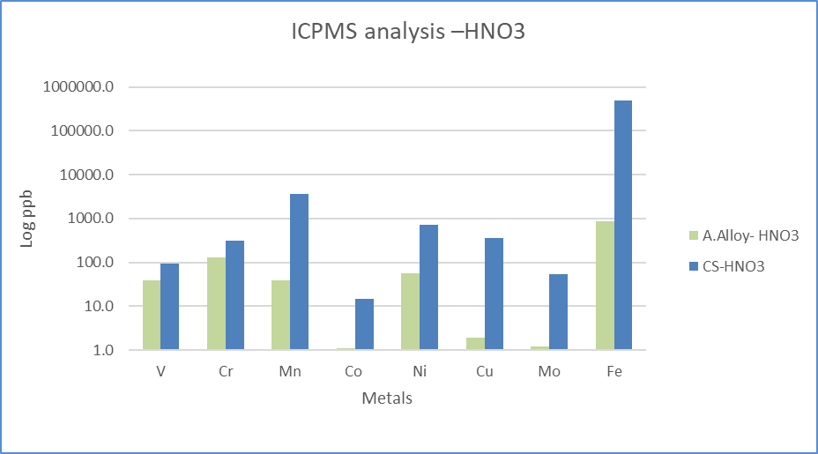
Results & Discussion
SEM Analysis
ICPMS Analysis
Optical images for CS in HCl
Optical images for A.A in HCl
Extract of metals with different Acid
Spectrum | A3 | A4
Cl |  | 0.2
O |  | 30.05
Si | 0.18 | 0.21
Ca |  | 0.42
Fe | 96.33 | 42.5
Mo | 0.46 | 0.31
Spectrum | A2 | A4
O | 26.79 | 0
Cl | 0.93
Cr | 28.38 | 16.89
Fe | 31.73 | 71.32
Ni | 1.84 | 8.36
Nb | 0.28 | 0.63
Sample solution analyzed by ICP-MS
ICP/ ICPMS technique
Minimum samples volume
0.5ml
Digesting -Clear solution
A. Alloys pronounced
CS Steel oxidized in HNO3 – Iron oxide
EDS analysis –Depletion in Metals.
As SEM-EDX optical technique limitation
Solution-Acidic/Organic
Sample solution analyzed by ICP-MS

Slide 10
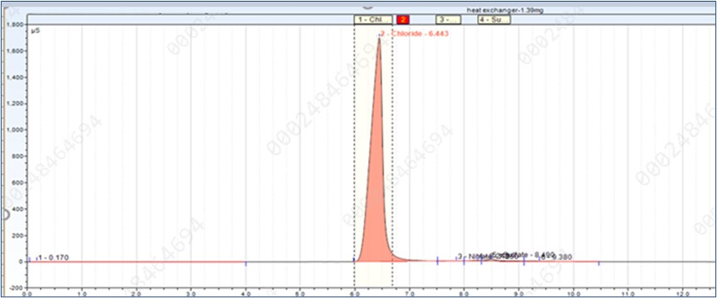
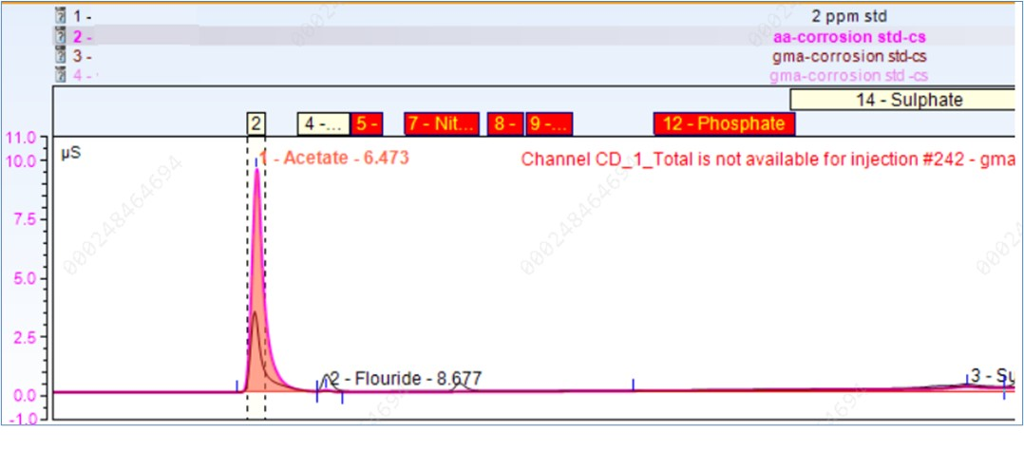
Results & Discussion
Chromatography
Figure 7 high chloride content even after washing the residue with water
Figure 5: Ion chromatography analysis of the organic acid
Ion chromatography -corrosion initiators
low as 0.5mL sample volume.
GC-MS chromatography -Unknow volatile impurities
Anions
Organic Acid
Trace Sulfur species – Thio compounds
Organic Chloride
Figure 6 GC-MS Mass spectrum organic Acid and Sulfur species

Slide 11
Conclusions

Slide 12
Conclusions & Recommendations
Conclusions
Analytical Techniques have several advantages and some limitation.
During sampling the extent of care taken would determine the effective analysis and the correlation.
Sample as low as 0.001g/ 0.1ml quantity which are deposited/ adhering to surface can provide useful information.
ICP/ ICP-MS as an alternative tool in absence of XRF or EDX , can provide information to level of low concentration.
Trace corrosion initiators like organic Sulfur, Chloride, Amines… can be identified and quantified.
Combustion Ion chromatography can add advantage in quantification of Trace halides for several type of samples which can be an alternative.

Slide 13
References
[1] Georgios Fytianos, rrosion evaluation of MEA solutions by SEM-EDS, ICP-MS and XRD, Energy Procedia 86 ( 2016 ) 197 – 204
[2] Ionita, Daniela, CP-MS determinations in sustaining corrosion data of 316 stainless steels in bioliquids, UPB Scientific Bulletin, Series B: Chemistry and Materials Science, I 2014/01/01.
[3] Vincent Souchon, Marc Maleval, Fabien Chainet, Charles-Philippe Lienemann. Chlorine speciation in complex hydrocarbon matrices using GC-ICP-MS/MS. Journal of Analytical Atomic Spectrometry, 2023, 38 (8), pp.1634-1642. ff10.1039/d3ja00066dff. ffhal-04289902

Slide 14
JUBCOR
2024
CONFERENCE & EXHIBITION
INNOVATIVE SOLUTIONS FOR CORROSION CHALLENGES
THANK YOU
Reach out.
+966 13 359 9170
rajua@sabic.com

