Slide 1
KAI-Con
JUBCOR
2024
CONFERENCE & EXHIBITION
INNOVATIVE SOLUTIONS FOR CORROSION CHALLENGES
Online CUI Risk Monitoring and Use cases for Predictive Maintenance
Presented By:
Ir. Theo Knijff

Slide 2
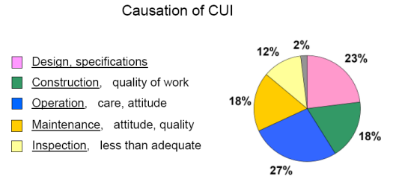
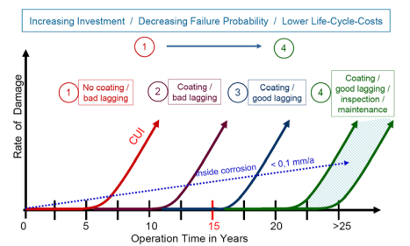
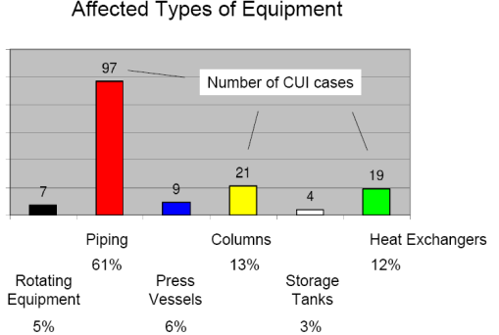
Within the (Petro) Chemical Industry CUI is among the biggest asset integrity threats.
Some numbers:
Insulated CS Piping is mostly affected by CUI, around 60% of the installed base (depending on plant lay-out).
60 – 70% of the total maintenance / turnaround budget is spent on Fixed Equipment. CUI inspection and repair is one of the larger contributors.
CUI is like an “Octopus”, many tentacles → see causation diagram.
Each year, Process Safety Incidents caused by CUI are reported throughout the industry.
Source: EEPC Roadmap to managing CUI

Slide 3
Why is CUI difficult to predict or find?
In fact, it is NOT, but it is getting complicated as (not limited to this listing):
Nobody is inspecting for the full 100%, by 100% insulation stripping. Nobody can afford the costs involved and impact on production. Everybody accepts “remaining risk”.
Industry standards for the extent of inspection are typically based the hazard properties of the Process Fluid. More inspection is required if the hazard is higher (e.g. extremely flammable versus flammable).
There is guidance to extent the inspection scope based on findings. Are we strictly following in a “conservative” way, or does budgets, resources and schedule play a role?
Operating conditions should be well understood, and inspection plans should include these specifics.
Severe CUI susceptibility: Equipment and Piping that cycles (> 2 annually) between low temperatures that are sub-freezing or sweating and high temperatures that are ambient to above 100° C.
Serious CUI susceptibility: Intermittent (1 to 2 annually), sweating service (below dewpoint) or having a transient zone (from outside to inside the CUI Temperature range) etc.
No CUI will take place if your coating is in good condition. Do we know the condition, and are we timely re-coating?
Damaged insulation might result in moisture or water ingress, accelerated unexpected corrosion can occur.
All NDT has got limitations, pro´s and con´s. We need to understand the details. As example, there is a difference between PEC and X-ray on usage and application.
Source: Dow Mechanical Integrity Manual

Slide 4
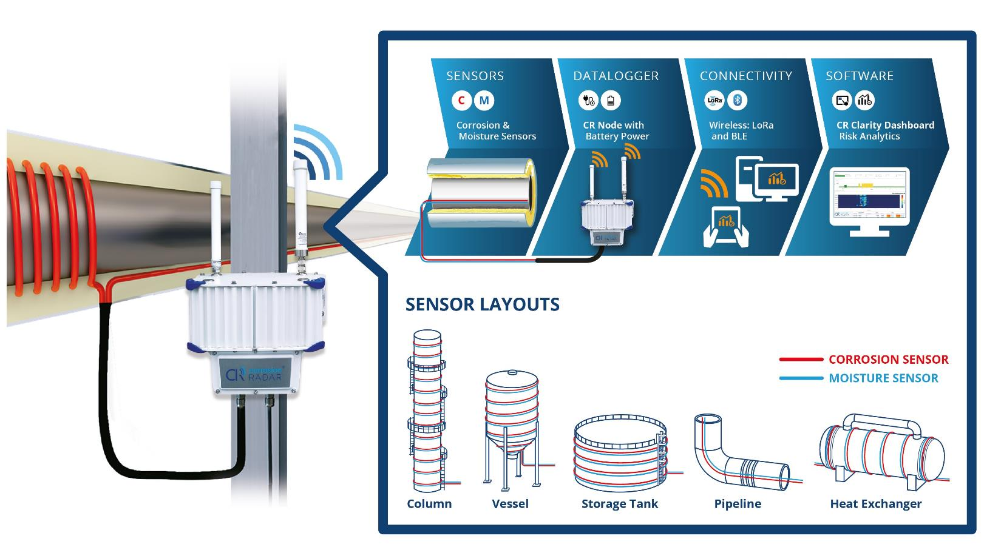
CRITICAL EQUIPMENT (*), required shift.
Minimizing the CUI risk by:
100 [%] monitoring of the Mechanical Integrity during the Asset Life Cycle.
What does that mean:
Maximize monitoring the [%] of susceptible area coverage of installed equipment.
Maximize the [%] of total equipment surface monitored by the sensor system.
TODAY’S VALIDATED SOLUTION WITHIN THE INDUSTRY:
CorrosionRADAR LR ® CUI Risk Monitoring System
with Corrosion and Moisture Sensing.
Source: CorrosionRADAR®
(*) Assets with high Consequence of Failure and/or
high (Severe/Serious) CUI susceptibility.

Slide 5
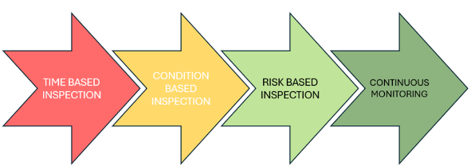
Inspection Strategies for Critical Equipment (*) .
THE GOAL: ONCE CUI MONITORING SYSTEMS ARE INSTALLED AND VALIDATED / QUALIFIED:
Shift to a 24/7 CUI monitoring of the equipment ’s Mechanical Integrity during the Asset Life Cycle.
The selected strategy shall always meet the regulatory requirements of the country/region where the asset is located.
Inspection Strategies are preferable based on credible damage mechanisms. CUI is one of them.
Time Based: Fixed time interval to take action (repair).
Condition Based: Minimum of fixed time interval or half remaining life.
Risk Based: All driven by risk (Likelihood and Consequence of Failure)
24/7 CUI Monitoring: Schedule REPAIR (reduce likelihood of failure) or extra inspection to monitor the
integrity (higher confidence level of remaining life) before a certain risk level is reached.
REPAIR WILL IMPROVE MECHANICAL INTEGRITY, INSPECTION CAN ONLY MONITOR.
(*) Most likely 80 – 90% of the installed base (PCE and Piping) will not have a CUI Monitoring Systems installed but will follow one of the listed inspection strategies. Scheduling and documenting must be done in a Maintenance Management System.

Slide 6
How to get to 24/7 monitoring (*)?
Understand the CUI Monitoring System and Technology (how does it work).
Moisture and corrosion sensors, data logger, connectivity protocols, and visualization software etc.
Develop selection criteria of assets and locations (where to install).
Risk based (Consequence and Likelihood) and / or Economics (LTCO and Production Loss).
Validate sensor methodology for first use within a company/site (proven to work).
Agree on CUI monitoring system design and field installation.
[%] of equipment surface covered.
[%] of suspect areas covered.
Sensor life versus equipment life.
Service level agreement.
Training and services during C&SU.
Define how CUI monitoring data will be used within the company CUI Inspection Strategy .
Time, Condition Based or RBI: avoid surprises, use sensor corrosion rates and locations where moisture is detected.
24/7 monitoring: initiate repair and / or extra inspection based on system data.
Define how to use your Maintenance Management System for data logging & analysis, history tracking and scheduling activities for the CUI monitoring system.
AND,………. Industry Standards and Guidelines are instrumental!
(*) Only for Critical Equipment where CUI Monitoring Systems are installed..

Slide 7
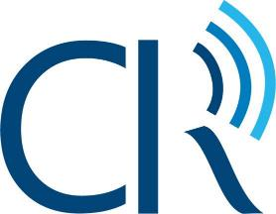
Example of a validated CUI Monitoring System as is installed by several Asset Owners within the petro-chemical industry.
Solution
CUI Risk Monitoring
Moisture and Corrosion Sensor installed

Slide 8
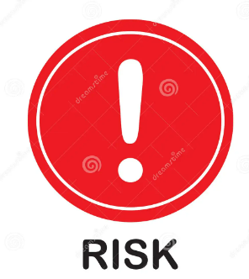
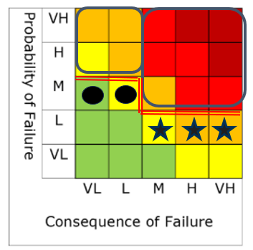
Selection of Assets.
H
High Consequence Assets
(Process Safety)
High CUI Susceptibility (Severe/Serious)
Asset LTCO
Financial / Production
H
Hazardous, toxic fluids or gases
Cyclic, Intermittent, Sweating, Transient zones
Production loss initiated by inspection
Assets with challenges to inspect
High Consequence / CUI susceptibility and cost of mitigation.
CG Dryers
(cyclic)
Columns (sweating)
LNG (production loss)
Loading Lines (accessibility)
Asset LTCO – Repair timely.
Refrigeration (transient)
Cryogenic (protrusions)
LPG / Propane
(intermittent)
Jetty Pipelines
(accessibility)
Source: CorrosionRADAR® and KAI-Con

Slide 9
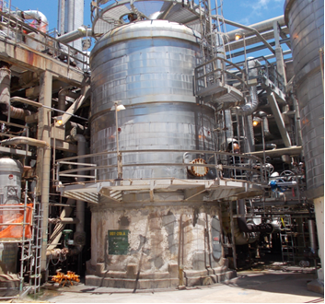
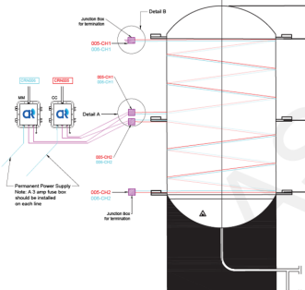
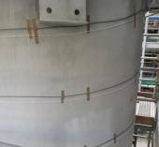
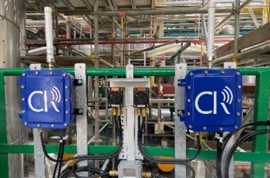
Cracked Gas Dryer Monitoring – Process Safety.
Problem – Equipment with highest CUI susceptibility due to extreme Cyclic Temp-service. Several unexpected Process Safety Near Misses occurred in the past within this company.
Asset Type:
Dryer with a catalyst bed (30 – 40 worldwide installed within this company).
Cyclical service: From < -15 ºC to > 180 ºC.
Insulation: closed cell structure (Perlite) with a vapor barrier.
Coating: Thermal Spray Aluminum (latest standard).
Solution:
2 units of CUI monitoring systems CR LR to monitor 24/7.
Today:
Minimized risk for unexpected equipment failure.
Susceptible locations for CUI Inspection 100% understood.
Cost savings up to $100k - $300k for a single Dryer inspection cycle.
Future:
Once the system is qualified, go to 24/7 monitoring.
Dryer (Molecular Sleeve absorption)

Slide 10
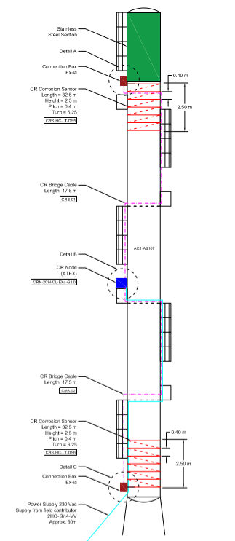
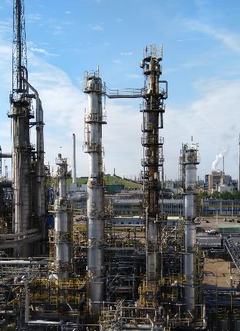
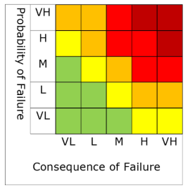
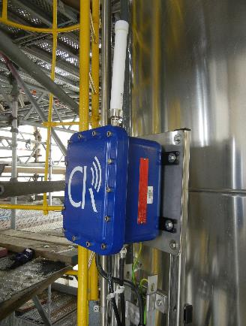
Production column – Asset LTCO.
Problem – Accessibility causing high scaffolding costs of >$0.5M. Time based Inspection cycles of 6 years with localized CUI findings.
Asset Type:
Insulated CS Production Column.
CUI temperature range zones being 90 ºC to 180 ºC.
Hot insulation used without any coating.
Solution:
2 units of CUI monitoring systems CR LR to monitor 24/7.
Outcome and Benefits:
Risk Reduction in RBI (Very High to High).
Inspection Optimization – Only zones with higher CUI susceptibility are selected.
Use of rope access instead of scaffolding leads to lower working at height costs.
ROI
60% Savings

Slide 11
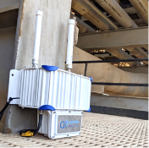
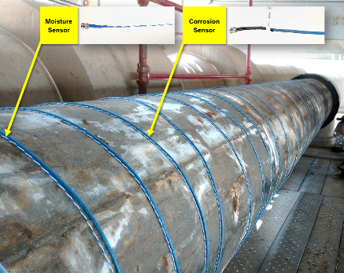
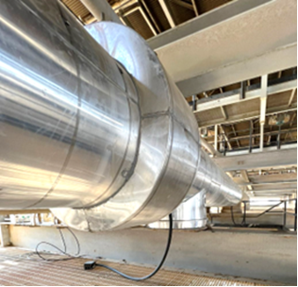
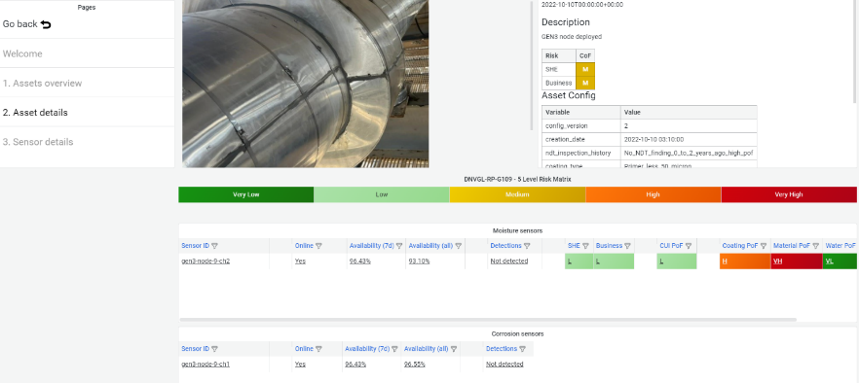
CS Propane refrigeration unit – Asset LTCO.
Problem​:
Insulated CS Protrusions (transient zone) must be inspected for CUI.
Insulated CS Pipe in intermittent service must be inspected for CUI.
Larger diameter insulated CS pipes in cold service can only be inspected when system is out-of-service by removal of insulation.
Asset Type​:
CS insulated pipes in refrigeration units and export pipelines.
Sub-zero temperature but in intermittent service.
Insulation: Closed cell structure insulation + vapour barrier.
Coating: Cold-service pipe is typically not coated.
Solution​:
1 unit of CUI monitoring systems per 100 meters.
Outcome and Benefits:
Risk Reduction in RBI (Medium to Low).
T&I scoping reduction to increase uptime due to availability of condition data.
Per day savings ~ $1M.
Source: CorrosionRADAR® Clarity Dashboard
ROI
60% Savings

Slide 12
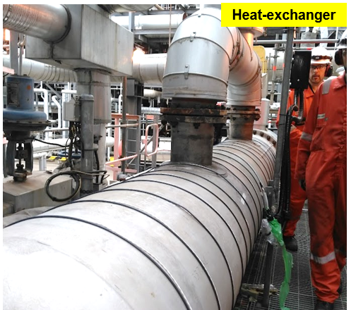
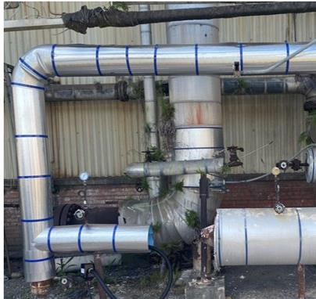
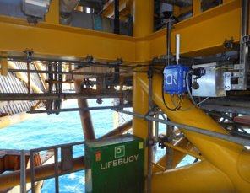
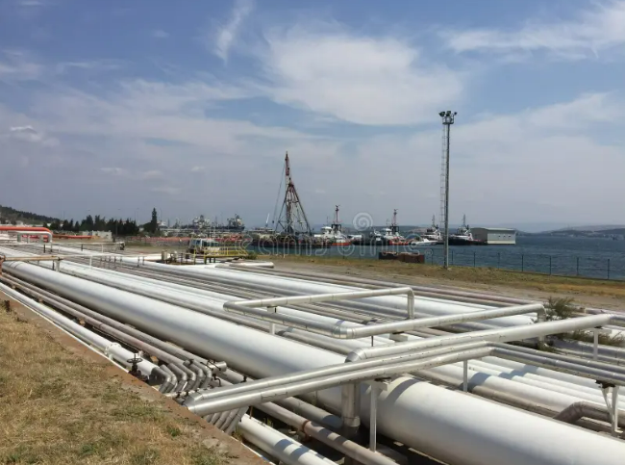
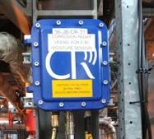
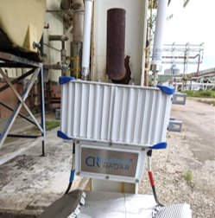
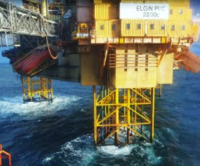
A wide range of applications.
Offshore
Loading/unloading marine terminal (example)

Slide 13
considerations from an independent Consultant (KAI-Con) perspective:
24/7 CUI monitoring of the equipment ’s Mechanical Integrity during the Asset Life Cycle will set the next step in CUI mitigation.
WHY IS THAT IMPORTANT:
Within our Industry we must improve Process Safety performance, we must reduce CUI Incidents.
Cost position / managing budgets is important. Repair will improve the Mechanical Integrity, Inspection will only monitor.
By having 24/7 monitoring systems installed:
A larger petrochemical company, expect to eliminate 3 incidents in the next 10 years for selected equipment, based on continuous ageing and incidents from the past.
Mitigation of Incidents is costly. Including production losses expect $100k to > $7000k per single serious incident.
Per equipment ID, the expected inspection and repair cost avoidance over a 10 – 20 year period can be $100k -$1000k.
Ballpark numbers on installation in a larger petrochemical company:
Based on favorable risk reduction this company can install in each (hydrocarbon) individual plant appr. 50 – 70 systems .
Economics are in favor to install another 100 to 300 systems more, within this company.

Slide 14
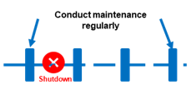
Operate to Failure
Time Based / Condition Based Inspection
Risk Based Inspection
24/7 monitoring
Optimisation of Inspection and Maintenance Costs
Total Cost
Repair costs
Repair costs
Repair costs
TOTAL costs
Capital + yearly service cost
Repair costs
Repair cost
Insp.
Insp.
I
Insp.
Inspection Cost
Source: CorrosionRADAR® and KAI-Con

Slide 15
INVITATION:
Recently a Joined Industry Project (JIP) has started to develop a Recommended Practice how to design, install, use and maintain 24/7 CUI monitoring sensors.
Today’s members of this JIP are customers / clients from KAI-Con® or CorrosionRADAR®.
More information on this JIP and possible partnership can be given while:
Visiting the CorrosionRADAR® booth at the Jubcor 2024 exhibition hall.
Contact T. Knijff

Slide 16
JUBCOR
KAI-Con
2024
CONFERENCE & EXHIBITION
INNOVATIVE SOLUTIONS FOR CORROSION CHALLENGES
THANK YOU
Theo Knijff (KAI-Con)
Ex-Dow, Senior Asset Integrity Manager
Calle Cualquiera 123, Cualquier Lugar
Tel +31 6 10786912
Email: theoknijff@zeelandnet.nl

Slide 17
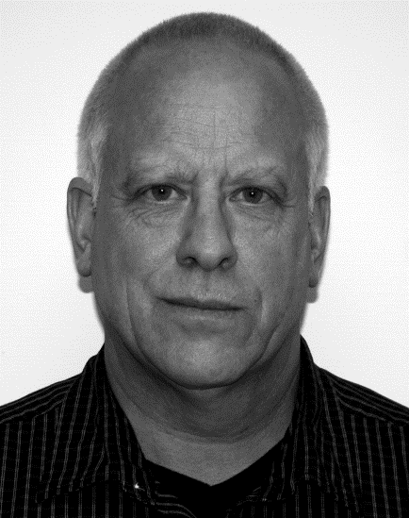
KAI-Con:
This company is a leading provider for Asset Integrity Consultancy within the Petrochemical Industry and provides services to:
Maximize the Mechanical Integrity / Reliability of all assets targeted.
Minimize Process Safety risks caused by unexpected (fixed) equipment failure.
Optimize Inspection and /or Repair Strategies for Fixed Equipment during daily maintenance and turnarounds.
Biography Theo Knijff
March 2024 – Now: Owner and founder of KAI-Con.
Dec 2020 – Sept 2023: Senior Asset Integrity Manager Dow Hydrocarbons.
Apr 2007 – Dec 2020: Senior Reliability Manager Dow Hydrocarbons.
Apr 2003 – Apr 2007: Maintenance Manager Dow Octene1 Project, Spain
Sept 1996 – Apr 2003: Reliability Manager Dow Styrene.
Sept 1992 – Sept 1996: Production Engineer Dow Styrene.
Feb 1987 – Sept 1992: Production Engineer Dow Polyurethane.
Jan 2013 – Sept 2023: Chair of the EEPC Maintenance Issue Group.
Mar 2013 – Nov 2016: Director of KIC|MPI in Terneuzen, The Netherlands.

