Slide 1
JUBCOR
2024
CONFERENCE & EXHIBITION
INNOVATIVE SOLUTIONS FOR CORROSION CHALLENGES
Presented By: Mazen Bahuwayni
Jubcor Presentation
SAUDI ARAMCO BASE OIL COMPANY – LUBEREF
Corrosion Control Document- Vacuum Distillation Unit (VDU)

Slide 2
Overview
CORROSION MANAGEMENT PROGRAM
VACUUM DISTILLATE UNIT
Executive Summary
Existing Refinery
Process Description
Major Corrosion Challenges
Corrosion Loops & Damage Mechanism
Corrosion Risk Assessment
Corrosion Control Methods
Inspection Plan
Corrosion Monitoring
Process Fluid Sampling
IOWs
CMP Dashboard & KPIs

Slide 3
CORROSION MANAGEMENT PROGRAM
VACUUM DISTILLATE UNIT
PCLs
Dominant
Damage Mechanism
Major Corrosion Challenge
RBI Highlight
Corrosion Monitoring & IOW
Revision of PCLs
PCLs in VDU: 18 Nos
Sulfidation
Naphthenic Acid Corrosion NAC
NH4HS Corrosion
Erosion Corrosion
Sulfidation in Pre-Heat exchangers
NAC in Over flash Side Cut
NH4HS Corrosion in Stripper Feed HE
Erosion Corrosion in Vacuum Tower Inlet
MH Risk Equipment – 3
RBI for PCL Not evergreened
Revised PCL to be used in RBI
No Online Monitoring – At present
Recommended areas for Minoring- 2
New Process Sampling established
IOW established
Executive Summary
Key Initiatives & Recommendations
Assessing and monitoring the Major Corrosion Challenges
Monitoring the Important Process & Operation Parameters
Effective implementation of the identified process sampling, Integrity Operating Window (IOW) and KPI
To deploy and install Online Non-Intrusive Probes at Critical Locations Planned to be installed in the Coming TA
Proposed to Purchasing Separate Platform to Monitor IOWs
The RBI study for PCL should be Ever-greened using new identified CL
Mitigation plan has to be in place for MH risk equipment and to implement the RBI recommendation.

Slide 4
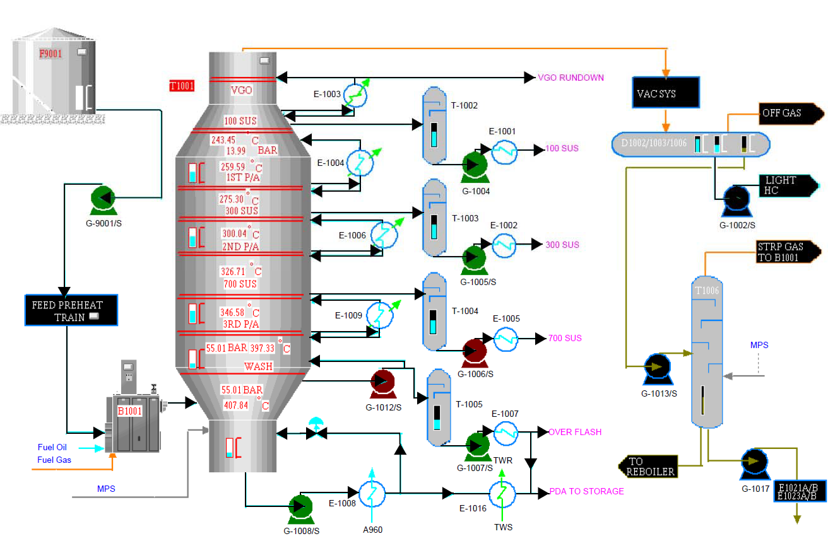
CORROSION MANAGEMENT PROGRAM
VACUUM DISTILLATE UNIT
Simple Process Flow Diagram
ARAMCO
Process Description
RCO Feed Stock

Slide 5
CORROSION MANAGEMENT PROGRAM
VACUUM DISTILLATE UNIT
E-1002A – CS tube bundle suffered Sulfidation. In 2011 Upgraded to 5Cr, then replaced again in 2018 with in-kind material
Vacuum Column 700 Distillate Side Cut – From T-1001 bed#7 to T-1004 and to then next exchanger the connecting pipelines are 5Cr. In 2020, UT survey revealed erosion corrosion in T-1004 outlet piping section after G-1006.
1
5
Sulfidation
Erosion Corrosion
Major Corrosion Challenges
Over flash Line – 9Cr from T-1001 to T-1005 and 5Cr from T-1005 to E-1007A. Complete 9Cr and 5Cr lines are replaced in 2014-2015 due to high corrosion. In 2018, high corrosion found in 5Cr and acceptable corrosion rate in 9Cr. Now all lines replaced to 9Cr
E-1021A – Tube side – sour water (mix of VDU OH and MLDW sour water). CS tube bundle replaced in 2011 due to internal corrosion. Repeated fouling and plugging was reported. Deposit was analyzed and revealed the presence of chloride and ammonium with sulfur.
2
Major Corrosion Challenges
6
NAC & Sulfidation
NH₄CL & NH₄HS
E-1007A – In 2011 high corrosion rate was reported in the tube bundle (SA268 TP410) and channel head inlet location. The corrosion is anticipated might be due to crude change between 2011 & 2013. In 2018, re-tubing done for top row tubes.
E-1008C (5Cr) – Commissioned in 2013, in 2013 tube inspection reported high thickness reduction. MFL reported external pitting corrosion. Shellside fluid is VTB which has high sulfur content. So, it is recommended to evaluate and consider material upgrade to 9Cr.
NAC & Sulfidation
Sulfidation
7
3
Erosion Corrosion
Sulfidation
E-1020A (Brass tubes) – Top three rows suffered severe external corrosion due to hydro-carbon impingement. Exchanger is fixed bundle type so internal inspection can’t be done.
E-1009C (SS410) – Commissioned in 2013, in 2018 tube inspection reported 43% wall loss. Shellside operating temp around 340-380°C and process fluid is Feed.
4
8

Slide 6
CORROSION MANAGEMENT PROGRAM
VACUUM DISTILLATE UNIT
Crude Feed Sulfur (wt%)
Unit Feed Rate (m3/hr)
T-1001 Overhead Accumulator sour PH, Cl, H₂S & Fe counts3/hr.
Heater B-1001 COT (DegC)
TAN in the Over flash Stream
Essential Process Parameters
Trending of Critical Process Variable
PH: The overhead PH is controlled in the range from 5.5 -6.5 and normally it is maintained and rarely deviation occurred. No impact in the OH system integrity reported in the previous inspection.

Slide 7
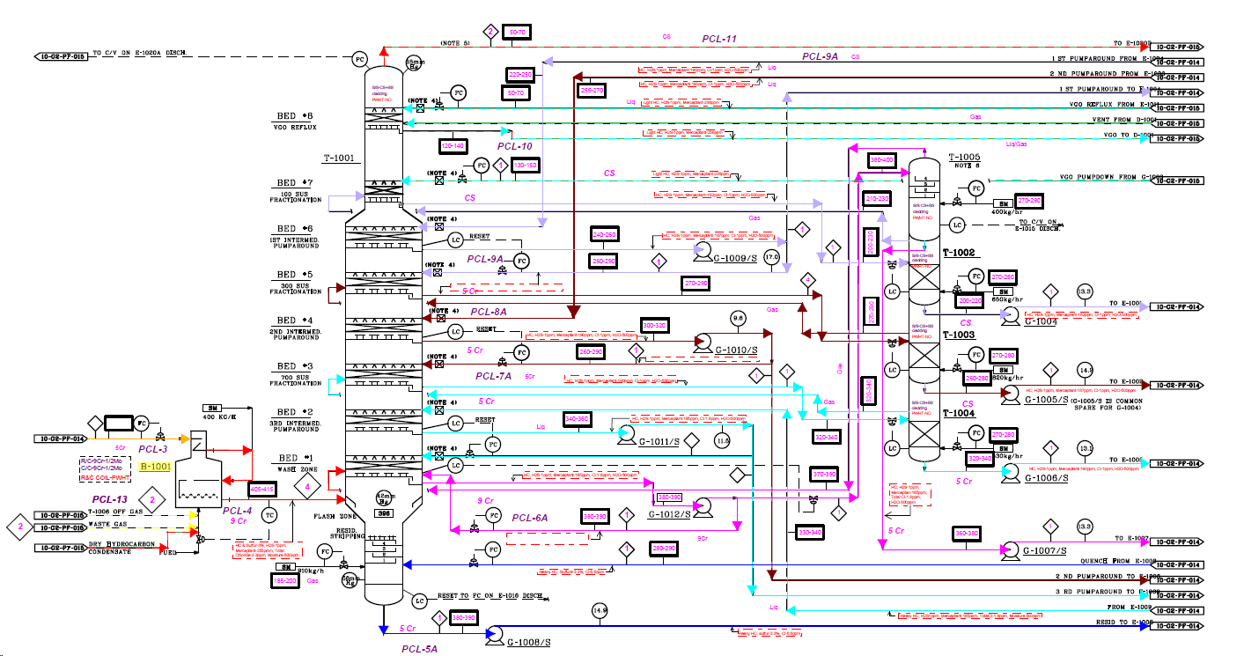
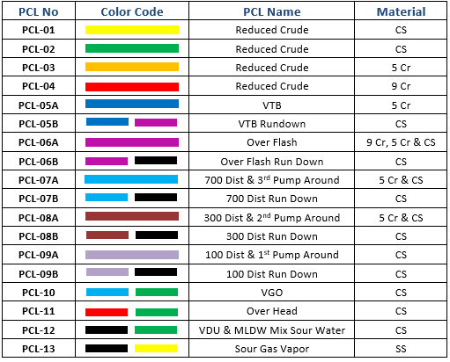
Total no. of Corrosion Loops - 18
CORROSION MANAGEMENT PROGRAM
VACUUM DISTILLATE UNIT
Corrosion Loop Identification and Marking
Corrosion Loops

Slide 8
Total no. of Corrosion Loops - 19
CORROSION MANAGEMENT PROGRAM
VACUUM DISTILLATE UNIT
Corrosion Loop Identification and Marking
Loop Boundary
Material of construction for equip & piping (HIC, PWHT,Insul & Damage mechanism #)
Description of damage mechanism and cause
Key Parameter & corrosion monitoring
Corrosion Loops
Slide 23

Slide 9
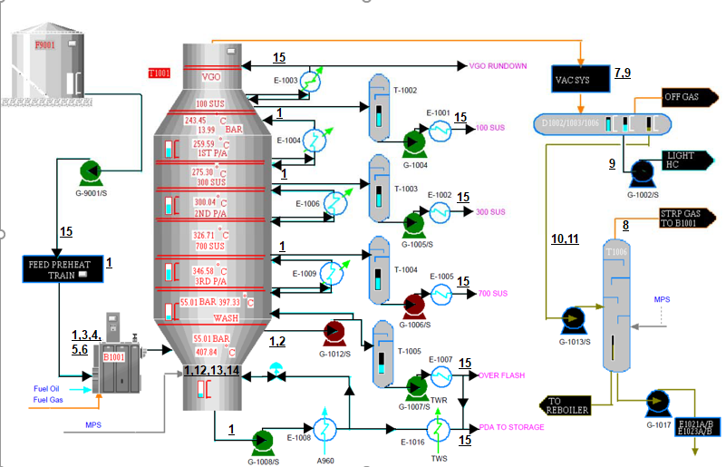
CORROSION MANAGEMENT PROGRAM
VACUUM DISTILLATE UNIT
Identified Damage Mechanism
Sulfidation
NAC
Localized Overheating
Creep
Softening
Refractory Damage
HCL Corrosion
CL-SCC
Wet H2S DM HIC, SOHIC & SSC
Sour water corrosion
NH4HS
Erosion Corrosion
Vibration induced Fatigue
885(F) or 475(C) Embrittlement
CUI
Damage Mechanism

Slide 10
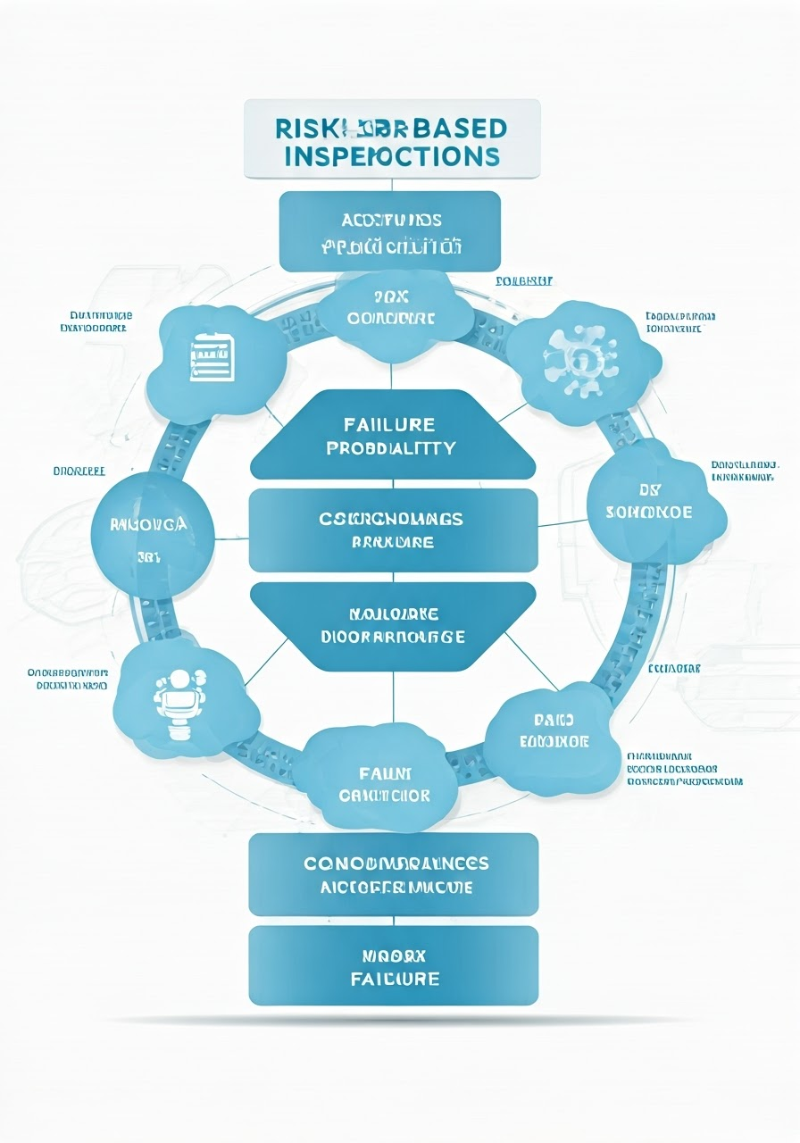
CORROSION MANAGEMENT PROGRAM
VACUUM DISTILLATE UNIT
Equipment Risk Ranking
Item # | Equipment # | Description | Due for Inspection | Risk Ranking |  | Damage Mechanism
 |  |  |  | HSE Risk Rank | Business Risk Rank
1 | E-1002A | A960 Charge/100 SUS Distillate Exchanger | Dec,2021 | Dec,2021 | Medium | Localized corrosion for tubes
2 | E-1008B | A960 Charge/VR Exchanger | Apr,2022 | Apr,2022 | Medium | Sulfidation for Tube side ID & OD
3 | E-1009C | 3rd Intermediate Pump Around Heat Exchanger | Jun,2022 | Jun,2022 | Medium | Localized corrosion for tubes
Corrosion Risk Assessment
PCL Risk Ranking
Item # | PCL # | Description | Risk Ranking
 |  |  | HSE Risk Rank | Business Risk Rank
1 | PCL#7 | VDU Overhead & VGO | High | Medium High

Slide 11
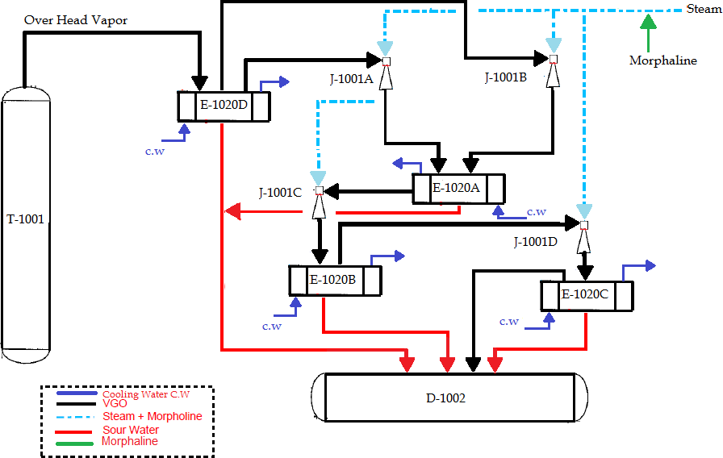
Chemical Injection
CORROSION MANAGEMENT PROGRAM
VACUUM DISTILLATE UNIT
2.5 liter / hr of Morpholine is injected in the medium stream line entering into the vacuum ejector J‐1001 A/B/C/D to maintain the pH around 6.5 in the sour water feed to T‐1006. Sample collection at E‐1021 is done on daily basis to ensure the pH is around 5.5‐6.5 which also ensures that the dosing adequate.
Corrosion Control Methods
PFD No | Stream No/ Equipment Tag | Location | Chemical | Status
10‐G2‐PF‐015 | Medium Stream | Stream entering to vacuum ejectors J‐1001 A/B/C/D | Morpholine | Active

Slide 12
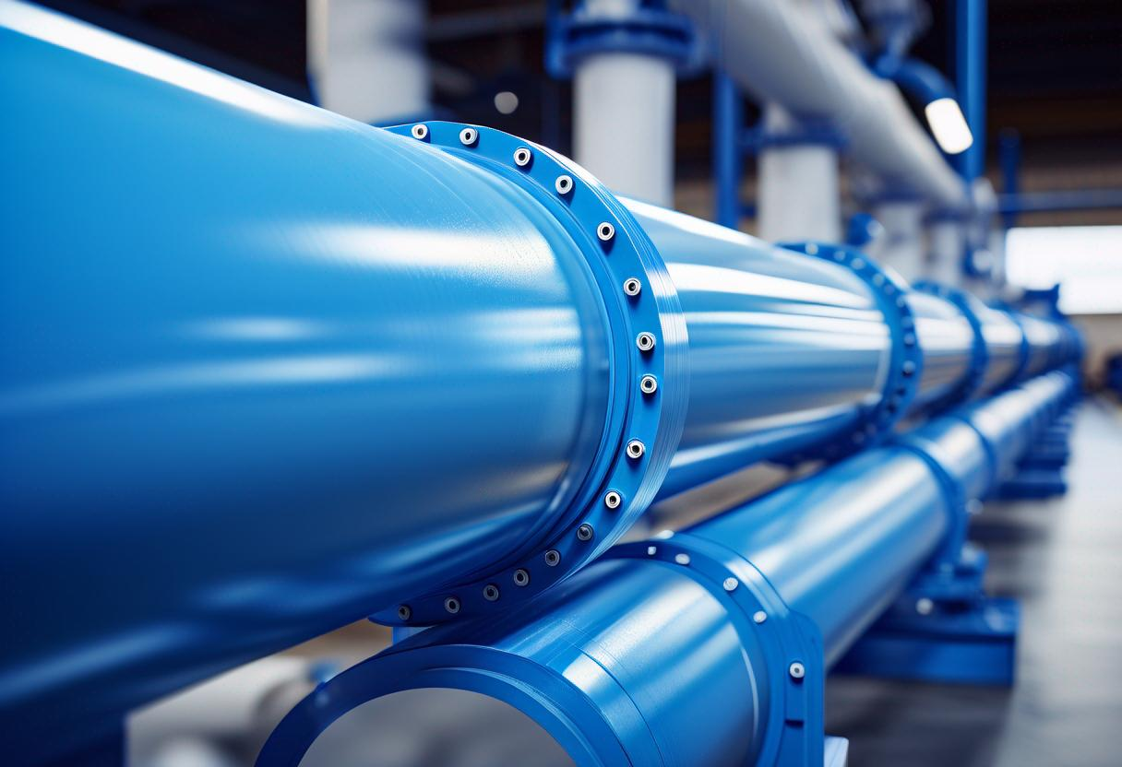
Coating & Internal Lining
CORROSION MANAGEMENT PROGRAM
VACUUM DISTILLATE UNIT
All equipment and piping are coated as per SAES-H-001 “Coating Selection and Application Requirements for Industrial Plants and Equipment” and SAES-H-002 “Internal and External Coating for Steel Pipelines and Piping”
Corrosion Control Methods
Equipment # | Description | Internal Surface | Component | Service
E‐1020A | 1st Stage Condenser | Coated | Channel Head | Cooling water
E‐1020B | 2nd Stage Condenser | Coated | Channel Head | Cooling water
E‐1020C | 3rd Stage Condenser | Coated | Channel Head | Cooling water
E‐1020D | Pre Condenser | Coated | Channel Head | Cooling water
E‐1024 | Seal Water Cir. Cooler | Coated | Channel Head | Cooling Water
T‐1001 | Vacuum Tower | SS 410 Cladded | Shell, Dish & Nozzle | Reduced Crude
T‐1002 | 100 SUS Dist. Stripper | SS 410 Cladded | Shell, Dish & Nozzle | 150 Distillate Cut
T‐1003 | 300 SUS Dist. Stripper | SS 410 Cladded | Shell, Dish & Nozzle | 300 Distillate Cut
T‐1004 | 700 SUS Dist. Stripper | SS 410 Cladded | Shell, Dish & Nozzle | 700 Distillate Cut
T‐1005 | Over Flash Stripper | SS 410 Cladded | Shell, Dish & Nozzle | Over flash Product
T‐1006 | Sour Water Stripper | SS 304 Cladded | Shell, Dish & Nozzle | Sour Water

Slide 13
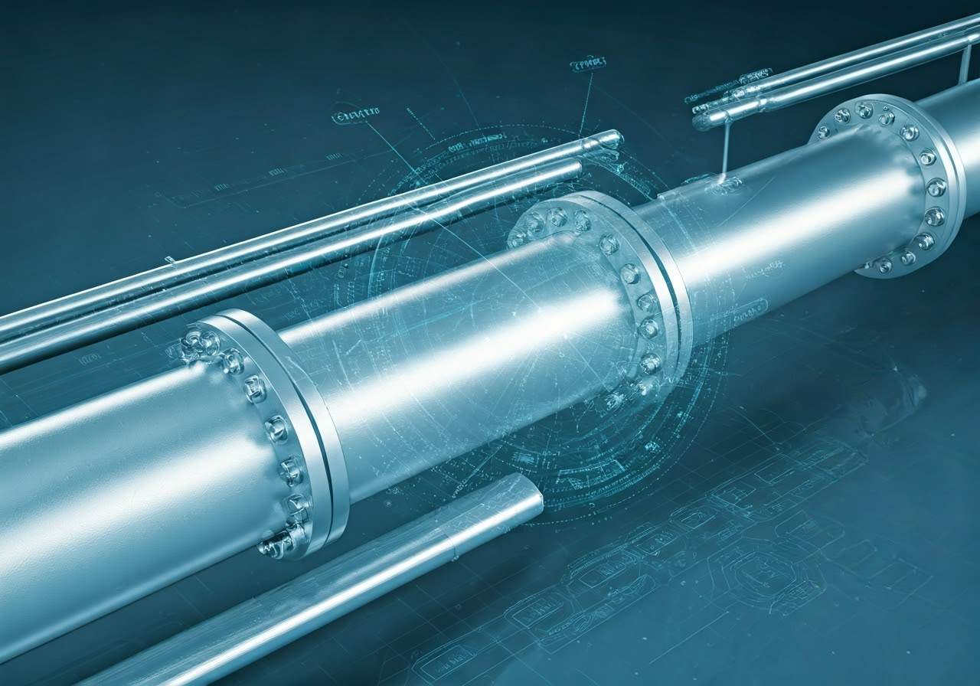
Cathodic Protection
CORROSION MANAGEMENT PROGRAM
VACUUM DISTILLATE UNIT
C.P surveys are being done according to Luberef’ s procedure lub-CP-001 which is prepared based on SAES-X-400 & SAES-X-600
C.P For Piping
Corrosion Control Methods
Sl.No | Pipe Line Details | C.P System | Test Station No | Status | Remark
1 | 10WFA‐1000‐6”‐DAA40 | Sacrificial Anode | T‐1 | Protected | Depleted Anode replaced in 2021
2 | UG Line from G‐1008/S to MH 104 | Sacrificial Anode | T‐2 | Protected | Depleted Anode replaced in 2021
3 | 90-WFU-9602-6"-DAA40 | Sacrificial Anode | T-4 | Protected | Depleted Anode replaced in 2021
4 | 90-WFU-9603-6"-DAA40 | Sacrificial Anode | T-5 | Protected | Depleted Anode replaced in 2021
C.P Equipment
Sl. No | Equipment# | Description | Service | Type of Anode | Location | Remark
1 | E‐1020A | 1st Stage Condenser | Cooling Water | Mg | Inside Channel Head | Replaced in Last TA2019
2 | E‐1020B | 2nd Stage Condenser | Cooling Water | Mg | Inside Channel Head | Replaced in Last TA2019
3 | E‐1020C | 3rd Stage Condenser | Cooling Water | Mg | Inside Channel Head | Replaced in Last TA2019
4 | E‐1020D | Pre Condenser | Cooling Water | Mg | Inside Channel Head | Replaced in Last TA2019
5 | E‐1024 | Seal Water Cir. Cooler | Cooling Water | Mg | Inside Channel Head | Replaced in Last TA2019

Slide 14
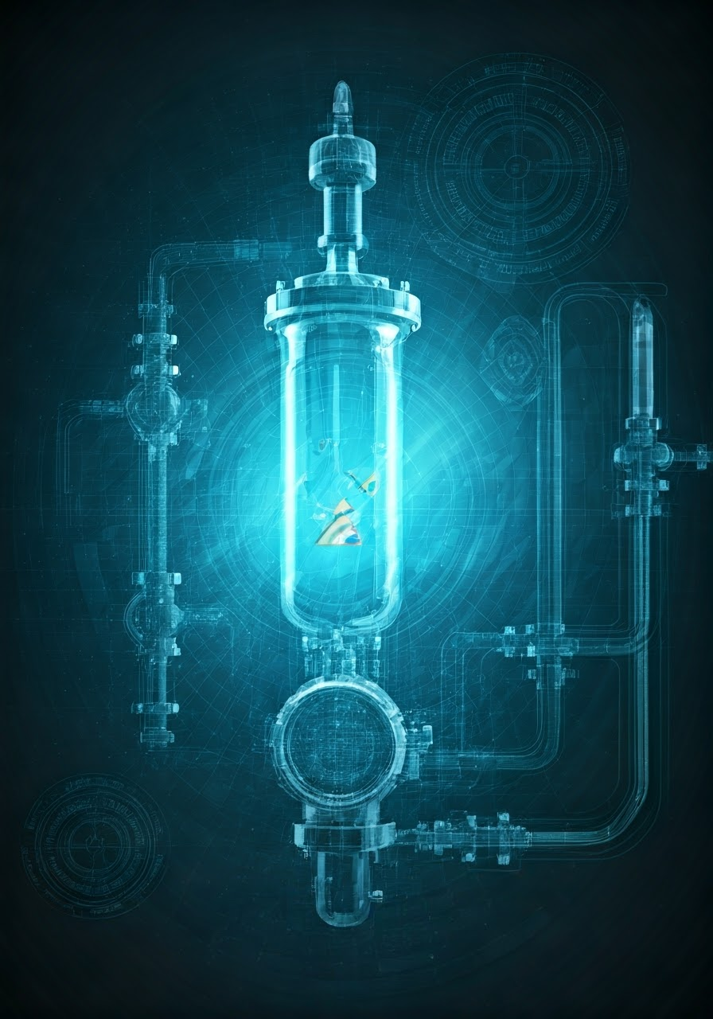
Inspection Plan
CORROSION MANAGEMENT PROGRAM
VACUUM DISTILLATE UNIT
On-stream Inspection is a non-intrusive inspection performed using NDT to establish the suitability of the equipment and piping for continued operation.
The frequency of the inspection for equipment and piping are as per RBI study.
Equipment IP
Inspection Plan
Sl. No | Equipment# | LID | Interval (Years)
 |  |  | EIS | RBI
1 | B-1001 | Nov-22 | 5 | 1.3
2 | D-1001 | Nov-13 | 5 | 12
3 | D-1002 | Mar-19 | 5 | 5
4 | D-1003 | Mar-19 | 5 | 5
5 | D-1004 | Nov-13 | 5 | 12
6 | D-1005 | Nov-13 | 5 | 12
7 | D-1006 | Mar-19 | 5 | 5
8 | E-1001A | Mar-19 | 5 | 3.9
Piping Corrosion Loop IP
Sl. No | PCL# | LID | Interval (Years)
 |  |  | OSI | RBI
1 | PCL#1 | Jan‐14 | 5 years | 3 years
2 | PCL# 2 | Jan‐14 | 5 years | 3 years
3 | PCL# 3 | Jan‐14 | 5 years | 12 years
4 | PCL# 4 | Jan‐14 | 5 years | 3 years

Slide 15
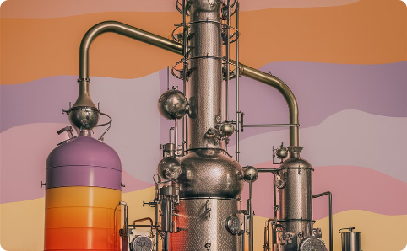
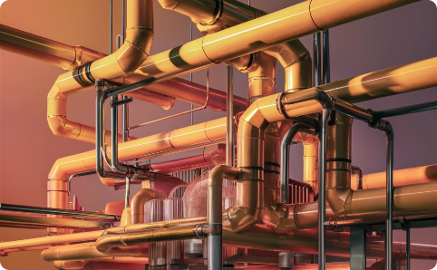
CORROSION MANAGEMENT PROGRAM
VACUUM DISTILLATE UNIT
Corrosion Monitoring
VDU relies on OSI and process sampling for corrosion monitoring, as there are no online corrosion monitoring devices installed.
Corrosion Monitoring
Vacuum Tower Overhead
Over Flash Side Cut Stream
The vacuum tower overhead is a critical unit area under frequent corrosion monitoring.
The over flash side cut stream is also a critical unit area that requires frequent corrosion monitoring.

Slide 16
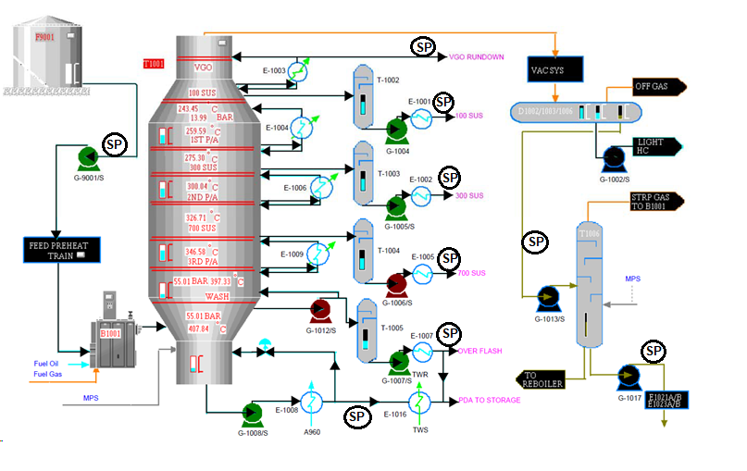
CORROSION MANAGEMENT PROGRAM
VACUUM DISTILLATE UNIT
Proposed Sample Analysis
Sr. No. | Stream | Analysis | Monitoring Scope | Frequency
1 | Reduced Crude (Feed) | Total sulfur | 3.8 % Max | Daily
 |  | Mercaptant | N/A | Monthly
2 | Over flash | Sulfur | <3.5 wt% | Monthly
 |  | Mercaptant | N/A | Monthly
 |  | TAN | 0.5 KOH/mg | Monthly
3 | 700 distillate | Sulfur | <3 wt% | Monthly
 |  | Mercaptant | N/A | Monthly
4 | 300 distillate | Sulfur | <2.5 wt% | Monthly
 |  | Mercaptant | N/A | Monthly
5 | 100 distillate | Sulfur | <2.5 wt% | Monthly
 |  | Mercaptant | N/A | Monthly
6 | Vacuum Tower Bottom | Sulfur | <3.5 wt% | Monthly
 |  | Mercaptant | N/A | Monthly
7 | T-1001 OH Sour Water | Fe | <1 ppm | Weekly
 |  | PH | 5.5-6.5 | Daily
 |  | CL | <30 ppm | Weekly
8 | MLDW Sour Water | NH3 | <100 ppm | Monthly
 |  | CL | <50 ppm | Monthly
 |  | PH | >5.5 | Weekly
9 | VGO | Sulphur | <2.5 wt% | Monthly
 |  | Mercaptant | N/A | Monthly
 |  | Moisture | N/A | Monthly
10 | Stripped Sour Water | PH | 7-9 | Daily
Process Fluid Sampling

Slide 17
Integrity Operating Window (IOW)
CORROSION MANAGEMENT PROGRAM
VACUUM DISTILLATE UNIT
Several Integrity Operating Windows (IOWs) have been identified for VDU. These IOWs includes process variables with established limits, measurement method, frequency, category, urgency, consequence and required action to remedy they deviation.
Below are the few sample of IOW
Sr. No | Variable | Tag | Min Limit | Max Limit | Unit | Data Source | IOW Category | Frequency Monitoring Level | Possible Consequence of Deviation Outside Limit | Response Required /Recommended | Response Owner
1 | B-1001 Inlet Flow | 10FI1234 | 180 | 256 | M3/Hr | DCS (PI) | Standard | Continuously | 1) Low flow decrease the flow velocity causes coke on the heater tubes and localize overheating. 2) High flow increase the flow velocity leading to erosion /corrosion on the heater tubes | 1) a- Increase the inlet flow by opening the pre-heat exchanger bypass valve. B- Pump G-9001/s switches over in case of fouling on the exchanger E-1008 or choking on the discharge line 2) Control the charge pump G-9001/s kick back pressure in order to minimize the inlet pressure | 1) Operation & Process 2) Operation & Process
2 | B-1001 Skin Temp | 10TI1469, (all eight tags) | NA | 584 | Deg C | DCS (PI) | Critical | Continuously | 1) Creep localise overheating 2) Tube rupture | 1) Reduce the firing and maintain the COT 2) Increase the propane gas flow from Utility/Offsite
3 | B-1001 COT | 10TIC1101 | NA | 408 | Deg C | DCS (PI) | Standard | Continuously | 1) Increase the corrosion rate(sulfidation corrosion) 2) Coke formation inside the tubes 3)Increase in vaporization rate inside the vacuum tower | 1) Control the firing 2) Decoking shall be performed if temp profile is not improved 3) Pass flow control valves shall be verified and calibrated if required 4) Quality of the feed need to be verified | 1) Operation & Process 2) Operation & Process 3) Operation, Instrument & Process 4) Operation & Process
Integrity Operating Windows

Slide 18
Integrity Operating Window (IOW)
CORROSION MANAGEMENT PROGRAM
VACUUM DISTILLATE UNIT
Sr. No | Variable | Tag | Min Limit | Max Limit | Unit | Data Source | IOW Category | Frequency Monitoring Level | Possible Consequence of Deviation Outside Limit | Response Required /Recommended | Response Owner
4 | B-1001 Pass#1 Temp | 10TI1406 | NA | 422 | Deg C | DCS (PI) | Standard | Continuously | 1) Increase the corrosion rate(sulfidation corrosion) 2) Coke formation inside the tubes 3)Increase in vaporization rate inside the vacuum tower | 1) Control the firing 2) Decoking shall be performed if temp profile is not improved 3) Pass flow control valves shall be verified and calibrated if required 4) Quality of the feed need to be verified | 1) Operation & Process 2) Operation & Process 3) Operation, Instrument & Process 4) Operation & Process
5 | B-1001 O2 | 10AI1011.PV | 2.5 | NA | % | Manual | Critical | Continuously | 1. incomplete combustion (can lead to explosion) | 1) Control the firing, draft, air flow 2) Reduce Feed rate. | Operation
6 | B-1001 Arch Temp -1 | 10TI1123.PV | NA | 850 | Deg C | Lab | Critical | Continuously | Damage the Refractory causing hotspot in the casing | 1) Control the firing | Operation & Process
7 | Sulfur in the feed | lab tag | NA | 3.8 | % | Lab | Informational | Daily | Increase the corrosion rate (sulphidation corrosion) Off spec MHFO product | Communicate with Feed supplier to control Sulphur in feed | Process, Production planning
8 | Mercaptant in the feed | lab tag | NA |  |  | Lab | Informational | Monthly | Increase the corrosion rate (sulphidation corrosion) | corrosion assessment | Inspection
9 | Overflash cut temp | 10TI1439 | NA | 386 | Deg C | Lab | Standard | Continuously | Increase the corrosion rate (sulphidation corrosion) | Control Tower T1001 temperature | Operation /Process
10 | Overflash cut Flow rate | 10fi1103 | 50 | 57 | M3/hr |  | Standard | Continuously | 1) Increase the corrosion rate (sulphidation corrosion) 2) Increase the erosion rate 3) Lo flow- settlement causing under deposit corrosion | Control Overflash flow and 3rd pump down flow control. Check control valve operation | Operation /Process
11 | Overflash Total Acid No (TAN) | lab tag | NA | 0.5 | KOH/mg |  | Informational | Monthly | Increase the corrosion rate (sulphidation and Napthalic acid corrosion) | Corrosion assessment | Inspection
12 | Overflash Sulfur | lab tag |  |  |  |  | Informational | Monthly | Increase the corrosion rate (sulphidation corrosion) | Corrosion assessment | Inspection
Integrity Operating Windows

Slide 19
Integrity Operating Window (IOW)
CORROSION MANAGEMENT PROGRAM
VACUUM DISTILLATE UNIT
Sr. No | Variable | Tag | Min Limit | Max Limit | Unit | Data Source | IOW Category | Frequency Monitoring Level | Possible Consequence of Deviation Outside Limit | Response Required /Recommended | Response Owner
14 | T-1001 Overhead PH | lab tag | 5.5 | 6.5 | PH |  | Standard | Daily | Increase the overhead HCL corrosion | Adjust chemical treatment program | Operation /Process
15 | T-1001 Overhead Chloride | lab tag | NA | 30 | PPM |  | Standard | weekly | Increase the overhead HCL corrosion | 1. Adjust chemical treatment program 2. Check integrity of CW condenser tubes | Operation /Process/ Inspection
16 | T-1001 Overhead Total Iron | lab tag | NA | <1 | PPM |  | Standard | weekly | Increase the overhead HCL corrosion | 1. Adjust chemical treatment program 2. Corrosion assessment | Operation /Process/ Inspection
17 | Neutraliser (T-1001 Overhead) |  |  |  |  |  | Standard | Continuously | Increase the overhead HCL corrosion and formation of Amine bi-chloride salts | Adjust chemical treatment program and check pump flowrate
18 | T-1006 Bottom PH | lab tag | 7 | 9 | PH |  | Standard | Daily | Increase the corrosion rate (NH4HS corrosion - Ammonium bi sulphide) | Increase stripping steam | Operation / Process
19 | D-5015 Chloride | lab tag | NA | 50 | PPM |  | Informational | Monthly | Chloride stress corrosion cracking in T-1006 overhead piping system.
20 | D-5015 Ammonia | lab tag | NA | 50 | PPM |  | Informational | Monthly | Increase the corrosion rate (NH4HS corrosion - Ammonium bi sulphide)
21 | B-1001 Draft | 10PI1013 | NA | 3 | mmH2o |  | Critical | Continuously | 1)Backfire through peep window 2)Flame impingement leading to Hotspots | 1) Adjust Draft Damper and Air Flow. 2) Check Tube leak | Operation / Process
22 | T-1001 Overhead Pressure | 10PIC1059 | 10 | NA | mbar |  | Critical | Continuously | Tower buckling | 1) Check Feed rate, 2) Check vacuum Control 3) Check Steam Flow | Operation / Process
23 | T-1006 Bottom Temperature | 10TIC1488 | 110 | 125 | Deg C |  | Standard | Continuously | 1) no proper stripping of H2s leading to Corrosion in the bottom 2) High vaporization leading to increase in corrosive component in tower bottom | 1) adjust Steam flow | Operation / Process
Integrity Operating Windows

Slide 20
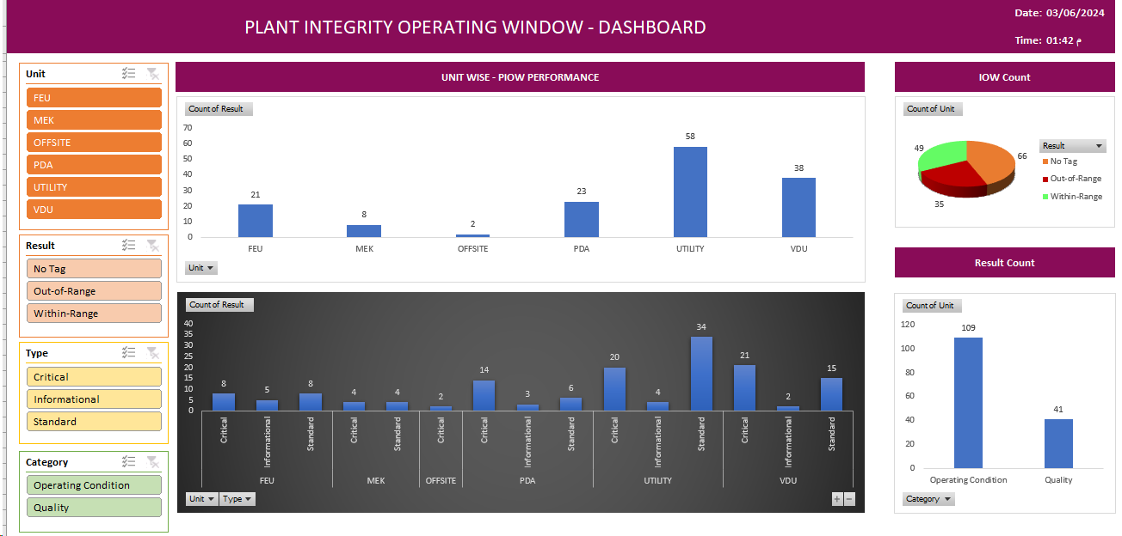
Dashboard & KPIs
CORROSION MANAGEMENT PROGRAM
VACUUM DISTILLATE UNIT
The dash board provide a list of specific key performance indicator (KPIs) through the relevant monitoring systems to adequately manage corrosion performance at Luberef VDU . Compliance and deviation, pertinent to each performance measure could be illustrated through a traffic light system.
CMP Dashboard & KPIs

Slide 21
CORROSION MANAGEMENT PROGRAM
VACUUM DISTILLATE UNIT
Key Recommendations
RBI Assessment & Corrosion loops
Evergreened RBI for PCL
Consider New identified CL in the CCD with DM
CMP Deployment
Effectively process sampling
Corrosion Monitoring Devices
Integrity Operating Window (IOW) & Dashboard
High Temp Sulfidation corrosion
E-1008C Tube side corrosion VTB stream
Over flash side cut piping & Tube side of E-1007A
Vacuum Tower Overhead System
Over flash side Cut
Invest in dedicated Platform for efficient implementation and follow up of IOW.
Corrosion monitoring for 700 cut piping downstream of the T-1004 stripper
Follow the recommendations from the SA technical alert for high-temperature sulfidation corrosion for low-silicon carbon steel (Si< .1) piping like A53
Assessment for The 5 Cr tube bundle was installed in 2013 that tube inspection exhibited high corrosion rate In 2019.
Engineering evaluation to be carried out for identifying the root cause of high corrosion rate in the over flash side cut in both 9 Cr & 5 Cr piping.
Integrity Operating Window (IOW) & Dashboard.
Recommendations

Slide 22
JUBCOR
2024
CONFERENCE & EXHIBITION
INNOVATIVE SOLUTIONS FOR CORROSION CHALLENGES
THANK YOU
Reach out.
phone:
00966122296594
Email:
BahuwayniM@luberef.com

Slide 23
