Slide 1
JUBCOR
2024
CONFERENCE & EXHIBITION
INNOVATIVE SOLUTIONS FOR CORROSION CHALLENGES
Presented By: Anis Ziani
Faris Al-Adainan
Corrosion Assessment of LDPE Reactor Tube

Slide 2
Contents
Introduction
Process Description
LDPE Reactor HP Tubes Design
Inspection Results
Laboratory Analysis
Critical Crack Size Calculation
Conclusion
Recommendations

Slide 3
1. Introduction
Inspection of LDPE Reactor high pressure tubes during plant planned shutdown revealed internal localized corrosion on 13 out of 61 tested tubes.
Corrosion was confirmed by internal visual inspection using borescope and found mainly located in the unjacketed sections at the extremities of the tubes.
The corrosion mechanism is known by the plant licensor who confirmed that acid gases formed or introduced in the process may condense at unjacketed portions of the tube during shutdown periods and cause internal corrosion.
Considering the severe operating condition (300 °C and 3000 barg) and cyclic nature of the process, sharp edges and surface irregularities resulting from corrosion can initiate cracks that may propagate and lead to failure.
Failure analysis was carried out to verify the material properties, microstructure, validate the corrosion mechanism and identify possible initiation of cracks.
Fracture assessment and crack growth calculation were performed to determine the maximum allowable crack size and number of cycles before failure.

Slide 4
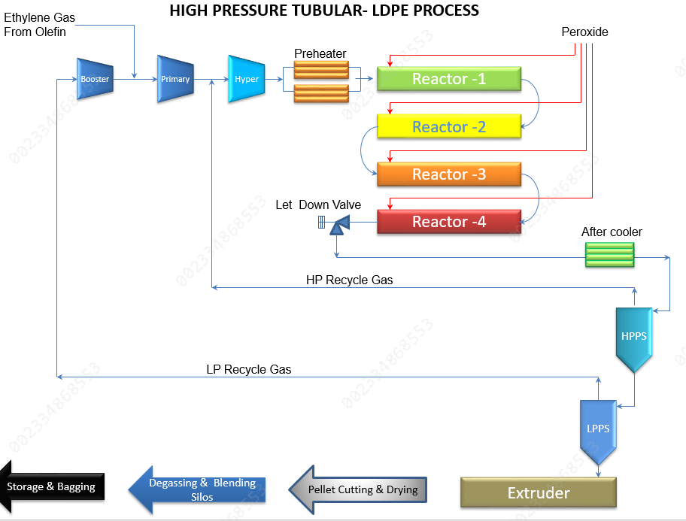
2. Process Description
LDPE is produced by a reaction which takes place in a Tubular Reactor comprising four zones.
Ethylene gas is heated, compressed and fed into reactor where the Polymerization reaction occur using Peroxide as initiator at higher pressure and higher temperature.
The reactor acts like a double pipe heat exchanger with the heat of reaction being removed by hot water, which flows through the outer jacket of the reactor pipe.
Polymerization requires propionaldehyde (PA) as modifier to achieve the appropriate product quality (density).
Figure 01: High Pressure Tubular LDPE Process

Slide 5
3. LDPE REACTOR HP TUBES DESIGN
LDPE Reactor tubes are made of high strength tempered alloy steel according to licensor proprietary specification which is a modified version of 30CrNiMo8 (1.6580) as per DIN EN 10083-3 standard.
The material has lower sulfur content and strength, and increased toughness compared with 30CrNiMo8. Chemical composition and mechanical properties are given in the following tables:
Table 01: Chemical Composition
Elements | C | Si | Mn | Cr | Mo | Ni | P | S
Conc.% | 0.26 to 0.34 | 0.4 Max | 0.3 to 0.6 | 1.8 to 2.2 | 1.9 to 2.5 | 1.8 to 2.2 | 0.035 | 0.005
Table 02: Mechanical Properties
Diameter (mm) | Yield limit min. (N/mm2) | Tensile Strength (N/mm2) | Elongation at break min. (%) | Cr | Notched impact energy min. (Joules) | Ni | Brinell Hardness (HB)
60 to 265 | 840 | 960 to 1160 | Longitudinal >16 | Transverse >14 | Longitudinal80 | Transverse60 | 0.035

Slide 6
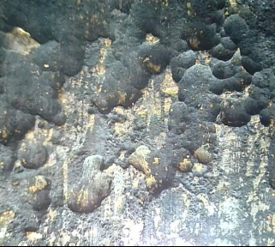
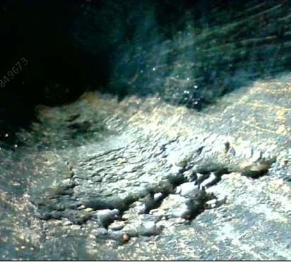
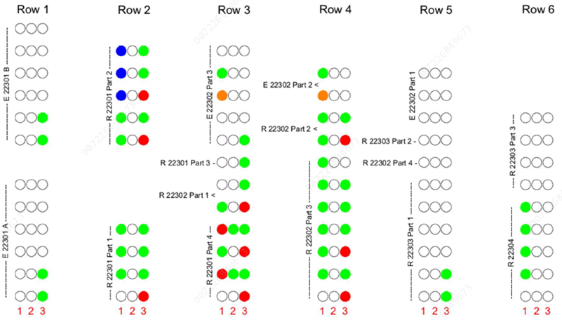
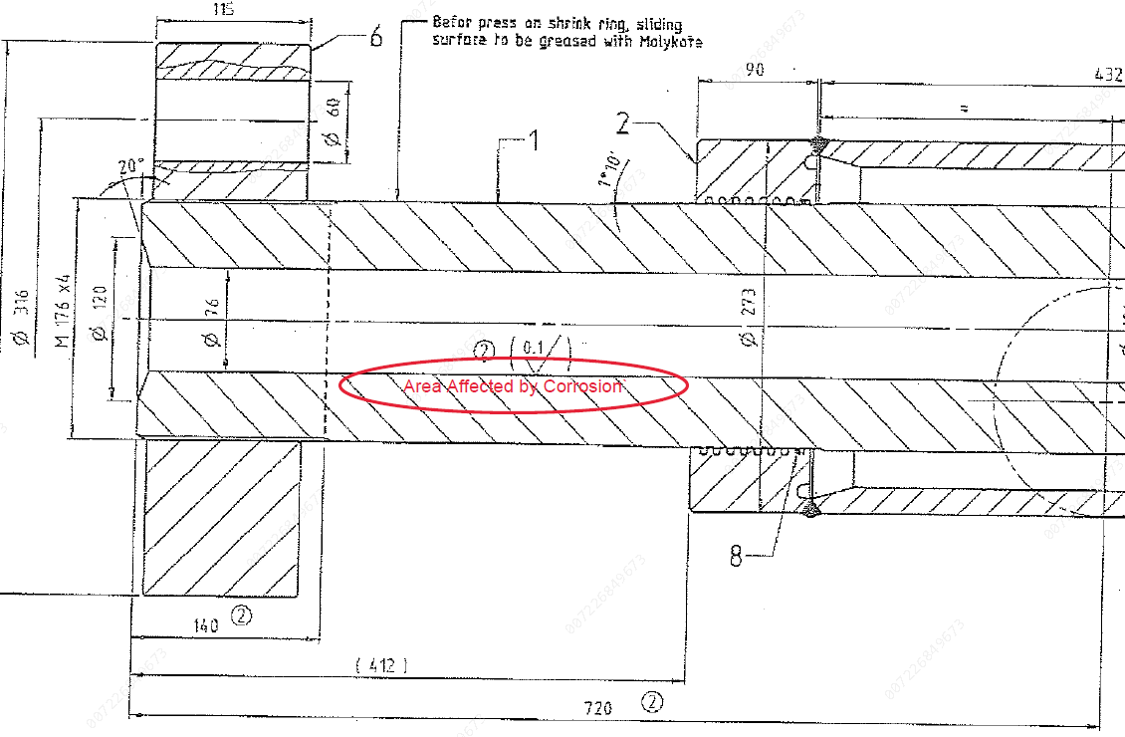
4. Inspection Results
ECT inspection was performed for 61 (32%) tubes out of 192. Localized internal corrosion causing thickness loss less than 2 mm was recorded on 13 out of 61 tubes. Borescope verification showed that the corrosion is mainly located at the bottom section of the unjacketed portion of the tubes.
Figure 02: Locations of the damaged tubes and position of the corrosion inside the tube

Slide 7
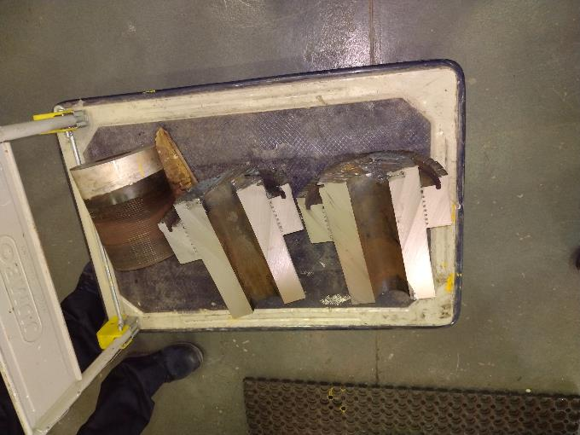
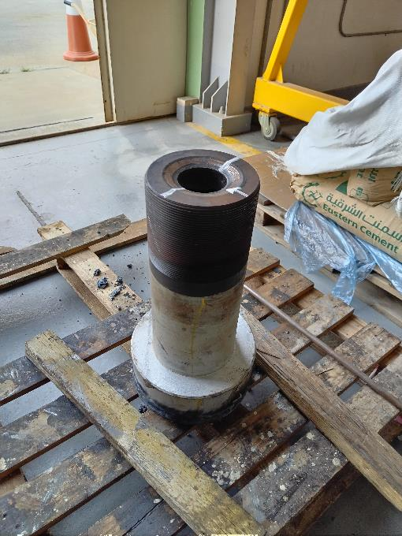
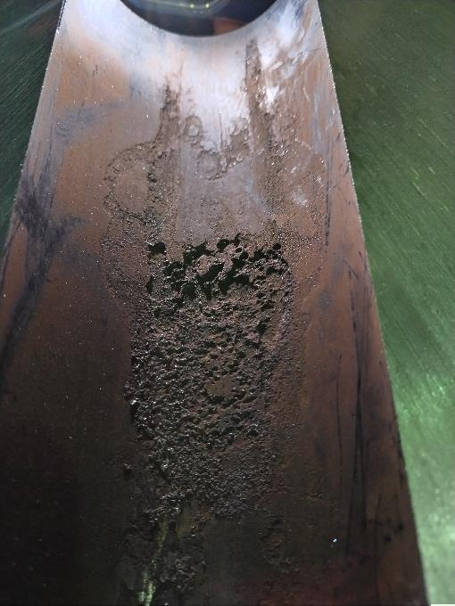
5. Laboratory Analysis
A sample was collected from the tube showing the most severe degradation and transferred to SABIC T&I Analytical Laboratory for detailed failure analysis.
5.1 VISUAL INSPECTION
Visual inspection indicated a form of localized corrosion characterized by isolated and interconnected pits that are more severe close to the pipe end and less deep in the direction of the jacketed area.
Figure 04: Condition of the sample when received at the Lab

Slide 8
5. Laboratory Analysis
5.2 CHEMICAL COMPOSITION
Chemical composition of the tube sample was determined utilizing XRF. The measured chemical composition was found conform to licensor specifications with a little higher Chromium content.
5.3 TENSILE TESTING
Tests were performed as per ASTM E8/8M (Standard Test Methods for Tension Testing of Metallic Materials) at room temperature (20.5°C). Strain was calculated by 50 mm gauge length axial strain gauge extensometer. Results are in conformance with licensor specifications.
Table 03: Chemical composition of LDPE Reactor Tube
Elements | Fe | Cr | Ni | Mo | Mn | C | Si | Cu | V | S
Conc.% | Balance | 2.37 | 2.2 | 0.429 | 0.352 | 0.335 | 0.33 | 0.1 | 0.013 | 0.005
Table 04: Tensile Test Results
Specimen Width [mm] | Thickness [mm] | Yield Strength (Offset 0.2 %) [MPa] |  | Ultimate Tensile Strength [MPa] | Elongation Transverse (%)
12.51 | 3.03 |  | 900 | 1055 | 14.40

Slide 9
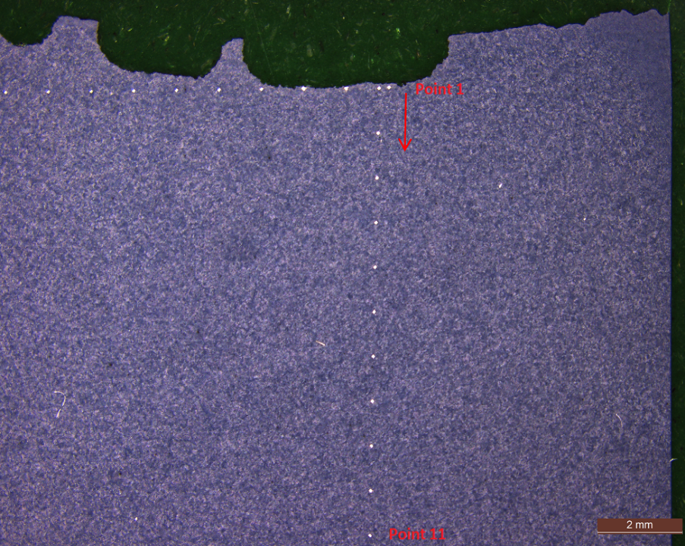
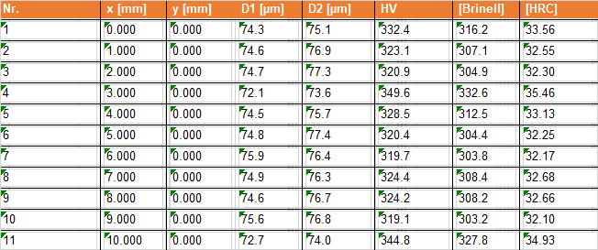
5. Laboratory Analysis
5.4 IMPACT TESTING
Samples were prepared from the longitudinal direction of the pipe and tested at room temperature (22.0 °C) as per ASTM E23 (Standard Test Methods for Notched Bar Impact Testing of Metallic Materials). The results comply with licensor specifications that require a minimum absorbed energy of 80 Joules for longitudinal sample.
5.5 HARDNESS TESTING
Hardness measurements along the cross-section of the tube sample were taken. Values between 303 and 332 HB which are within the limits specified by licensor specifications (290 – 335 HB) were measured.
Table 05: Impact Testing Results
Sample | Toughness (J) - Longitudinal
Average | 138
Table 04: Hardness Testing Results
Figure 05: locations of micro-hardness measurements

Slide 10
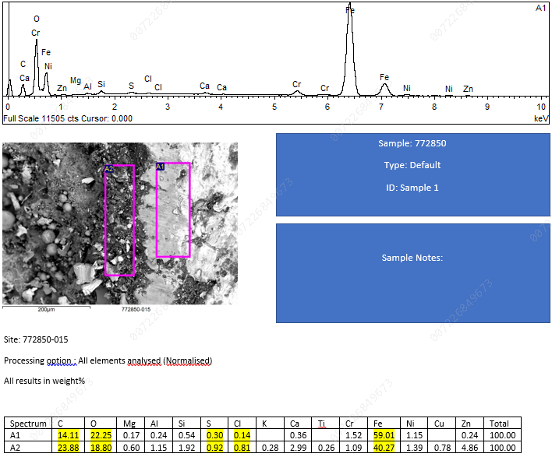
5. Laboratory Analysis
5.6 SEM/EDS EXAMINATION
SEM/EDS examination of the outer surface of the sample was conducted to investigate the elemental composition of the corrosion products and surface contaminants.
5.6.1 As Received Condition
EDS analysis of the surface revealed that the scales / deposits are mainly composed of Iron, Oxygen and Carbon. Small quantities of Sulphur and Chloride were also found on the surface.
Chloride contamination was caused by tube cleaning with service water that contain few amount. Sulfur is sometimes present in solvent or other chemicals that are used in the process.
Figure 06: SEM/EDS Analysis of the surface as received

Slide 11
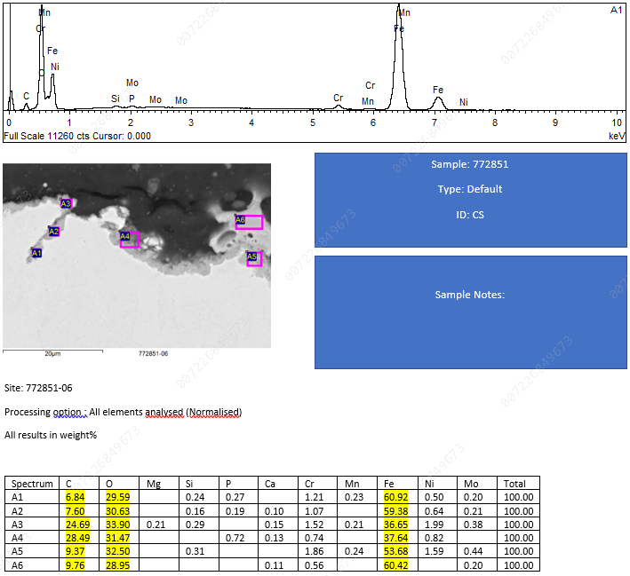
5. Laboratory Analysis
5.6.2 As Prepared Condition
Chemical analysis of the corroded surface after polishing indicates presence of multiple pits and micro-cracks filled with iron oxides.
High Carbon content was measured inside the crack and on the corroded surface supporting licensor feedback that corrosion is caused by condensation of propionic acid at low temperatures which is weak organic acid.
Improper storage/transportation or bad quality of the supplied propionaldehyde containing high acidity and moisture is also a possible source.
Propionic acid is formed by the reaction of Propionaldehyde with oxygen.
Figure 07: SEM/EDS Analysis of the surface after polishing

Slide 12
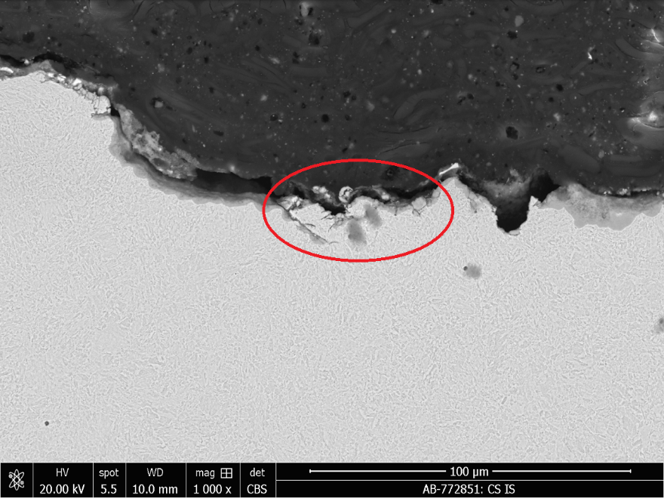
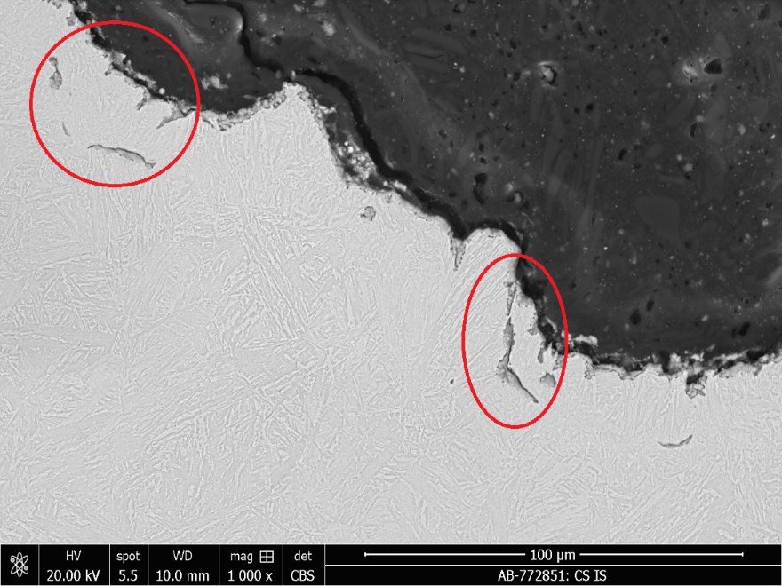
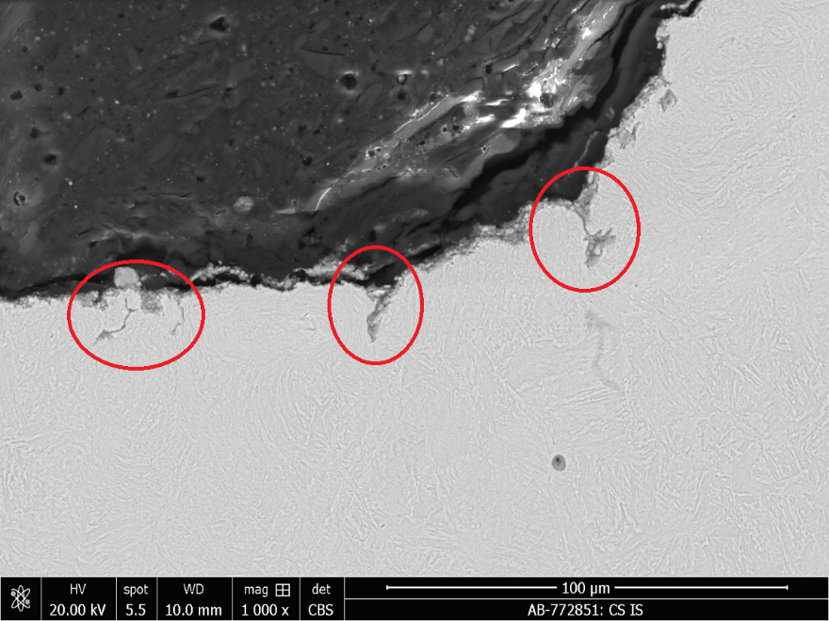
5. Laboratory Analysis
5.7 METALLOGRAPHIC EXAMINATION
5.7.1 Examination before Etching
The surface of the sample was examined under SEM at different magnifications (50 to 2000X). Several micro-cracks sometimes branching and filled with oxides with depth between 10 and 40 µm were observed at different locations. Rounded porosities (voids) were also observed in the base material at some areas.
Figure 08: SEM Examination of the corroded surface

Slide 13
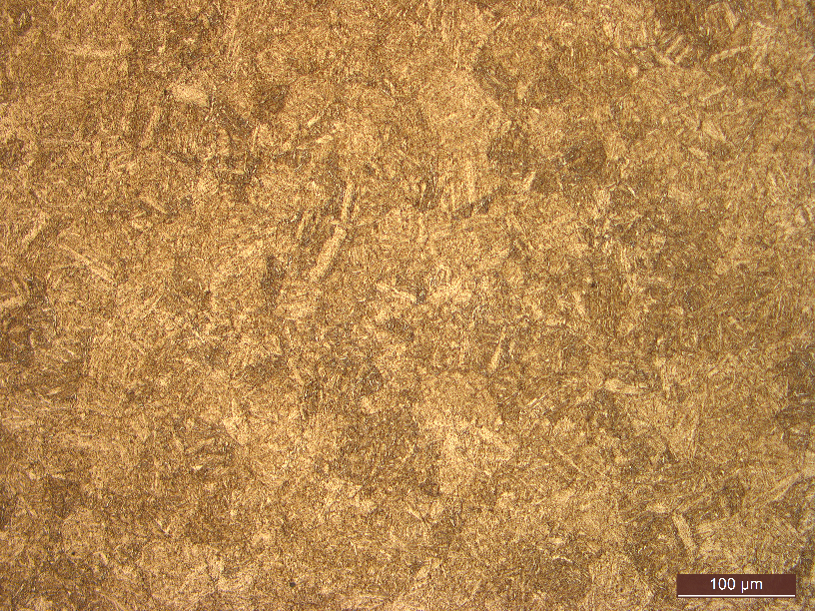
5. Laboratory Analysis
5.7.2 Examination after Etching
The revealed microstructure is tempered martensitic with no significant sign of degradation.
However, ferrite islands were noticed in few areas and a change in the microstructure was observed at the surface of the sample.
Microstructure change (fine grains) indicates possible surface hardening caused by the multiple decomposition events that occurred in the past years.
Decomposition is a local exothermic runaway reaction (explosion) that occur inside the tubes resulting in fire impingement (hot spot) where temperature can increase up to 1500 °C.
Figure 09: Tube sample microstructure after etching

Slide 14
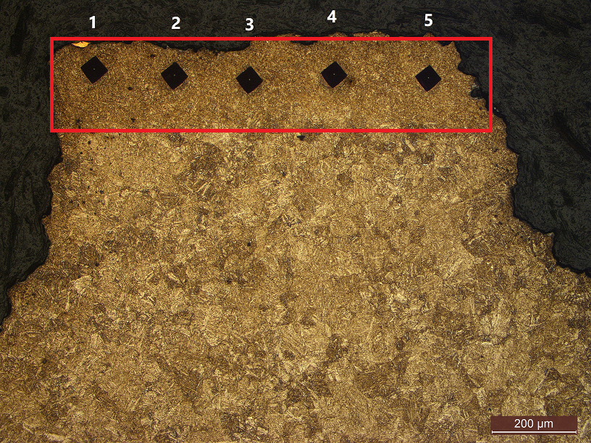
5. Laboratory Analysis
Micro-hardness measurements of this specific area indicated high hardness values (average of 444 HV) which is above the recommended limits specified by the tubes OEM (342 HV).
Metallographic examination revealed a very fine microstructure compared to other areas of the sample.
The microstructure change occurred due to exposure of the tubes to high temperatures during decompositions and the subsequent quenching by the incoming colder gas from the opening of the hydraulic safety blow-off valve which result in hardening of the bore surface.
Figure 10: Tube sample microstructure after etching

Slide 15
5. Laboratory Analysis
Decompositions lead to a thermo-mechanical loading of the material at the ID surface near region.
As a function of the decomposition and heat input, respectively, the time-dependent temperature distribution in the tube wall can vary greatly
Figure 11 shows calculated temperature profiles along the wall thickness in radial direction at different times.
The initial tempered martensite is transformed into austenite then into martensite/bainite due to rapid subsequent cooling.
The microstructure has very high strength (hardness, yield strength and ultimate tensile strength) and very low ductility and toughness.
Figure 11: temperature profiles along the wall thickness at different times during a decomposition

Slide 16
6. Critical Crack Size Calculation
Critical crack size calculation using ASME BPVC section VIII division 3 / API 579-1 ASME FFS-1 methodology was performed to determine the maximum allowable crack depth under the current applied stress (temperature, pressure, compressor pulsations) and the time for failure in case of unstable crack growth.
Compressive residual stresses from autofrettage was calculated using ASME BPVC section VIII division 3 and verified by Finite Element Analysis.
Autofrettage is the process in which internal compressive residual stresses are introduced in the tube by being subject to enormous pressure (6700 barg). The goal of autofrettage is to increase the pressure carrying capacity and the resistance to stress corrosion cracking and fatigue damage.
The critical crack size calculation using fracture toughness converted from measured impact energy and the residual stress calculated from FEA gave a critical flaw size of 75% of the tube thickness.
It should be noted that in case compressive residual stresses from autofrettage has reduced or completely disappeared due to exposure to high temperatures during decomposition events (stress relaxation), this critical flaw size become lower and the number of cycles to critical crack depth will diminish dramatically.

Slide 17
7. Conclusion
Based on the above analysis, we conclude the following:
Internal corrosion was caused by organic acid (propionic) which condense at the unjacketed sections of the tube during shutdown periods.
The micro-cracks filled with oxides (10-40 µm depth) observed on the surface of the corroded sample indicate possible initiation of fatigue damage.
Sign of material degradation was observed on the surface of the tube sample indicating a transformation of the microstructure due to exposure to high temperatures and rapid quenching.
The affected layer of the inner bore surface became hard and more brittle which result in decrease of fracture toughness and reduction in fatigue life of the tube.
The maximum allowable defect is 75% of the thickness according to calculations. In case compressive residual stress was affected by decompositions, the allowable crack size and fatigue life is expected to be much lower.

Slide 18
8. Recommendations
Repair the damaged tubes by machining/honing followed by autofrettage to restore the residual compressive stress state of the tube.
Perform thermo-mechanical FEA simulation and residual stress measurements on the tube samples to assess the impact of past decomposition events on autofrettage.
Implement procedure for purging and preservation of the reactor under nitrogen during shutdown condition to prevent condensation of acid gases at unjacketed sections.
Evaluate the possibility to install thermal insulation at the unjacketed sections of the reactor tubes as measure for prevention of acid gas condensation during shutdown condition.
Analysis Propionaldehyde product when received at site for verification of acid and moisture content prior to use in the process.
Report decomposition events to Inspection for assessment of their negative impact on tube material.

Slide 19
JUBCOR
2024
CONFERENCE & EXHIBITION
INNOVATIVE SOLUTIONS FOR CORROSION CHALLENGES
THANK YOU
Reach out.
+966 (13) 356 5708
ZianiA@saudikayan.sabic.com

