Slide 1
JUBCOR
2024
CONFERENCE & EXHIBITION
INNOVATIVE SOLUTIONS FOR CORROSION CHALLENGES
Presented By: Khalid Aldossary
Jubcor Presentation
Coating in conjunction with Cathodic protection and Coating shielding behavior

Slide 2
Table of Contents
Introduction
CP Shielding
Coating
CP Shielding by Coating
Conclusion

Slide 3
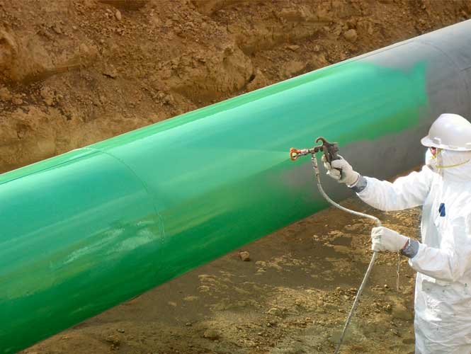
Introduction
Corrosion poses a significant threat to the integrity of metal structures, in underground piping. There are two essential strategies for mitigating corrosion which are coating and cathodic protection. However, there is a phenomenon of coating shielding, where protective coatings can hinder the effectiveness of cathodic protection.

Slide 4
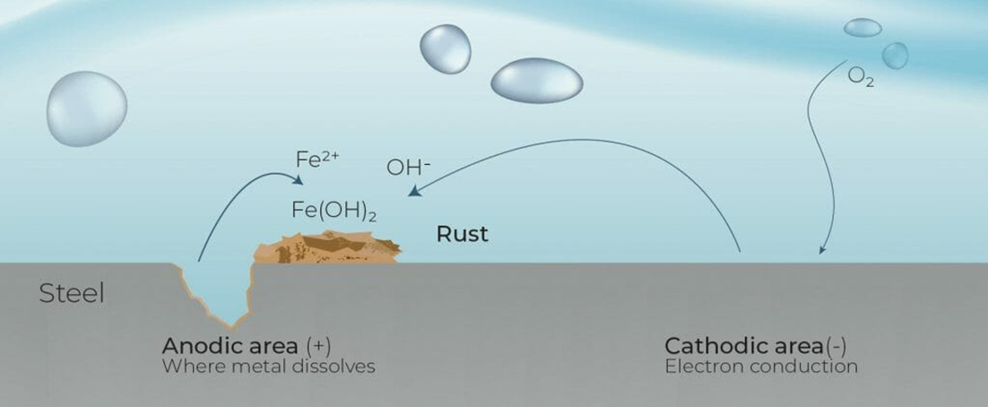
Electrochemical Corrosion
Corrosion is defined as the deterioration of a material that results from a reaction with its environment.
For a metal in contact with an aqueous solution, the reaction is electrochemical in nature involving the transfer of electrons across the metal/solution interface.
The corrosion reaction can be generalized for any metal as follows:

Slide 5
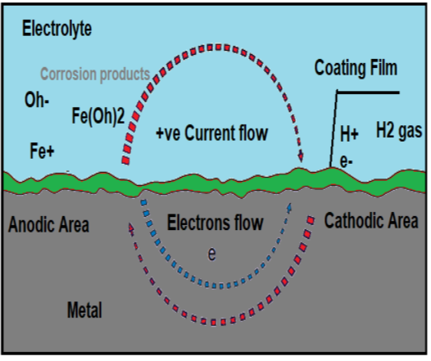
Coating
Coating
Inorganic and organic based coating systems are the most widely used method for corrosion control, especially on carbon steel fabrications.
Coatings provide :
A physical barrier between the metal and the electrolyte.
Decreases the amount of water and oxygen or hydrogen ions that diffuse to the metal surface.
increases the total electrical resistance of corrosion cell.
Provide Cathodic protection.
Work as corrosion inhibitor.
These processes limit the amount of corrosion current that can flow in the corrosion cell.
1
Cathodic protection
2
CP Shielding
3

Slide 6
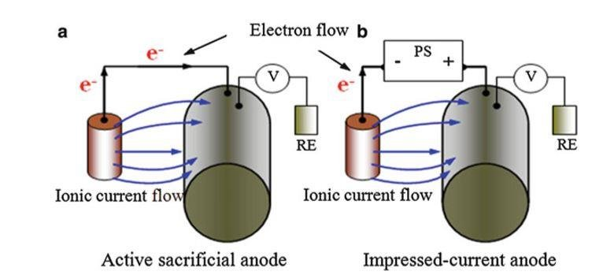
Coating
Coating
1
Cathodic protection
To stop corrosion of steel part located in a conductive electrolyte (water, soil, conductive liquid, concrete –etc.) by cathodic protection: we shall keep tis steel part a fully cathode to an external anode .This anode can be a more active metal /alloy (sacrificial Andes) or introduce a DC power source and ICCP anodes.
2
CP Shielding
3

Slide 7
Coating
Coating
1
Cathodic protection
2
Cathodic Protection Shielding definition from NACE SP0169: Preventing or diverting the Cathodic protection current from its intended path.
How this shielding can happen:
Complicated network with parts suffering from coating defects/low resistance pass will consume most of CP current and remaining current which reaching other parts will not be able to protect them so CP is inherently shielded.
Electrical insulation material as coating and asphalt under tank bottom plate can isolate the metal from the anode current .
CP Shielding
3

Slide 8
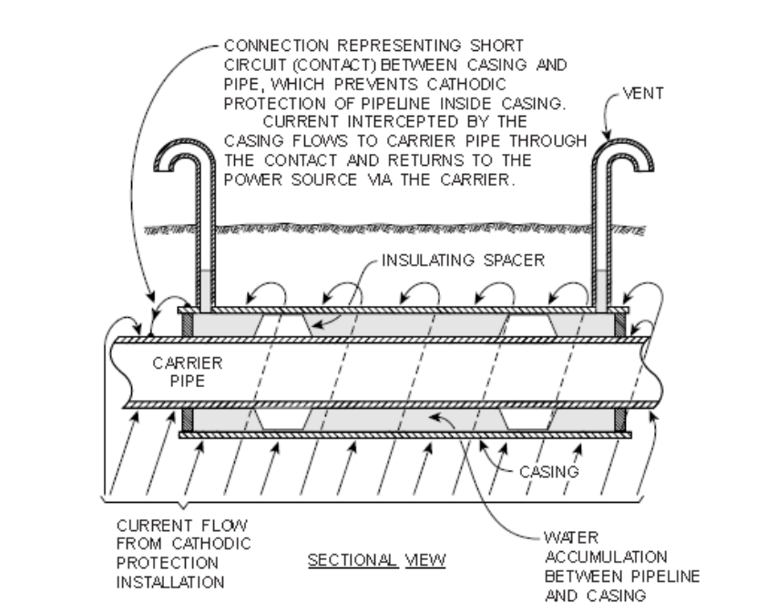
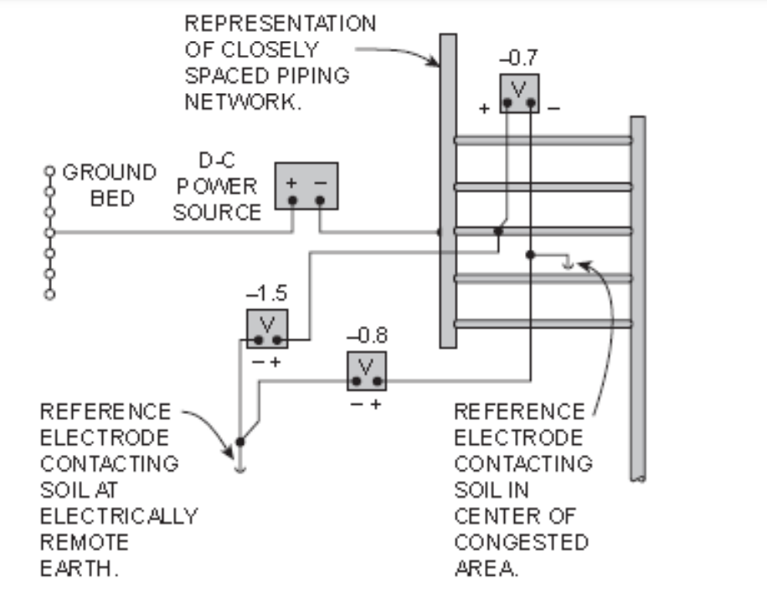
Cases for Cathodic Protection Shielding happen
Shielding by short circuit | Shielding in Congested Area

Slide 9
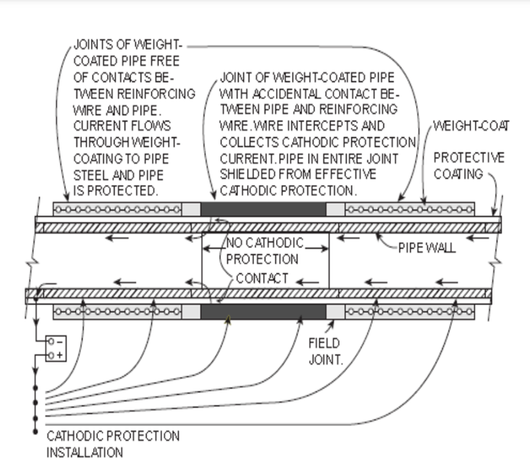
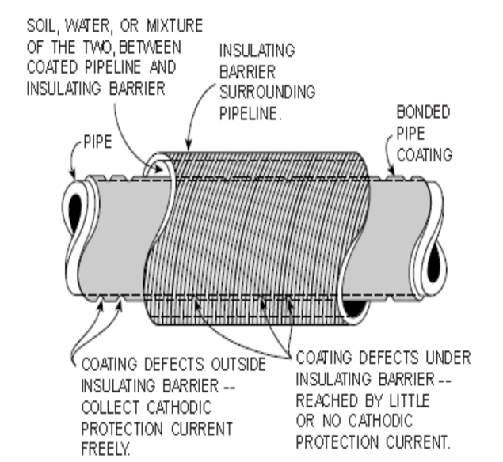
Cases for Cathodic Protection Shielding happen
Shielding by short circuit | Shielding in Congested Area

Slide 10
Mitigating Shielding is Important
Shielding Mitigation
Pipeline Integrity is mostly managed by close interval surveys (CP potentials) and remote coating surveys – DCVG, ACVG, Pearson survey and etc.
Pipeline Integrity can be managed by ILI, but only in pig gable sections, and is a lagging indicator of a corrosion mitigation problem
When CP shielding is present, must overlay (a) and (b), then identify that a problem exists
There is no actual inspection tool for CP shielding, so difficult to address with integrity management plans

Slide 11
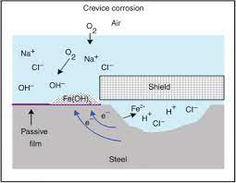
Damages from CP Shielding
In cases where CP shielding is present, there are two degradative mechanisms:
Corrosion rate will be at or less than ordinary corrosion rates in the local groundwater.
Crevices corrosion damage mechanism can be occurred.
The most insidious factor for CP shielding is that it can exist for decades and will not be recognized, detected, or mitigated until an incident (Corrosion/SCC) occurs.

Slide 12
Facts About CP Shielding
CP shielding is not an inherent coating property, it is a set of conditions which must be met “Proofing” shielding is very difficult – always other factors/features can result in CP shielding:

Slide 13
Common types of coatings
Coating
Thickness:
<200 µm for atmospheric exposure
<300 µm for immersed service, depends on duty
Application:
Protect steel and concrete from environments and prevent/delay deterioration

Slide 14
Coating specifications address the shielding issues
1
2
3
A quality assurance inspection and testing program for the coating
The pipe must be protected against external corrosion by non-shielding coating
Coating on pipe used for trenchless installation must be non-shielding and resist abrasions.
Not clear or obvious what is meant by non-shielding coating.
Interpretation left to individual, or to a regulator.

Slide 15
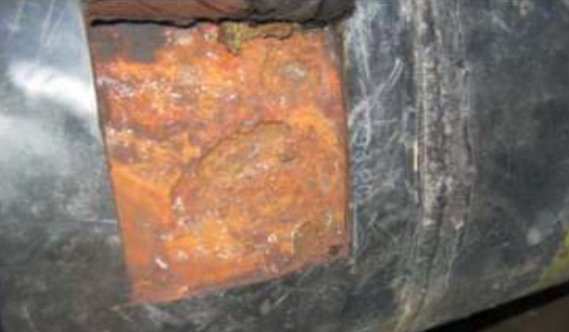
Cathodic Protection Shielding by Electrically Insulator Coating
Possibility of undetectable external corrosion if it disbanded.
Extra bell-hole digs required to verify CIS/ILI overlays.
CORROSION DUE TO CP SHIELDING AT GIRTH WELD
(HEAT SHRINK SLEEVE)

Slide 16
CP Shielding –Polyethylene Tape Wrap
Spiral corrosion on tape- wrapped pipelines
Soil stress leading to tape wrinkling and disbonding

Slide 17
Facts of Damages from CP Shielding
All coatings, given the right conditions, can shield CP
No coating will shield CP if well bonded to the substrate
In the absence of electrolyte, shielding cannot occur
CP shielding is in fact an outlier regarding pipeline service, But shielding has been the cause of notable failures
1
2
3
4

Slide 18
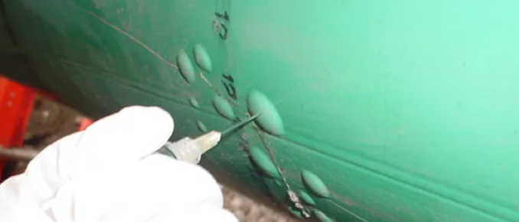
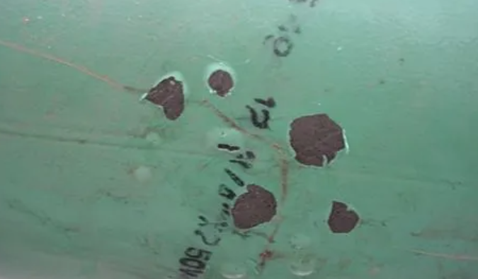
None Shielding FBE and Liquid Epoxy Coatings
Blistered FBE discovered with no corrosion evidences and high PH solution indicative of active CP under the blisters.

Slide 19
Conclusion
1
2
CP shielding is a complex issue, it is not an intrinsic coating property.
FBE coatings show lowest tendency to shield CP.
Conclusion
All coatings designed to be good insulators – key is knowing how a coating tends to fail.
3
4
PE tape wraps show highest tendency to shield CP.

Slide 20
JUBCOR
2024
CONFERENCE & EXHIBITION
INNOVATIVE SOLUTIONS FOR CORROSION CHALLENGES
THANK YOU
Reach out.
Calle Cualquiera 123, Cualquier Lugar
0539580808
Aldossaryka@ibnzahr.sabic.com

