Slide 1
JUBCOR
2024
CONFERENCE & EXHIBITION
INNOVATIVE SOLUTIONS FOR CORROSION CHALLENGES
Presented By:
Dr SAJJAD AHMED
Paradigm Shift in Corrosion Science - Model-Based Reliability & Financial Risks Analysis

Slide 2
Paradigm Shift in Corrosion Science
AGENDA
Introduction & Background
Challenges
Nano Technology Concepts
Artificial Intelligence Approach in Corrosion Prediction & Control
A New Mindset in Modeling Solutions for Corrosion
A New Methodology(a) for Quantitative Approach in Corrosion Concepts Analysis: Model-Based Reliability & Financial Risks Analysis
Closing & Wrap-Up
(a) Sajjad’s Methodology

Slide 3
Paradigm Shift in Corrosion Science
Introduction and Background

Slide 4
Introduction and Background
Summary of Advances in Corrosion Science
Infinite chemical space: potential size of small molecule and material spaces is effectively infinite
Automation and robotics: other fields utilize advanced automation for rapid synthesis and property measurement
AI and machine learning: essential for finding useful molecules in vast chemical spaces
Recent innovations:
Quantum machine learning methods
Generative methods for designing new molecules and materials
Massive chemical libraries
Autonomous chemical discovery systems

Slide 5
Introduction and Background
Corrosion is one of the biggest problems that affects the country’s economy.
Protective coating is one of the easiest ways to prevent corrosion of metals.
Based on cost and effectiveness, four types of coating are employed by the industry:
Plastic
Powder
Paint
Nano composite coatings by electrochemical offers excellent corrosion resistance on the metal surface

Slide 6
Introduction and Background
Nano composite coatings are a new generation coating designed to offer smart and inexpensive functional surface coatings with superior properties for corrosion resistance in antimicrobial and adhesive applications.
Modern corrosion science was set off in the early 20th century with the local cells model proposed by Evans and the corrosion potential model proved by Wagner and Traud. The two models have joined into the modern electrochemical theory of corrosion:
Metallic corrosion as a coupled electrochemical (EC) reaction consisting of anodic metal oxidation and cathodic oxidation reduction
The EC is applicable to wet corrosion metal at normal temperature, but also dry oxidation on metals at high temperature

Slide 7
Introduction and Background
The introduction of Price of Conference (PONC) Real Time Record Keeping
Corrosion is undesirable process. Due to corrosion, there is limitation of progress in many areas and the cost of lost production, replacement of material, and lost equipment is unlimited.
The overall PONC impact:
Reliability – plant shutdown
Stream factor – plant slowdown
Overall maintenance cost
Additional improvement and innovative corrosion ideas
Best practices, lessons learned, and training

Slide 8
Introduction and Background
Artificial Intelligence is a branch of science devoted to making machines think and act like humans.
Machine learning enables computers to learn without the need for explicit programming.
Despite corrosion costing more than $2.5Tn per year, the corrosion protection industry has been very late in adopting innovative technologies.
The potential for machine learning and other AI methods to provide effective, safe, extremely fast, and cost-effective methods, such as organic replacement for inorganic corrosion inhibitors EPA banned because of toxicity.

Slide 9
Paradigm Shift in Corrosion Science
Challenges

Slide 10
Challenges:
Environmental and Economic Consideration
Chromate and phosphate have excellent corrosion resistance. However, due to restriction by EPA regulations, their applications as coating materials are progressively declined.
Some environmentally friendly compositions, such as Fluorometallate and Vanadate, among many others, are investigated (Buchheit et al. 2006; Dolan & Carlson 2007).
The economy of coating is another important issue for consideration (Hill, 2009;Bradly, 2007).
Corrosion is the most predominant cause of metal failure surpassing other failure modes like fatigue, creep, impact, and others.

Slide 11
Challenges:
Environmental and Economic Consideration
Most metals other than the noble metals do not exist in their native state as compounds of metal oxides, sulphides, etc.
Most metals tend to go back to their more stable compounds through corrosion.
The cost is not only replacement cost, but a lot of additional costs:
Loss of production due to shutdown and high maintenance costs
Compliance with environmental and consumer regulations
Loss of product quality due to contaminations
High fuel and energy costs as a result of leakage from corroded pipes
Extra working capital and larger stocks

Slide 12
Challenges:
Environmental and Economic Consideration
Data scarcity: limited high throughput testing rigs result in small data sets
Accuracy and applicability: current models have limited domains of applicability
Need for scale: increased throughput is necessary to generate larger data sets

Slide 13
Paradigm Shift in Corrosion Science
Nano Technology Concepts

Slide 14
Nano Technology Concepts
Today, nano-based corrosion inhibitors and coating not only serve as protective layers against mechanical aggressors, but also act as smart materials that are multifunctional.
Inserting nano particles on coating creates:
Dense covering physical barrier
Uniformity
Fewer pores in comparison with traditional coatings
Corrosion resistance properties
Corrosion resistance that is even higher than traditional coatings
Corrosion research delivers data only to the basic kinetics and instruments of the corrosion procedure.

Slide 15
Nano Technology Concepts
The environmental effect can be enhanced by using nanostructure particulates in corrosion inhibitors, corrosion coatings, and disposing of the prerequisite of toxic solvents.
Nano coating has significant potential to offer in the absence of pores and flaws in the coating as well as creating a uniform physical barrier.
Corrosion test results through surveys uncovered that nano coatings have preferred corrosion resistance than traditional coatings.
Nano composite coatings are new generation coatings designed to offer smart and inexpensive functional surface coatings with superior properties for corrosion resistance.

Slide 16
Nano Technology Difficulties
Nano coatings contain ultrafine constituents that may impact the subsequent surface with respect to parts of the lattice structure, grain size, porosity, intermetallic particles' dispersion, surface state, etc.
Smooth the surface properties and diminish the likelihood of initiation at such surfaces.
Foreseeing the progress mechanism is challenging, it requires further exploring of corrosion.
The nonuniform dissemination of the nano particles outside of the coated substrate, particles may amass and create weak points of higher reason of pit initiation.

Slide 17
Nanocomposite Coating Methodologies and Application
Chemical vapor deposition – CVD
Powder metallurgy
Physical vapor deposition – PVD
Thermal plasma spray
Electrodeposition solution dispersion
Spin coating methods
Note: depending on application, different polymeric, metallic, ceramic, clay or nanocomposite materials are applied as corrosion prevention compounds by coating methodologies.
Groups: organic/inorganic; organic/organic; inorganic/inorganic; inorganic/organic

Slide 18
Typical Nano Composite Production Process Using Plasma Torch
There are six processing units:
Raw material handling
Reaction (reactor)
Product separation & dust collection
Product purification
Byproduct handling
Utilities, offsite, & packaging

Slide 19
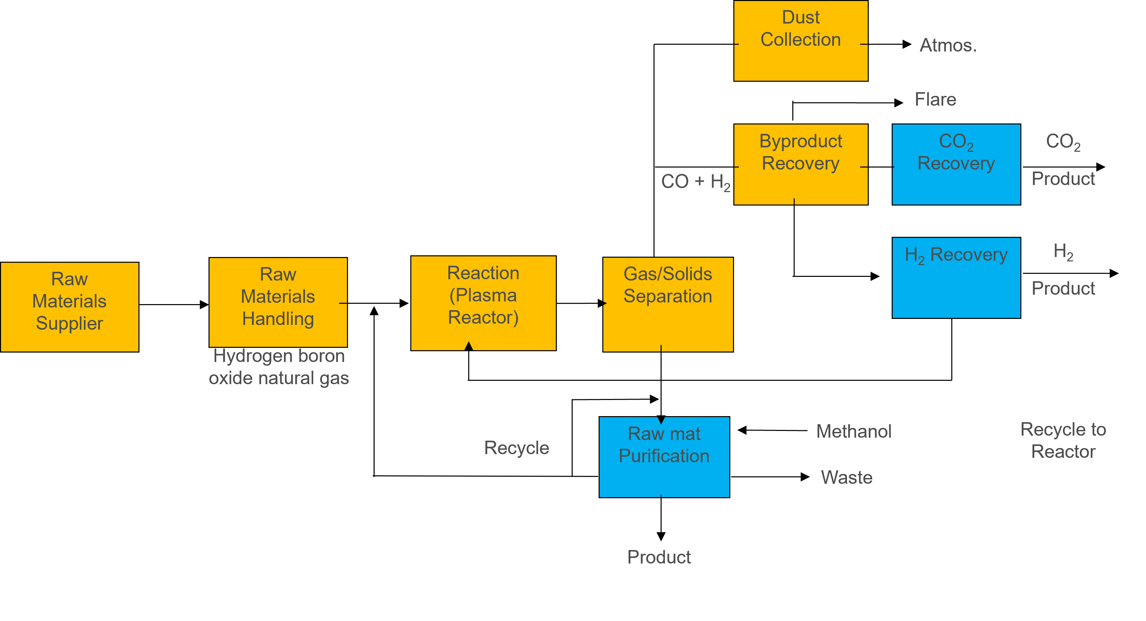
Typical Process of Nano Composite & Nano Structure Production by Using Plasma Torch & Reactor System

Slide 20
Nano Technology Computational Modeling
Tool for complex scientific and engineering problems – similar to Deterministic and Stochastic programming (Ref, Dr Sajjad’s methodology).
Simplest simulation with increase in computational memory and speed simulation, the prevalent tool for analysis.
Then simulation turns to probability models into standard statistical methods.
The challenge is to implement the methodology efficiently to capture the desired model characteristics. In fact, computation of high reliabilities is an ongoing research concern – there is no one in which to do the computation. The Box-Muller and Monte carlo simulations are traditional well-known powerful methods.

Slide 21
Paradigm Shift in Corrosion Science
Artificial Intelligence Approach in Prediction & Control

Slide 22
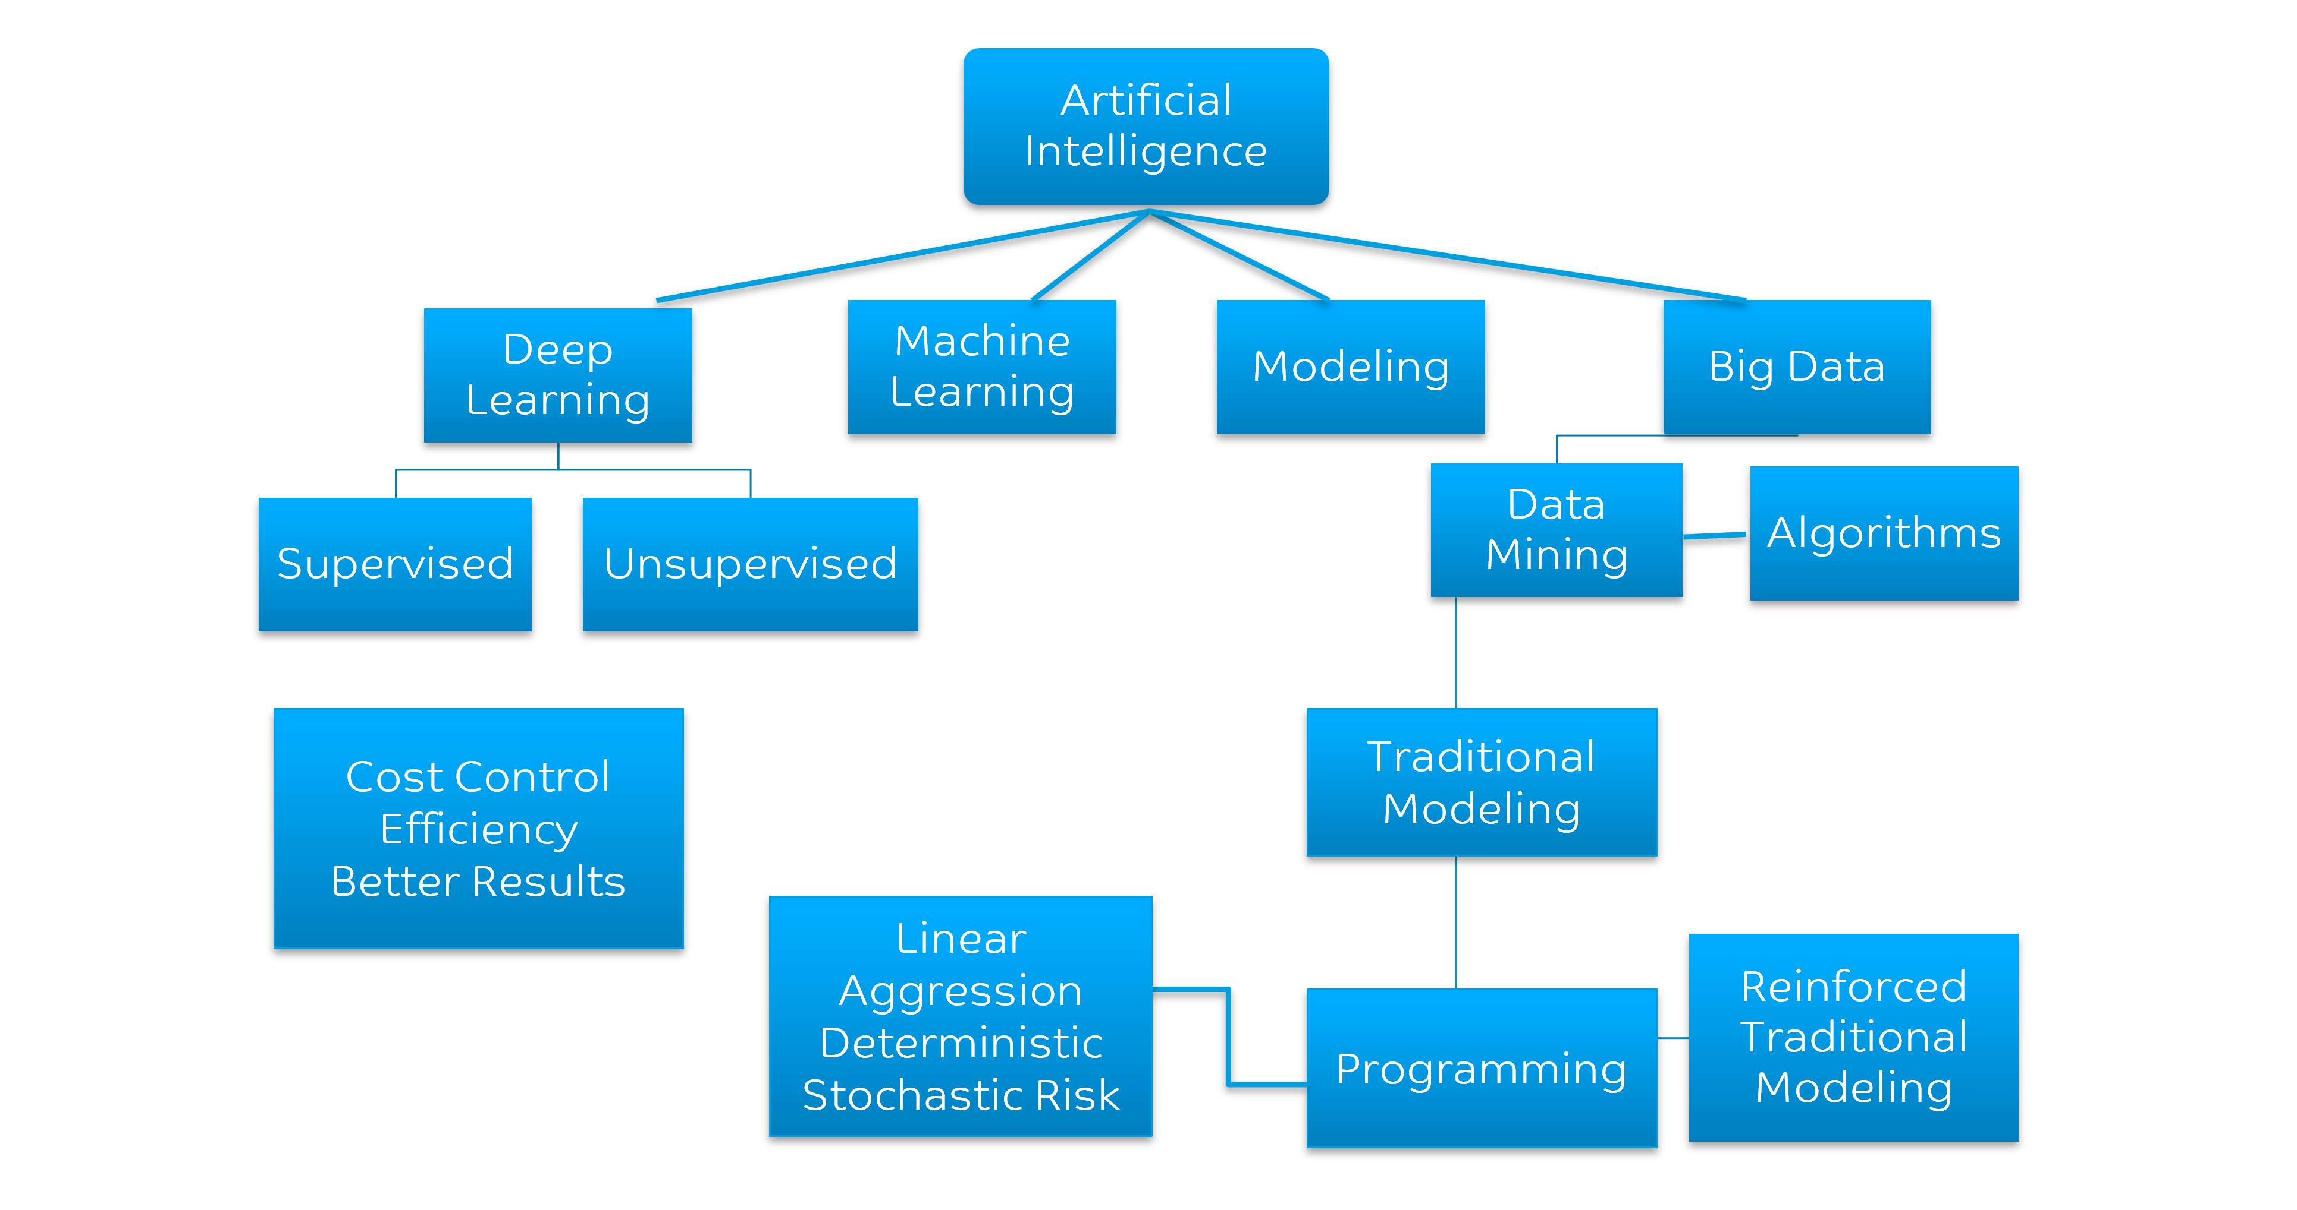
Artificial Intelligence Approach in Prediction

Slide 23
Technology Concepts
Machine learning is focused on computers to perform tasks without explicit programming. It is the scientific study of statistical models and algorithms that computer systems use to perform a task without explicit instructions.
Broad field that encompasses a wide range of operations such as clustering, classification, and development of predictive models.
Supervised learning algorithms include decision tree, linear & multivariate regression, linear determinant analysis, artificial neural networks.
Unsupervised learning allows data to organize itself after following a specific pattern in how the data is dispersed. Algorithms are complicated and being researched.

Slide 24
Technology Concepts & Limitation
Deep learning is a subset of machine learning based on neural networks, requires large data, provides high accuracy, and takes a longer time.
The corrosion protection industry is very late in adopting new technologies. Note that:
There are relatively few testing rigs, testing inhibitors & coatings performance.
Limited data sets for machines learning models – accurate prediction is limited.
There are relatively few uses of machine learning methods in corrosion science.
Data-driven learning methods generate models linking molecular properties to corrosion inhibition and can predict performance of materials – not yet synthesized.

Slide 25
Selecting Model Input/Output Variables (Example)
Start
Define system and collecting data
Prediction crude oil pipeline
Influencing factors of crude oil
Information / data regarding the influencing factors of crude oil
Strong correlation between
Corrosion
Influencing
factors
Too many influencing factors of pipeline corrosion
In the established prediction model, the output variable is the corrosion rate
Input variables are determined by the influencing factors of pipeline corrosion
Pipeline corrosion is collected through inspection, measurement, and fluid analysis
Due to the strong correlation between corrosion influencing factors, there may be redundant variables
Dividing sample sets
Model training / testing
Selection & optimization of model parameters
Model testing

Slide 26
Impact on Corrosion Science
Current Limitations
Corrosion science has not yet fully embraced these technological advances
Potential for Transformation:
Adoption of these technologies can significantly enhance corrosion inhibitor discovery
Data-driven methods
Machine learning models can predict the performance of un-synthesized materials
Future prospects
AI-driven discovery methods can accelerate the identification of novel, effective corrosion inhibitors

Slide 27
Conclusion
Transformative potential: Integration of machine learning and high throughput methods can revolutionize corrosion inhibitor discovery.
Strategic implementation: Addressing data generation and model validation challenges is crucial for progress.

Slide 28
Paradigm Shift in Corrosion Science
A New Methodology for Quantitative Approach in Corrosion Concepts Analysis: Model-Based Reliability & Financial Risks Analysis

Slide 29
Risk-Based Methodology - Reliability
Understanding and adopting risk-based methodology in reliability maintenance programs help to utilize:
Continuous improvement processes
Risk-based decision making
Understanding and managing risk associated with failures is key for world class performance.
Advanced technologies help to support maintenance programs and strategies.
Tasks are based on consequence of a failure and probability of occurrence.
Consider maintenance as a cost center rather than a technical resource for improvement.
Improvement in reliability by failure mechanisms not addressing failures
Improvement in operations brings higher return and lower maintenance cost
Increasing maintenance by performing unneeded maintenance
Performing unplanned reactive maintenance

Slide 30
Risk-Based Approach & Inspection
Risk-based approach is supported by:
Extensive plant operating experience
Improved understanding of material degradation mechanism
Availability of fitness-for-service assessment procedures
Improved targeting and timing of risk-based inspection offer the following potential benefits:
Improved management of HESS and other risks of plant failures
Timely identification of repair or replacement of deteriorating equipment
Cost savings by eliminating ineffective inspection, extending intervals, and greater plant availability

Slide 31
Risk Management
Risk Management
Progress
Matrix
Adopt consistent decision makeup process
Focus on most important concerns (effectiveness)
Eliminate unneeded work (efficacies)
Visual guide
Support decision making
Consistency
Maintenance
Inspection
operations

Slide 32
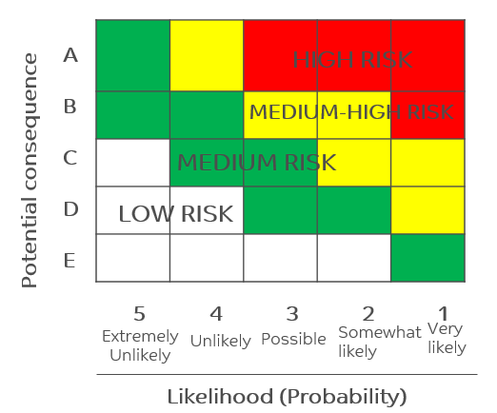
Risk Management
Risk management consists of:
Developing a process to consistently determine what we should do and when we should do it
Understanding that we cannot afford, or have the resources, to do everything
Managing risk associated with work we are not doing at this time or at all
Risk is the function of consequence and probability which must be considered separately
Risk = Consequence X Probability

Slide 33
Risk Management
Data Input
Data Analysis
Estimate Likelihood
Determine Consequences
Risk Matrix
Risk Matrix
Acceptable
Yes
No – Reduce, mitigate, Transfer
Operate

Slide 34
Risk-Based Integrity Management Process Inspection
Deterioration mechanism
Assess and ranks risks and uncertainties
Develop inspection plan within integrity management plan
Achieve effective and reliable examination
Update – plant data base and risk analysis, review inspection plan and self-intervals
Audits & review Integrity management process
Assess results and fitness in service
Analyze accident scenarios
Repair, modify change operation conditions

Slide 35
Modeling Approach in Quantifying Risks – “ELIMINATING THE GUESS WORK”
Determine probable outcome
Quantify financial impact
Logistics and market dynamic
Spanning of design, capacity, operations, and maintenance
The Challenges
Optimizing maintenance cycle & duration
Understanding the losses or benefits of making changes
Drive decisions in right places for the highest return

Slide 36
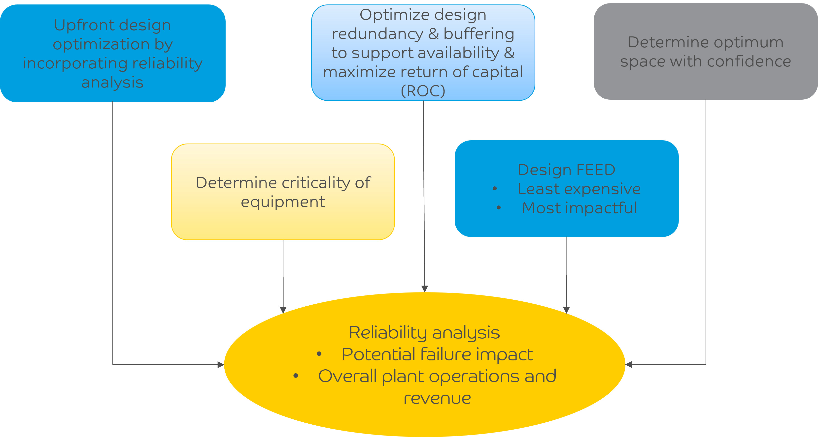
Reliability Modeling Approach Impacting Plant Design & Project Capex

Slide 37
Methods of Risk Analysis
Cause – Consequence analysis
Event-tree analysis failure mode
Effect is critical – analysis
Fault tree analysis
Hazard & operably – analysis
Qualitative & Quantitative
Deterministic Modeling
Stochastic Modeling

Slide 38
Major Steps of Proposed Methodology – Integrating New Technologies and New Concepts into Mature Processes
Step 0
Business Case
Step 1
Process Improvement w/o New Technologies
Decision
Y
N
Step 2
Process Improvement with New Technologies
Decision
Step 3 & 4
Financial Risk Management
Step 5
Reliability & EHS Risk Management

Slide 39
Major Steps of Proposed Methodology Integrating New Approaches into Project Execution
Step 0
Business Case
Step 1
Project Execution with
Conventional Approach
Decision
N
Step 2
Project Execution with
Un-conventional Approach
Y
Decision
Step 3 & 4
Financial Risk Management
Step 5
Reliability & EHS Risk Management

Slide 40
What is New?
Comprehensive methodology
Incorporating all concepts
Integration of new approaches into existing project execution processes
Financial risk management – with and without new approaches into existing project execution processes
Comparison of results:
With and without financial / Reliability risk management
With and without new approaches / new technologies

Slide 41
Model Based Methodology - Presentation of Results
Deterministic Results
Evaluate alternate options
Produce results to meet capacity / cost / reliability under certain conditions
Estimate total cost to meet required cost / design conditions
Stochastic Results
Stochastic cost, capacity & reliability – we don’t know conditions before produce products
Divide required conditions into 3 scenarios with probability 1/3
High
Medium
Low
Obtain results in two stage mix integer programming based on required scenarios information, example:
Z+ over produce product, Z+ = Total product – demand
Z- under produce product, Z- = Demand – total product

Slide 42
Under Uncertainty with Financial/Reliability Risk Management Stochastic Formulation
Yield a solution that is less sensitive to the presence of uncertainties
Attempt to minimize variation in costs that arise due to operation under unplanned events of scenarios
Adopt two-stage stochastic programming to deal with uncertainty
Consider CAPEX, OPEX, capacity & reliability uncertain or random parameters

Slide 43
Paradigm Shift in Corrosion Science
Backup Slides

Slide 44
Reliability & Validity
Reliability
Reliability tells us how consistency test scores measure something
Implement your measurement – risk XX at two separate times for each injury
Compute the correctable between the two separated measurements
Assume there is no change in conditions between tests
Test/Re-Test
Internal consistency
Validity
Validity tells us whether the test scores are measuring the right things for a particular use of the test
Conclusion validity
Relationship between program and observed outcome
Internal validity
Relationship between program and outcome we saw
External Validity
Our ability to generalize the results of our study to other settings

Slide 45
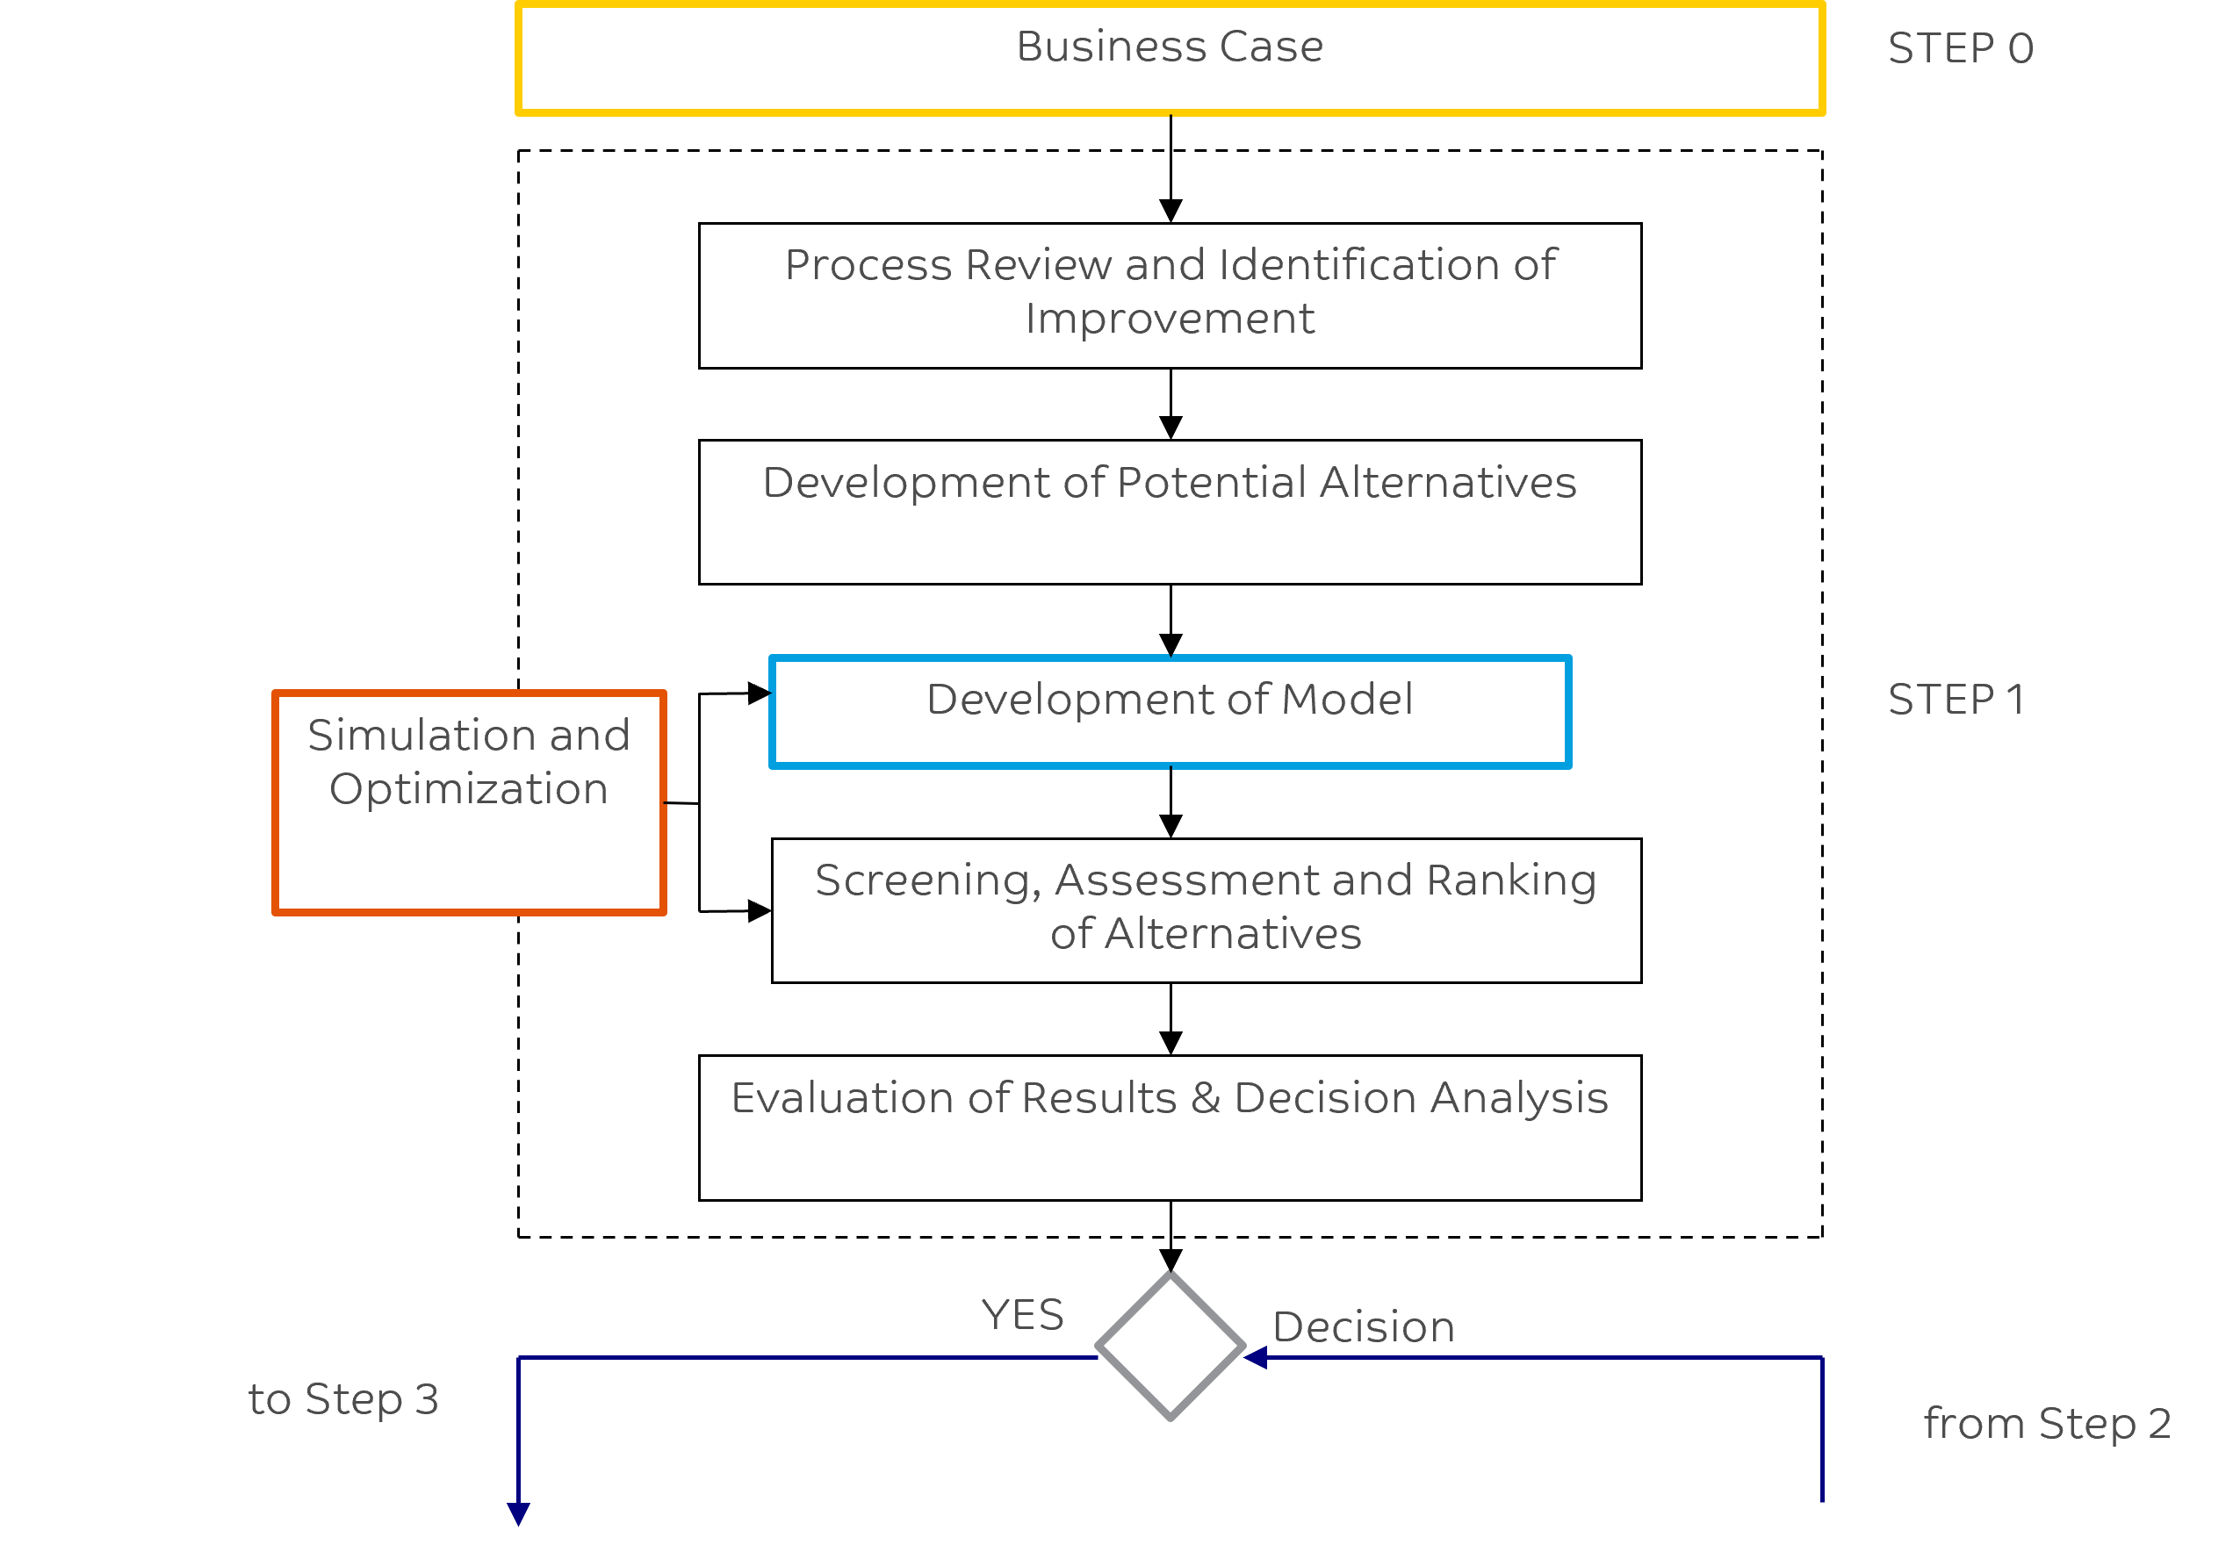
Proposed Methodology: Steps 0 and 1

Slide 46
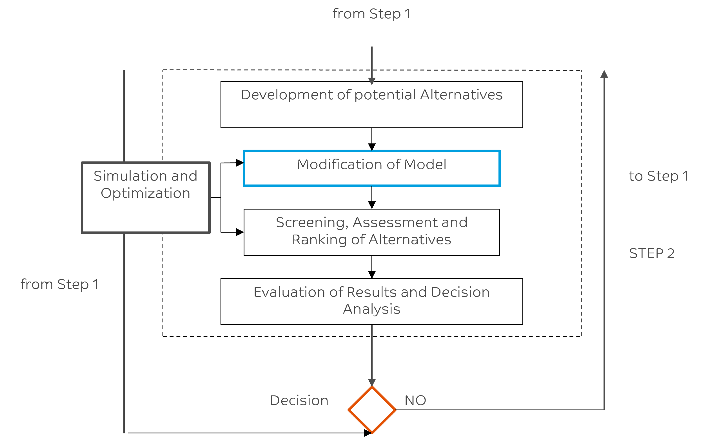
Proposed Methodology: Step 2

Slide 47
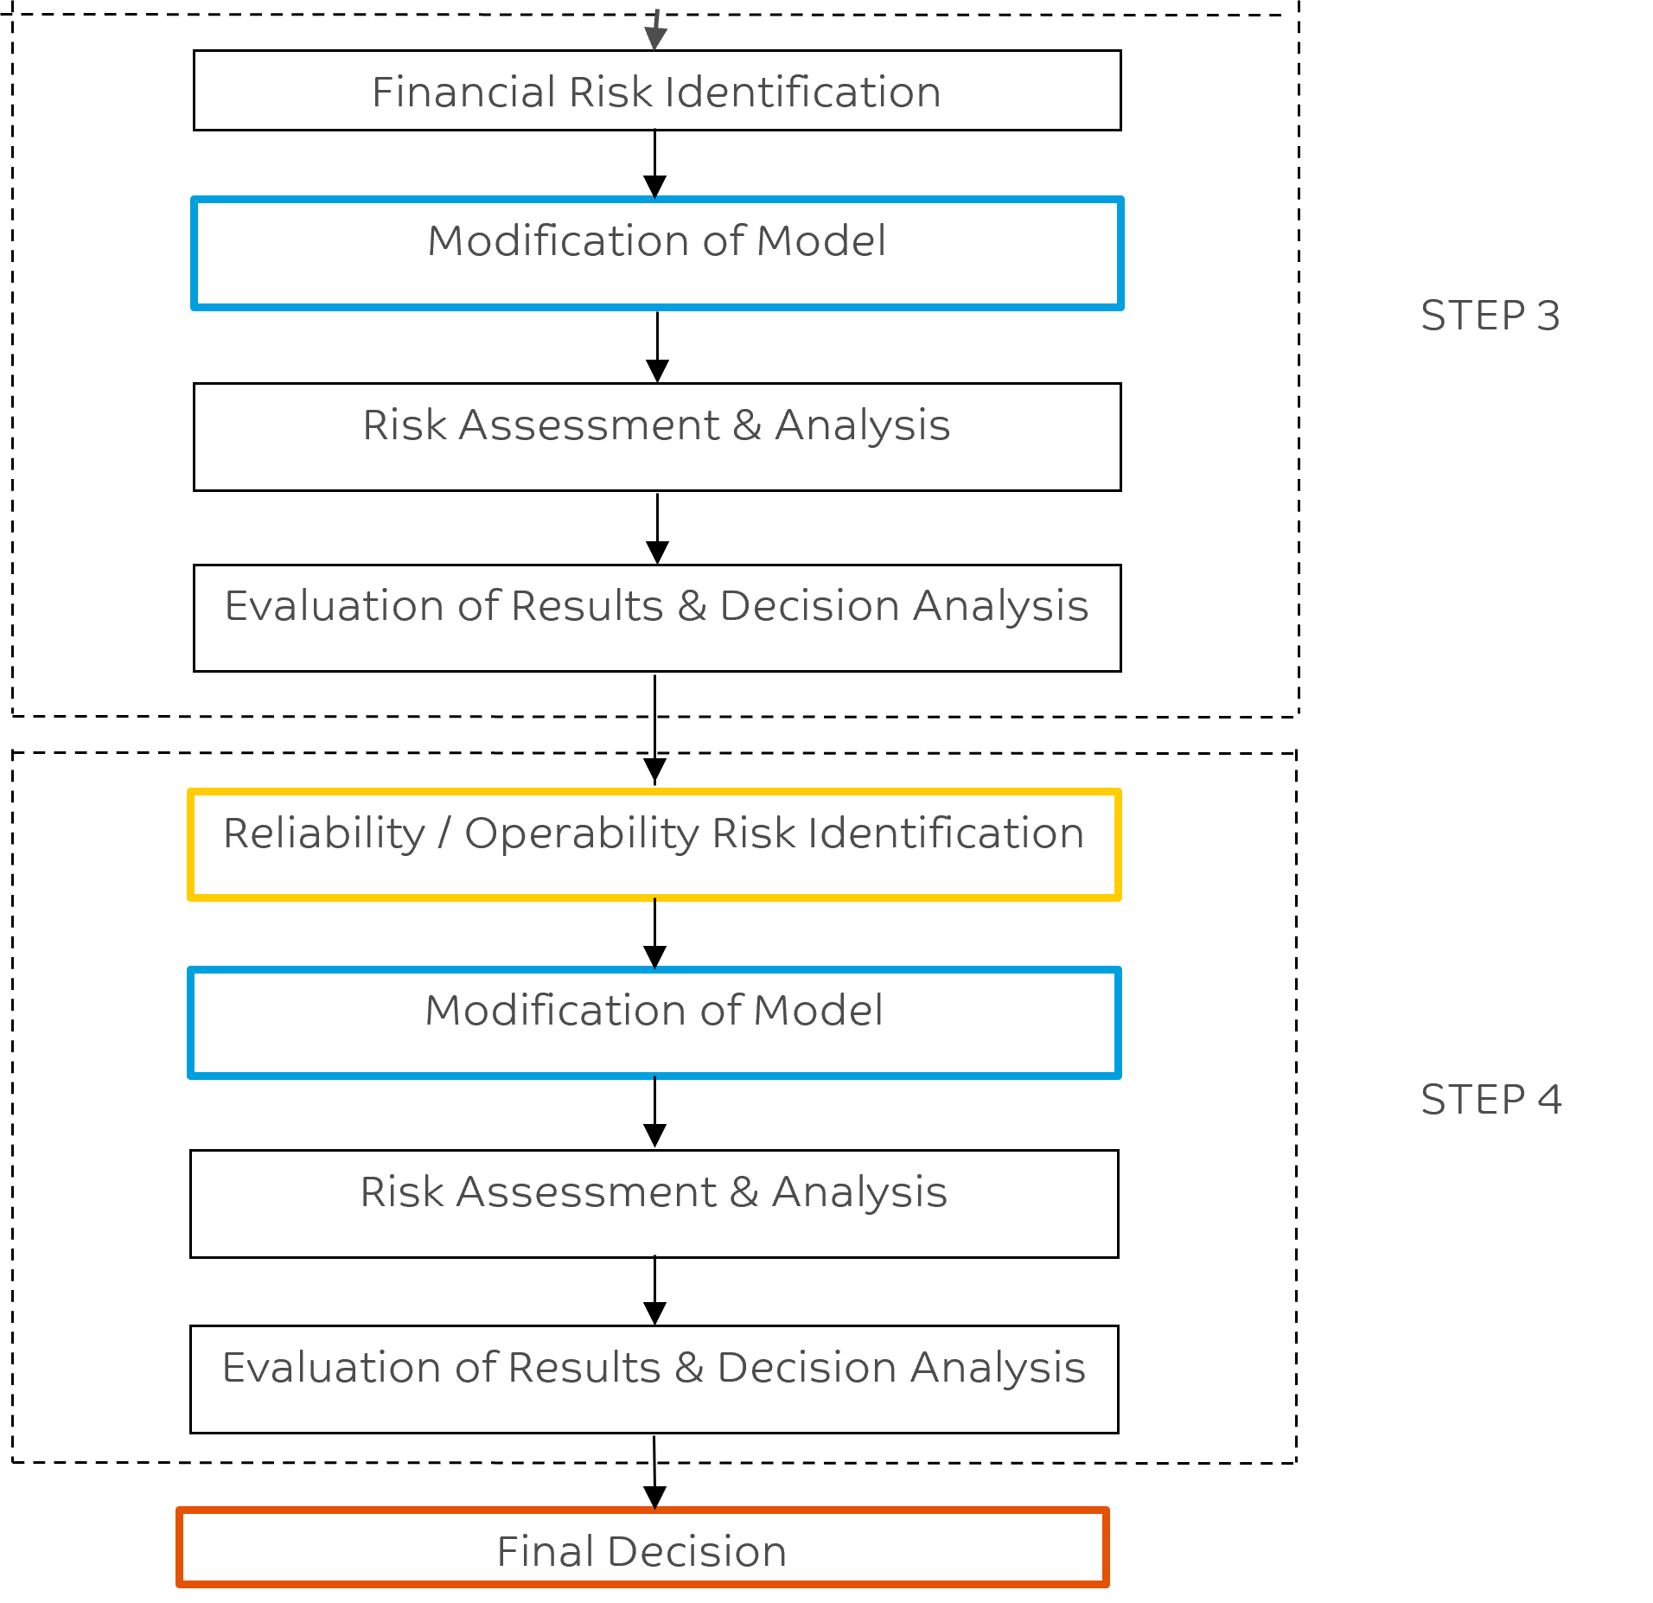
Proposed Methodology: Steps 3 & 4

Slide 48
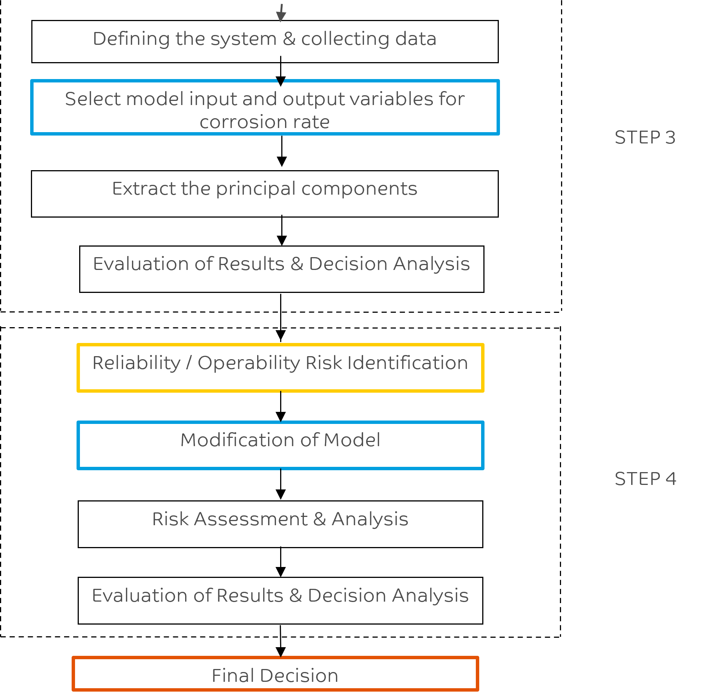
Proposed Methodology:

Slide 49
JUBCOR
2024
CONFERENCE & EXHIBITION
YOUR LOGO
INNOVATIVE SOLUTIONS FOR CORROSION CHALLENGES
THANK YOU
Calle Cualquiera 123, Cualquier Lugar
Email: Sajjad.ahmed@sabic.com

